Slide 1
THERAPY UNIT 2:
INTRODUCTION TO THE METACOGNITIVE THERAPY PROGRAM (MCT+)
Metacognitive Therapy

Slide 2
What is the Metacognitive Therapy Program?
Meta = about
Cognition = thinking
“thinking about thinking”
In the Metacognitive Therapy Program cognitive errors are discussed that may contribute to the development of psychosis.
In several exercises, different strategies are used to alter these cognitive errors in order to prevent the reoccurrence of psychotic episodes.
Introduction to MCT+ 2.2

Slide 3

Therapy Units of the MCT+
Therapy Unit
“Decision Making”
“Attributional Style”
“Case Formulation”
“Self Esteem”
“Depression and Thinking”
“Memory and Certainty of Judgement”
“Empathzing”
“Changing Beliefs”
“Dealing with the Diagnosis/ Relapse Prevention”
Contents that are relevant for you can be picked from the different therapy units.
Which ones would you like to choose?
(“Thinking RFID” by Jacob Bøtter)
Introduction to MCT+ 2.3

Slide 4
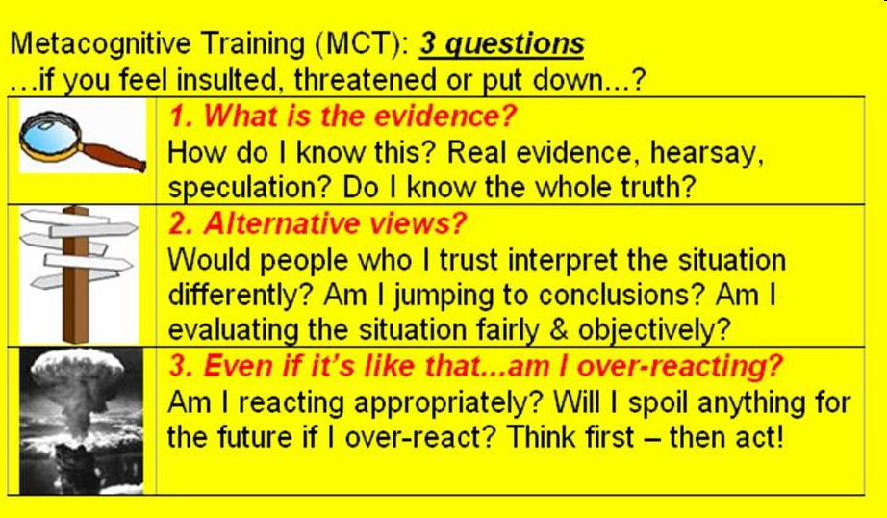


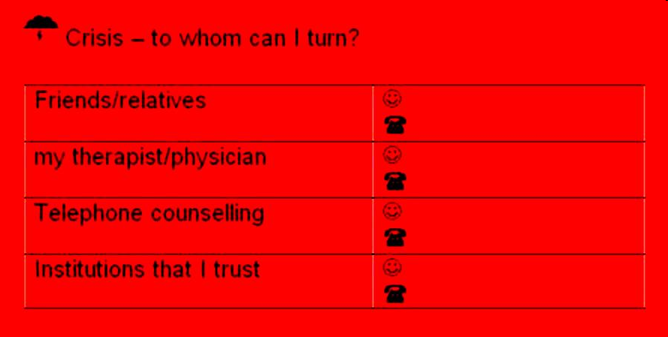
The yellow and the red card
When you feel insulted or threatened:
Please ask yourself the 3 questions on the yellow card
When you are in a crisis, turn to______
Please insert names on the card!
Introduction to MCT+ 2.4

Slide 5
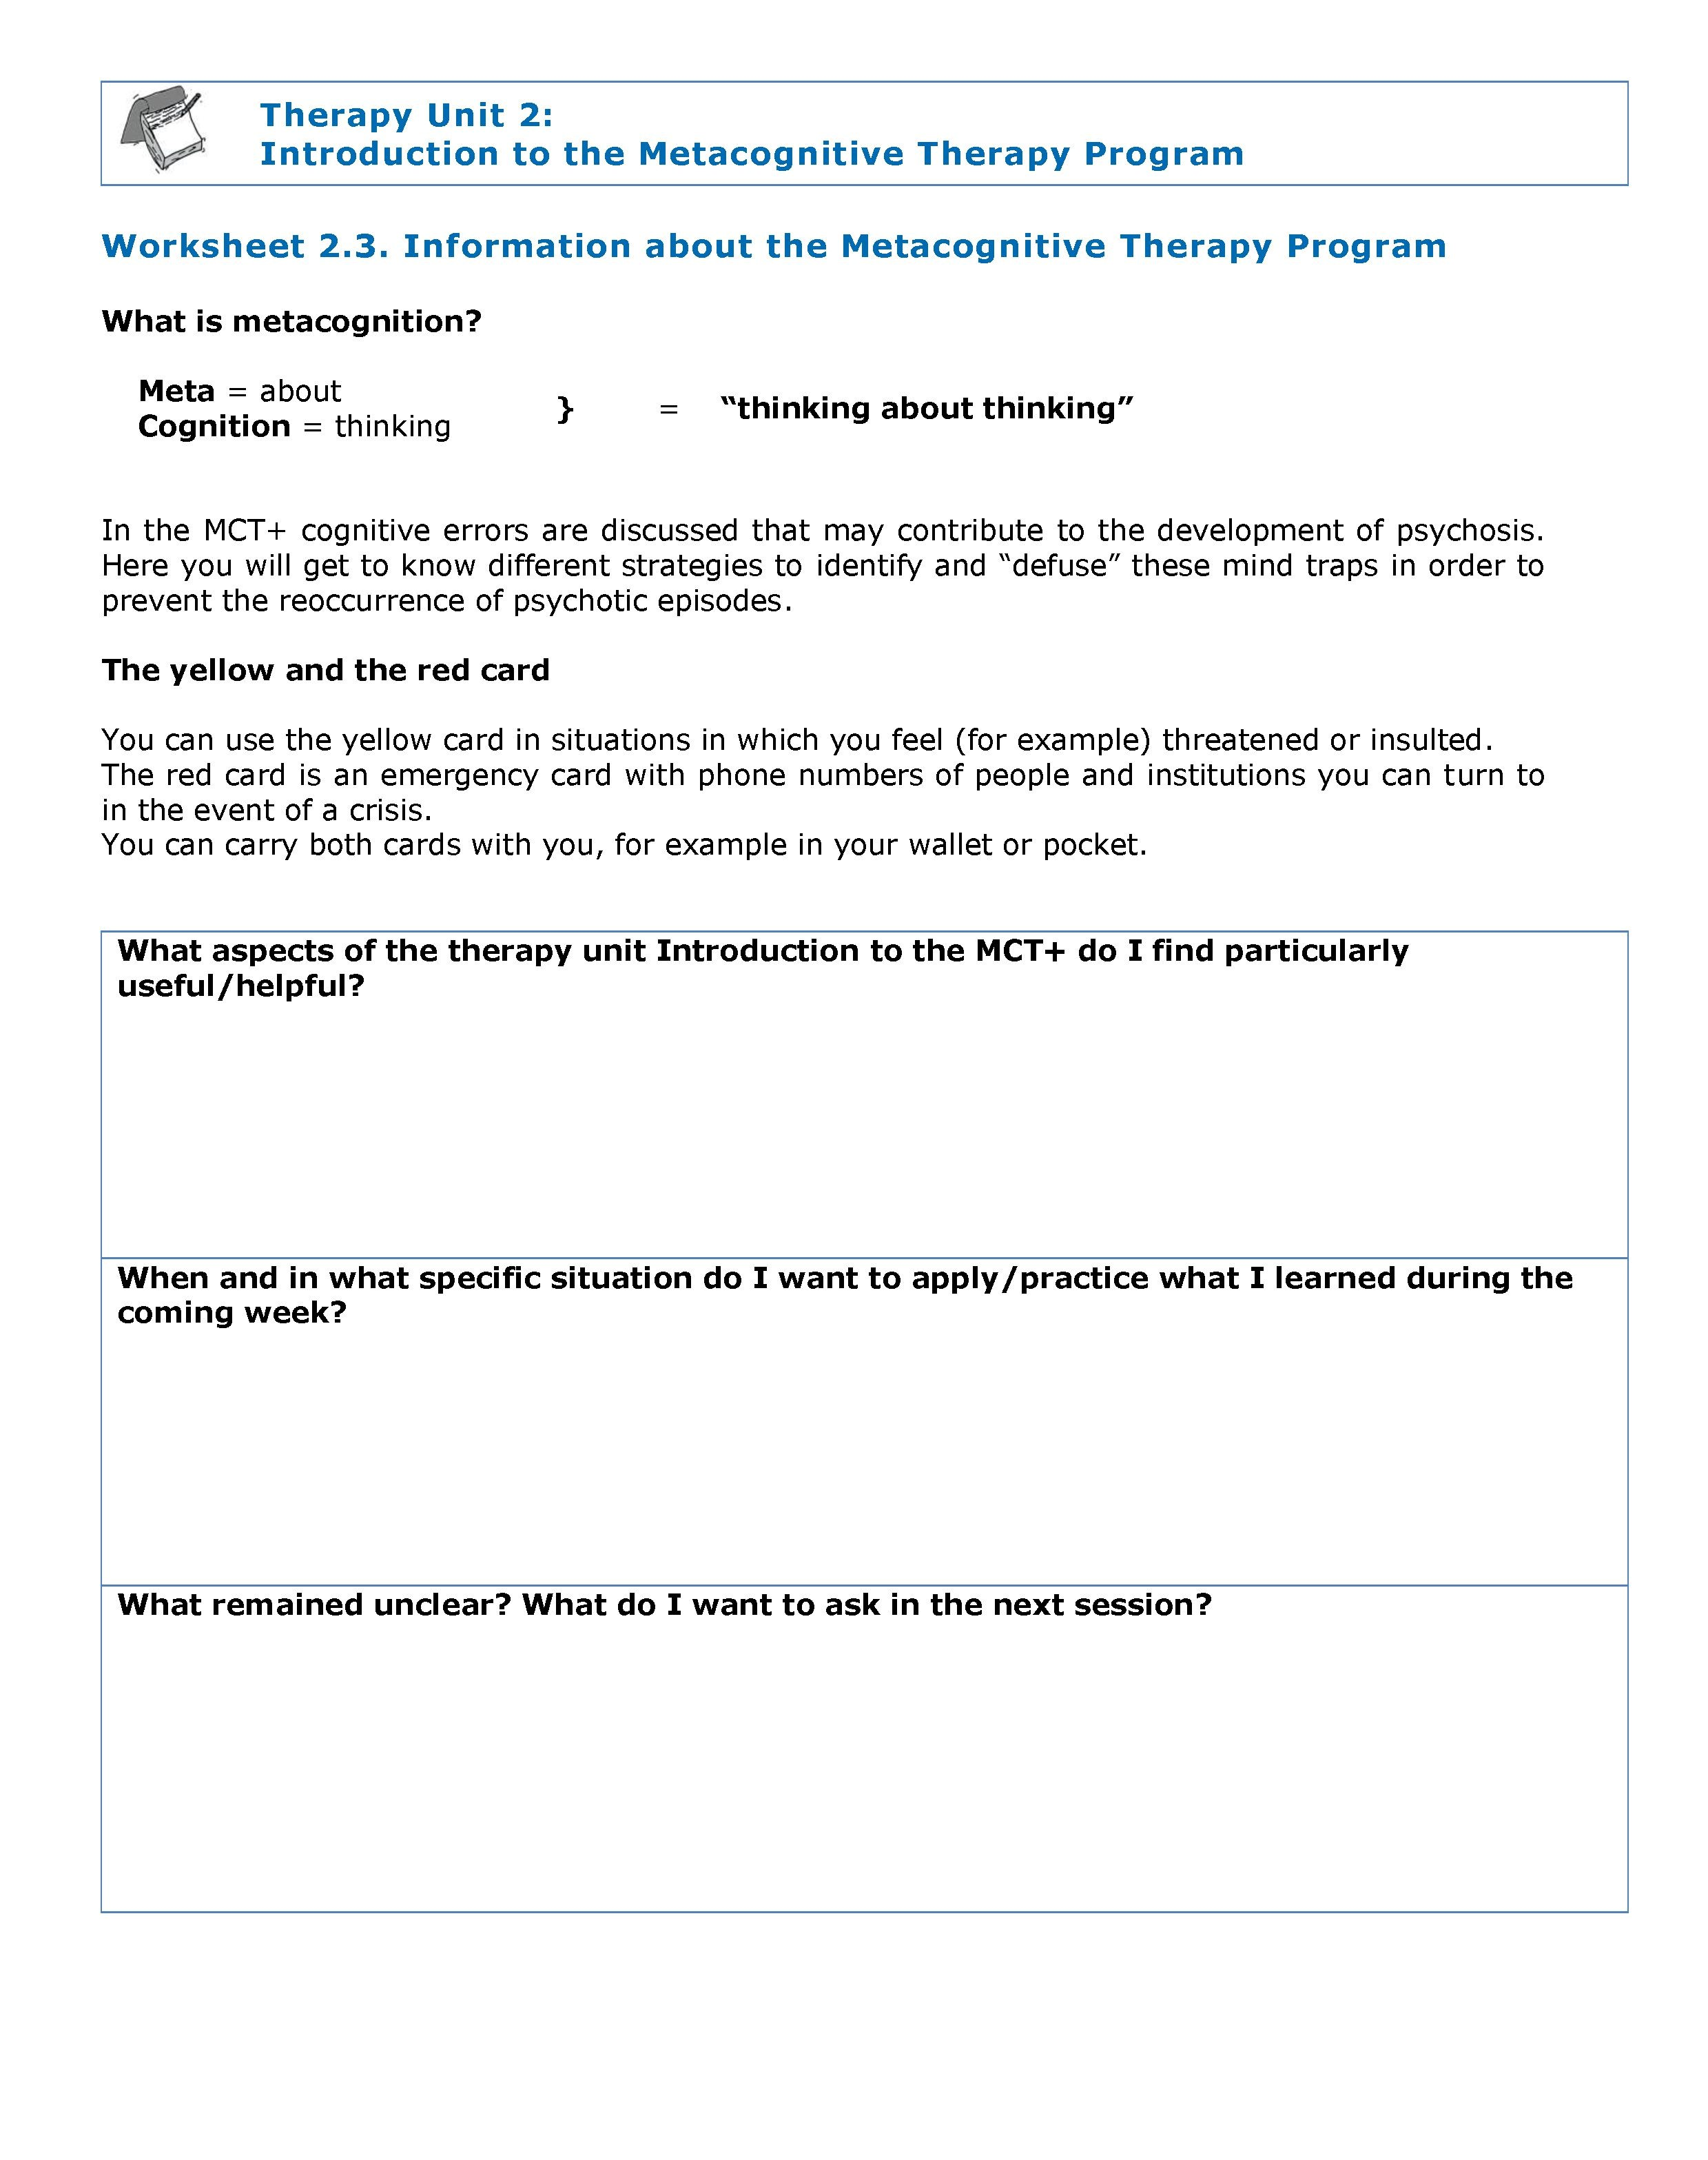
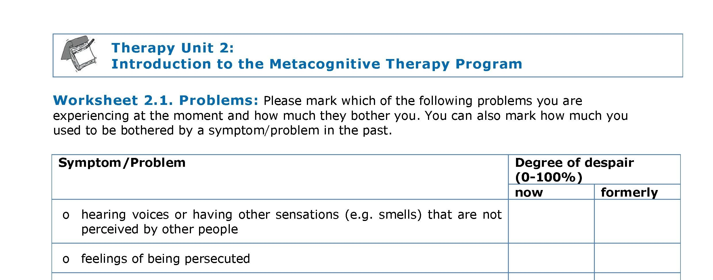
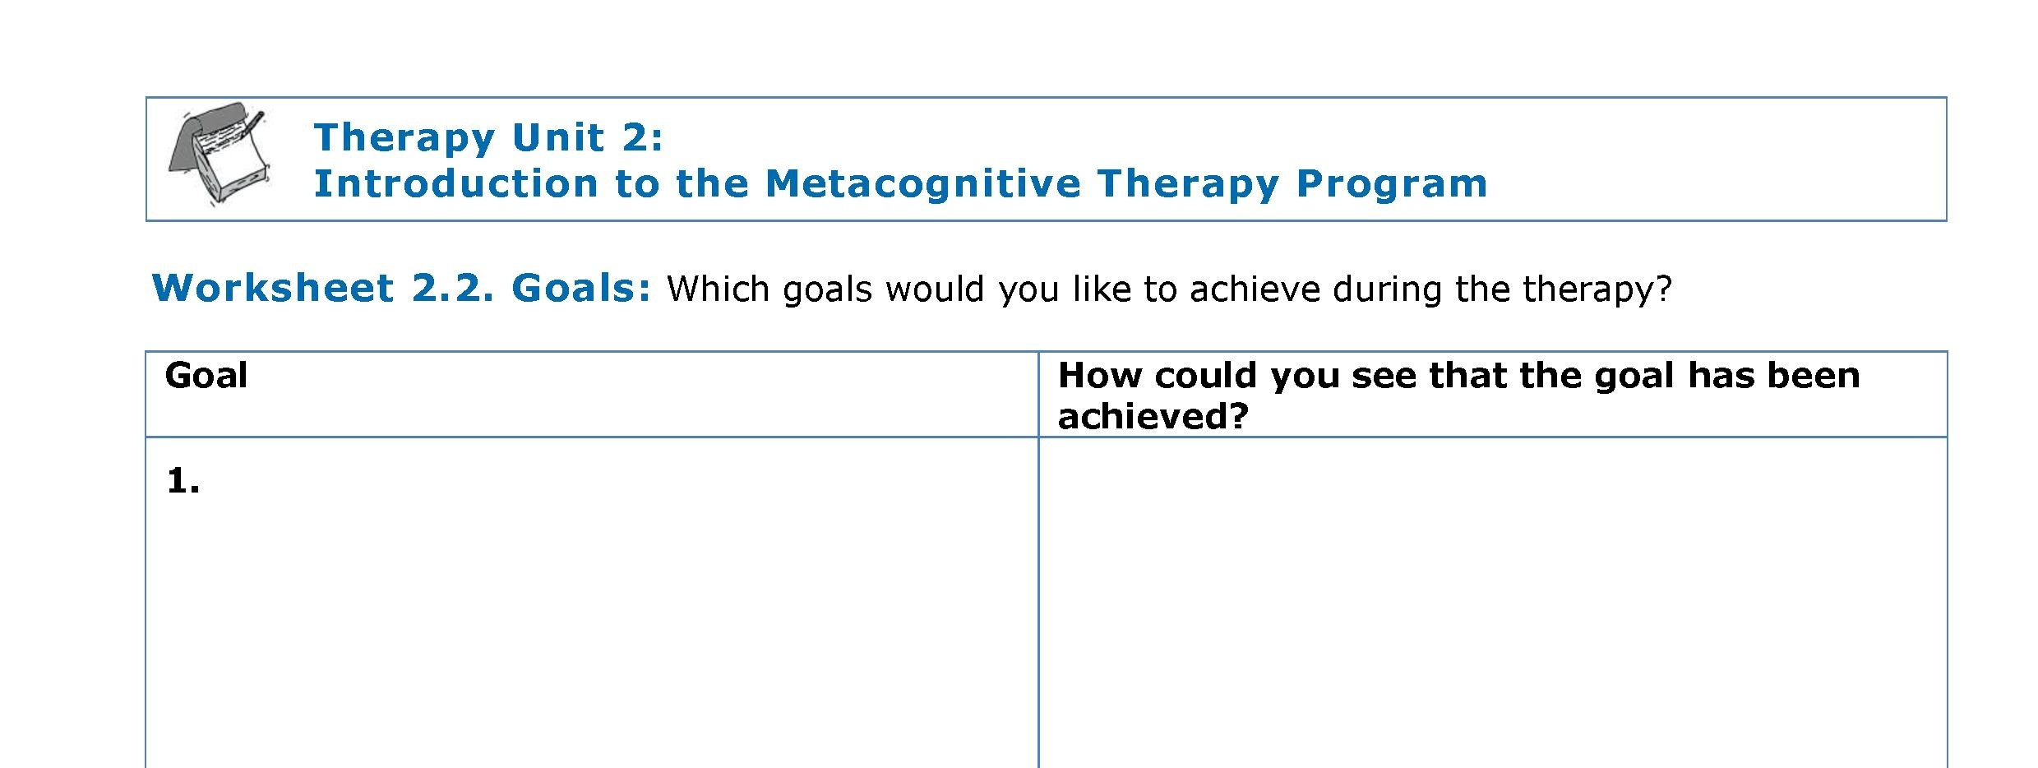

Problems/Goals
Which symptoms/problems are you currently experiencing and how much do they bother you?
worksheet
worksheet
Which goals do you want to achieve in the therapy?
worksheet
→ worksheet 2.1,
2.2 & 2.3
Introduction to MCT+ 2.5

