Slide 1
THERAPY UNIT 3:
CASE FORMULATION
Metacognitive Therapy

Slide 2
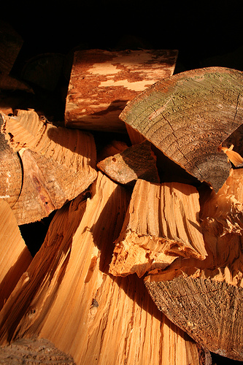
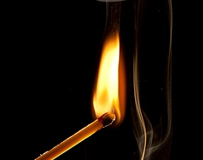
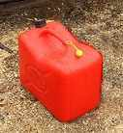
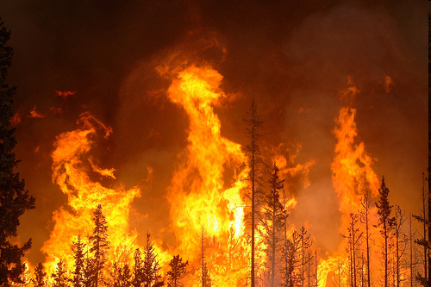
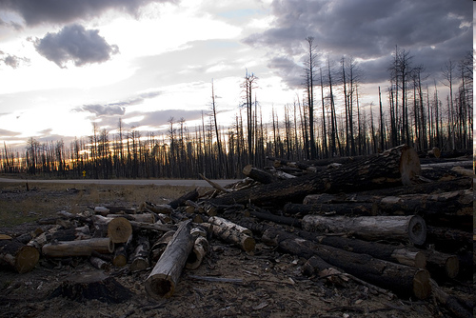
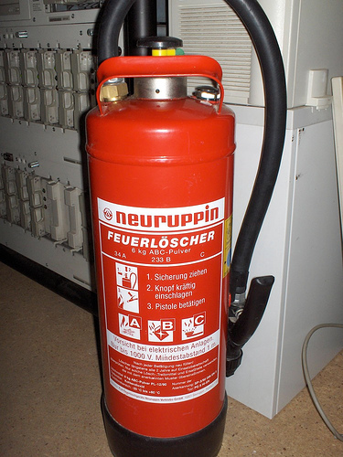
predisposition |  | e.g. parent also had psychotic episode; traumatic experiences in childhood
trigger |  | e.g. stress (work, relationship); other particular stress factors, like moving to a new city
factors leading to increase and perpetuation |  | e.g. abuse of alcohol/drugs; discontinuing medication against therapeutic advice; irregular sleep; ruminating
breakdown |  | delusions, illusions, hallucinations/hearing voices, exhaustion, depression
consequences |  | Withdrawal, unemployment, loneliness
intervention and resources |  | intervention: medication, psychotherapy, some therapy methods already adopted (e.g. relaxation techniques) resources: motivation for therapy, good social network
fuel
spark
fire accelerant
wildfire
fire damage & restoration
fire extinguisher
(f.t.t.b.: “Holz” by senfgurke; “Match on Fire” by Ambient Ideas; “jerry cans and chemicals” by colchu; “Banff Prescribed Burn 2009” by Eggs&Beer; “Wood Pile” by dani0010; “Feuerlöscher” by rudolf schuba)
Case formulation 3.2

Slide 3
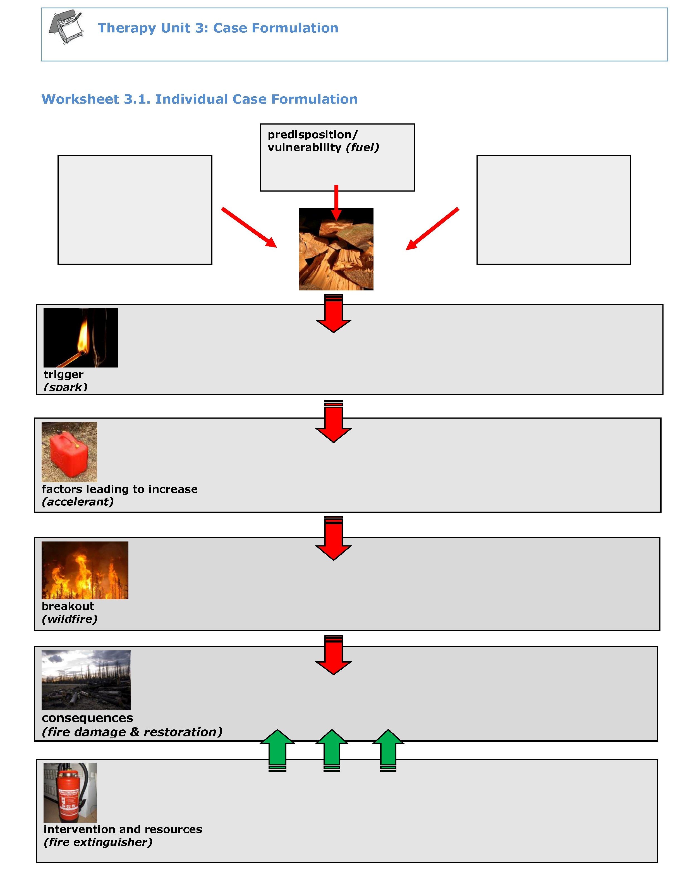

Individual case formulation
worksheet
→ worksheet 3.1
(f.t.t.b.: “Holz” by senfgurke; “Match on Fire” by Ambient Ideas; “jerry cans and chemicals” by colchu; “Banff Prescribed Burn 2009” by Eggs&Beer; “Wood Pile” by dani0010; “Feuerlöscher” by rudolf schuba)
Case formulation 3.3

Slide 4
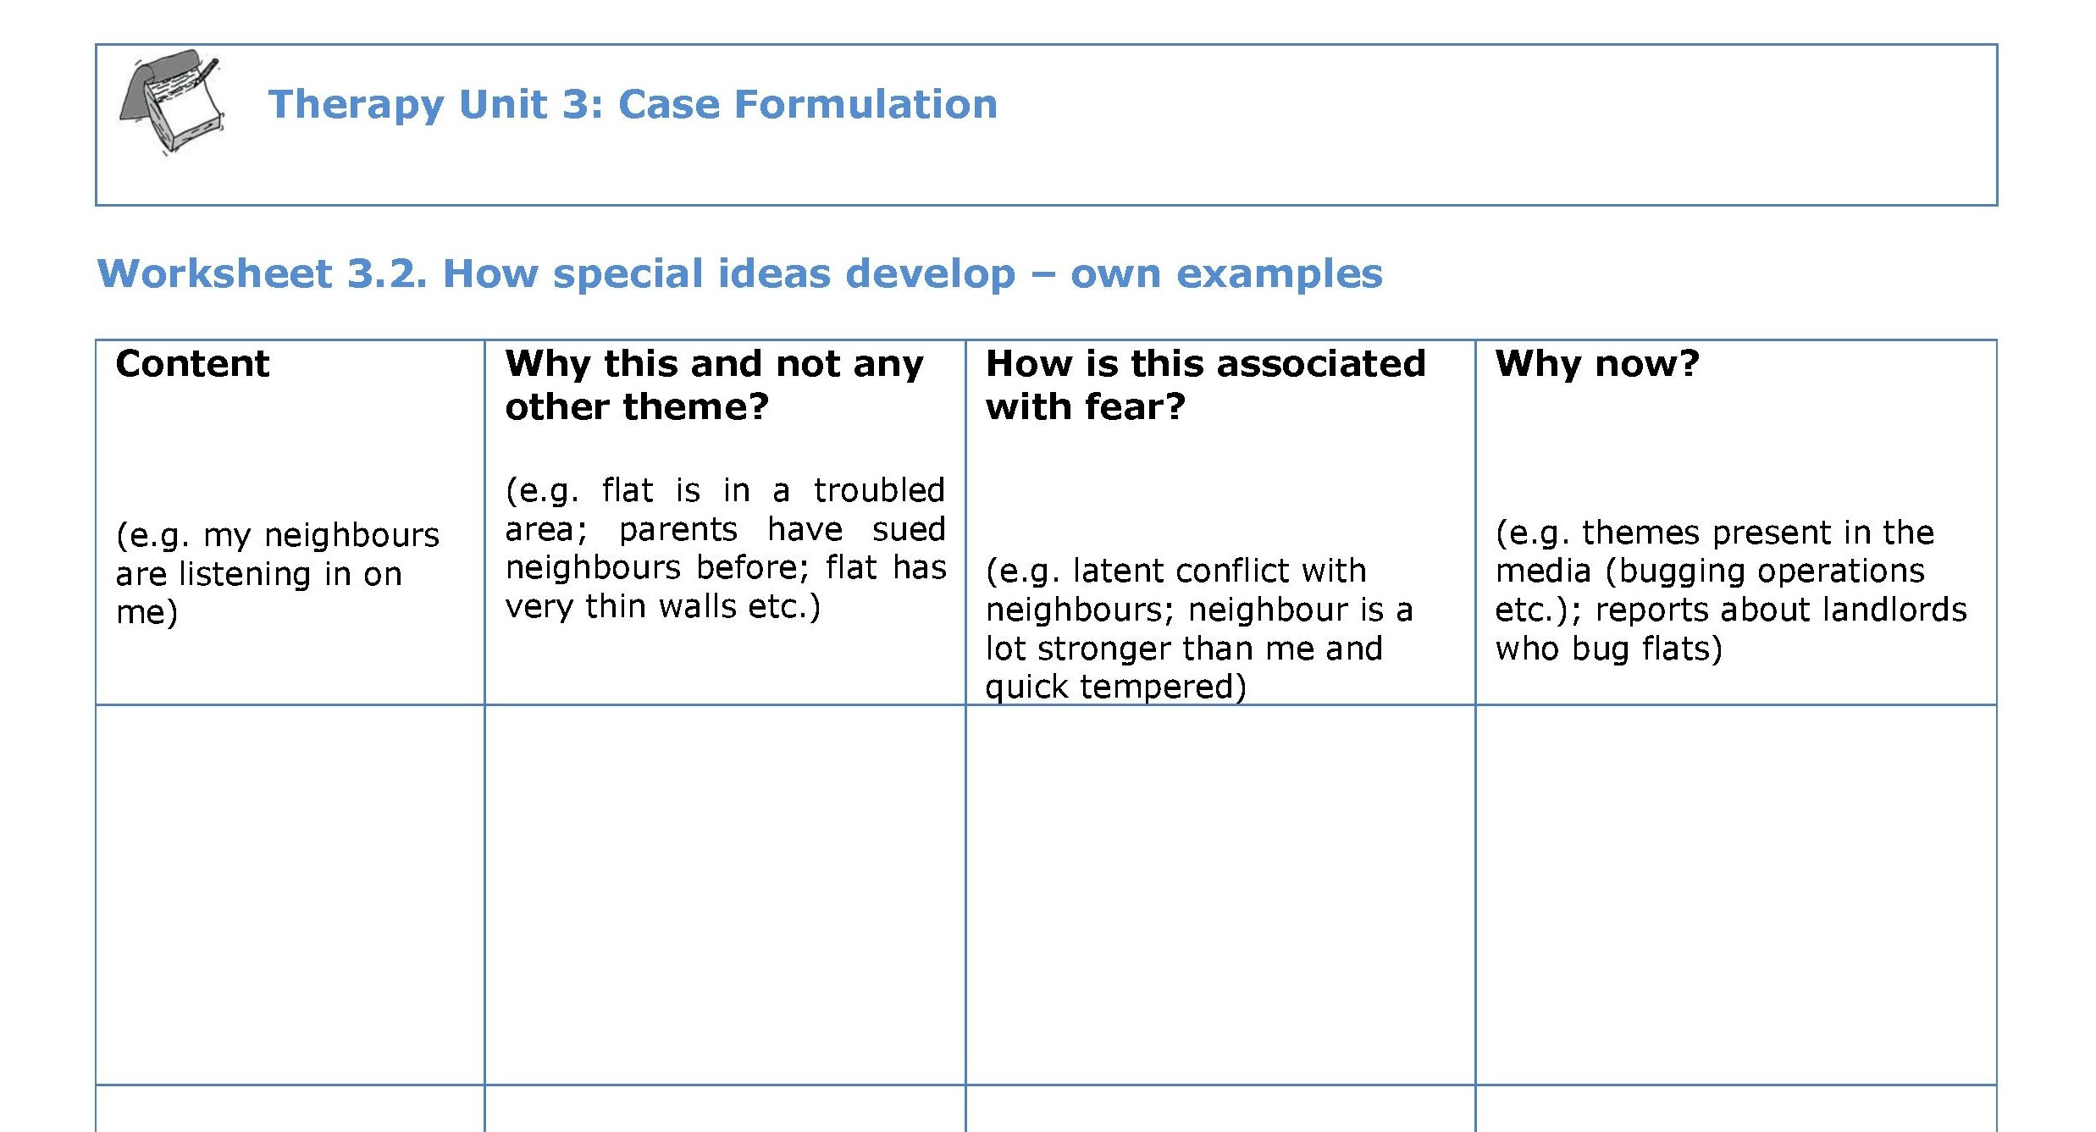
Development of particular ideas
worksheet
→ worksheet 3.2
Case formulation 3.4

