Slide 1
THERAPY UNIT 4:
ATTRIBUTIONAL STYLE
Metacognitive Therapy
Notes:
Gestern/Heute haben wir über Zuschreibungsstil in der Gruppe gesprochen, Gibt es irgendetwas was Ihnen besonders in Erinnerung geblieben ist…

Slide 2
Attributions
Attribution = inferring causes for events (e.g. blaming others for negative events)
We often overlook the possibility that the same event can have very different causes.
Which causes could have contributed to the following situation?
You failed your drivers test.
Attributional style 4.2

Slide 3
Attributions
Why did you fail your drivers test?
Possible causes...
... oneself | nerves, lack of driving experience
... others | demanding examiner
... a situation or chance | bad weather conditions, difficult roadway, a lot of traffic
Attributional style 4.3

Slide 4
Why are we doing this?
Studies show that many (but not all!) people with depression:
tend to blame themselves for failure
tend to give others or circumstances credit for success
This attributional style may contribute to low self-esteem!
me
Attributional style 4.4
Notes:
4

Slide 5
Why are we doing this?
Studies show that many (but not all!) people with psychosis:
tend to make one-sided explanations; tend to blame other people for negative events or failures
show the tendency to think that positive as well as negative events are beyond their control
The attributional style of blaming others may lead to interpersonal problems!
(Saying: “Eyes see everything – except themselves!”).
Attributional style 4.5
Notes:
5

Slide 6

People laugh while you are speaking
What might have caused people to laugh while you are speaking?
What is the main reason for this event?
Think about possible effects or your attributions.
Yourself?
Another person or people?
Circumstances or chance?
(“Laughter workshop” by yanec)
Attributional style 4.6

Slide 7
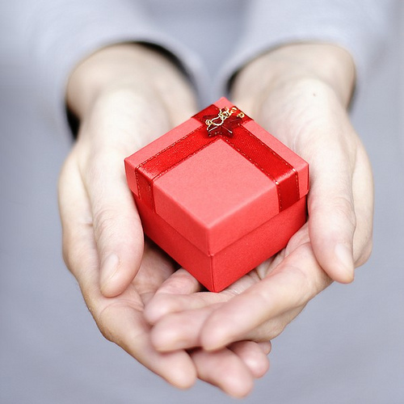
A friend has bought you a present
What has caused your friend to give you a gift?
What is the main reason for this event?
Think about possible effects or your attributions.
Yourself?
Another person or people?
Circumstances or chance?
(“Gift :D” by Marcin Moga / Lolek)
Attributional style 4.7

Slide 8
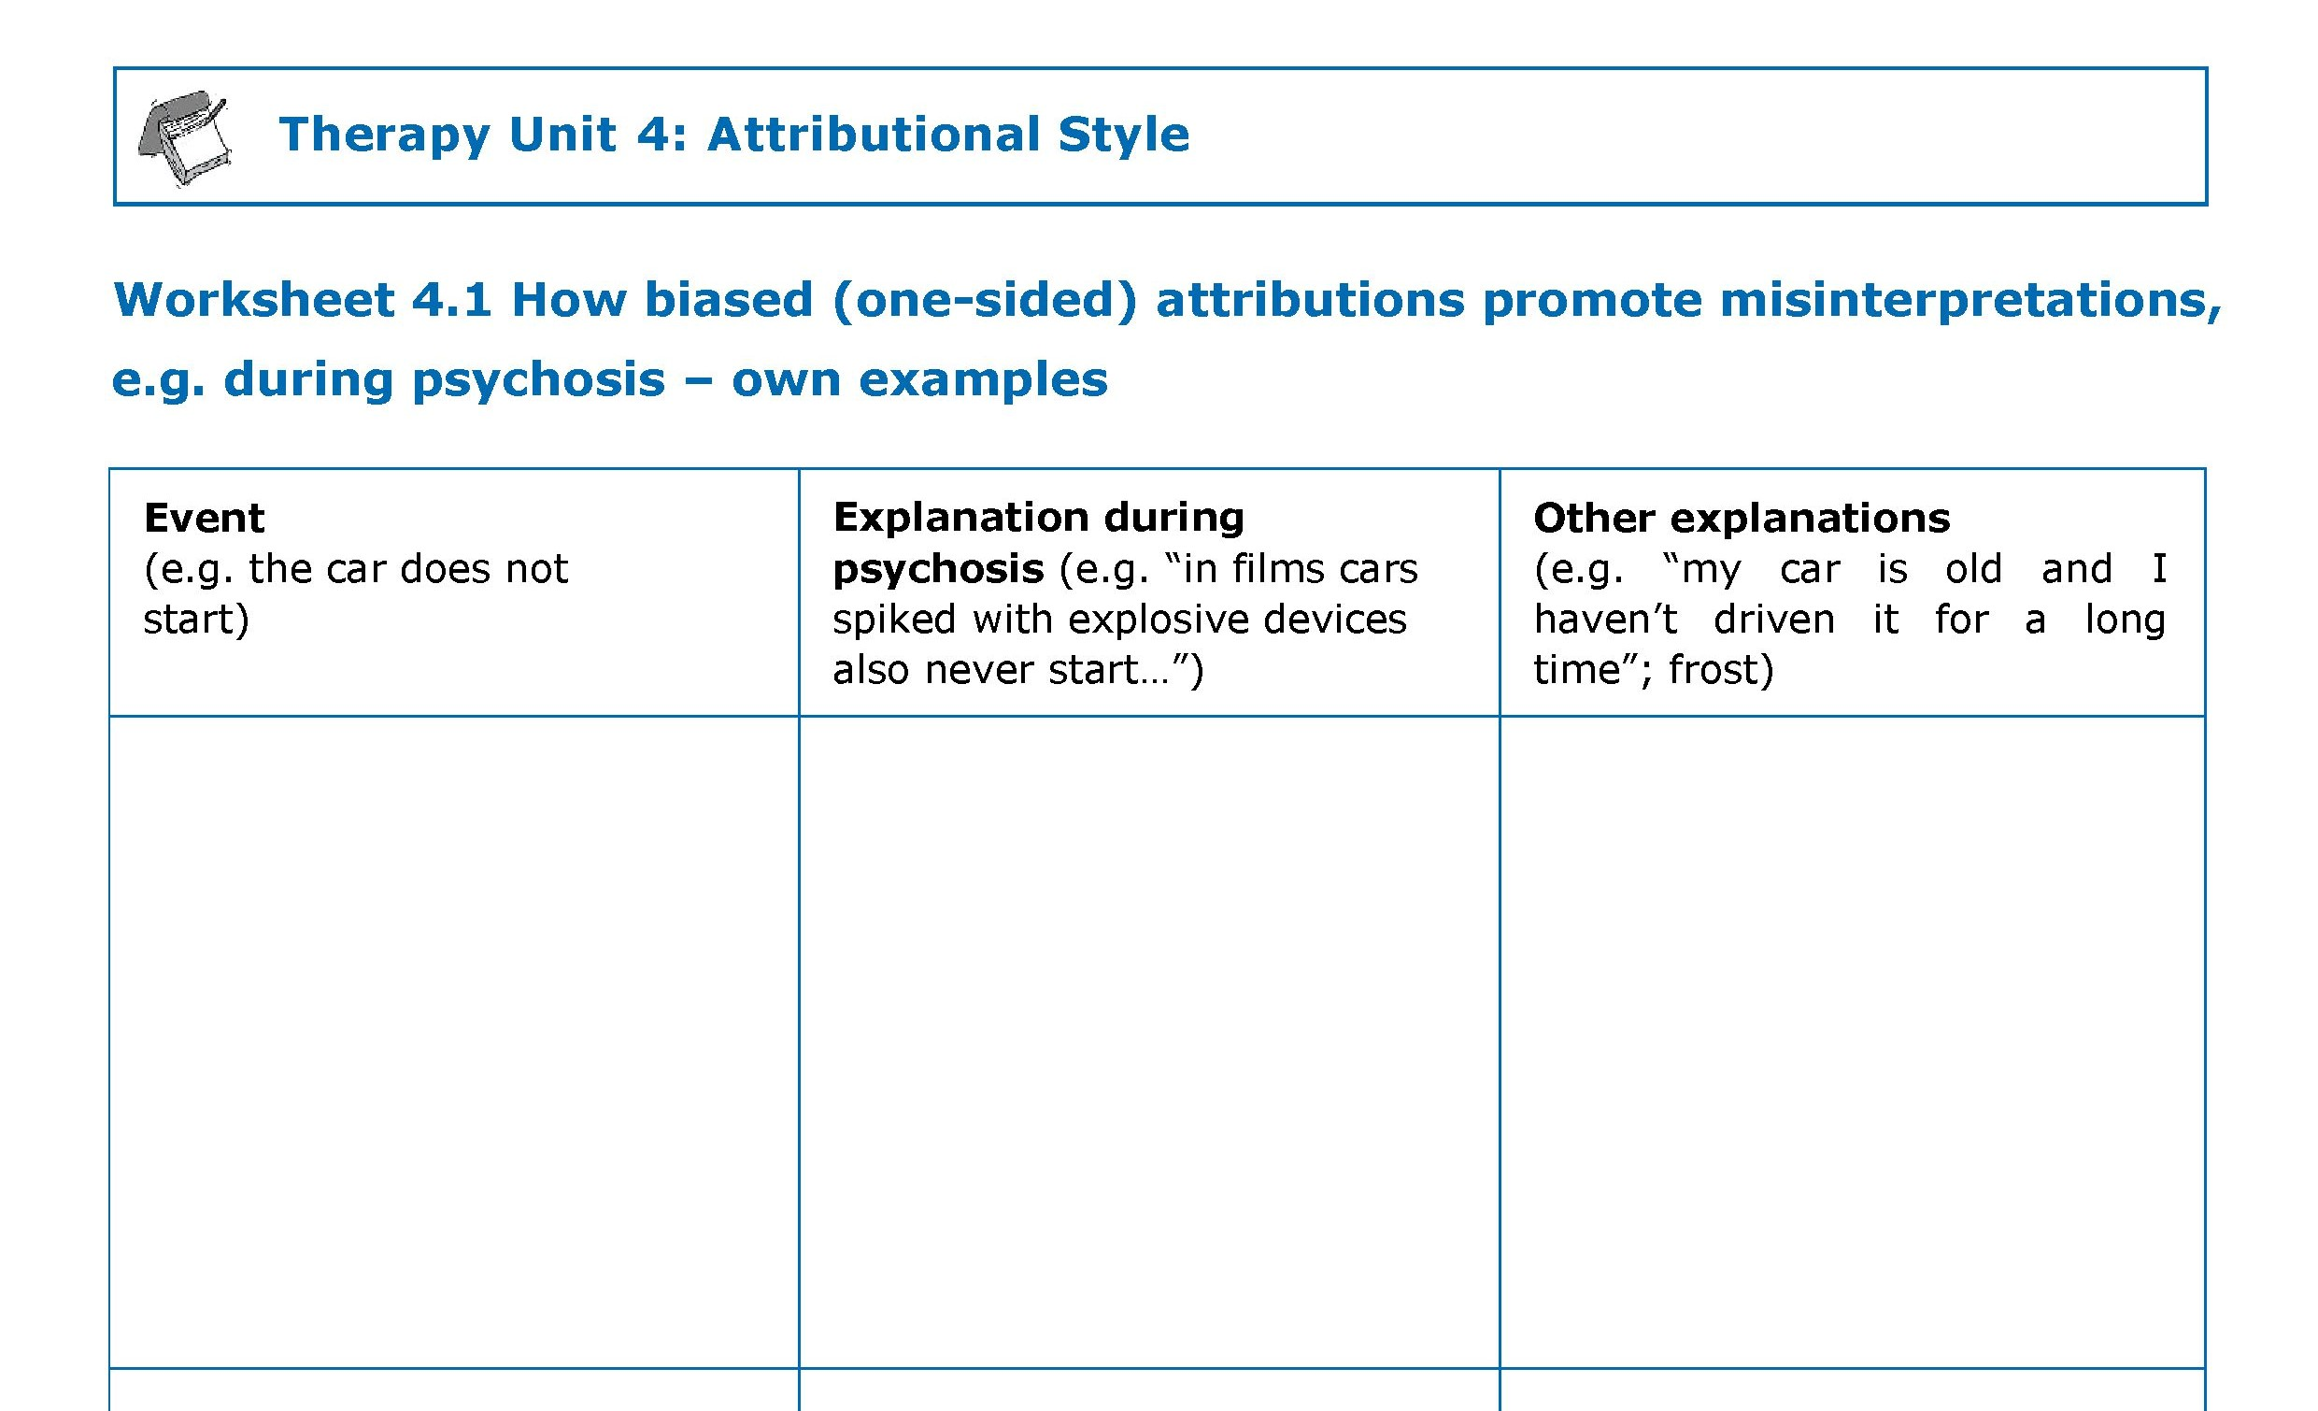

How one-sided attributions promote misinterpretations,
e.g. during psychosis - examples
worksheet
→ worksheet 4.1
Attributional style 4.8

Slide 9
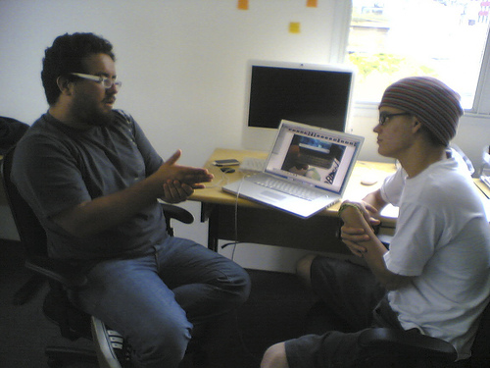
Effects of certain attributional styles on negative events
I am sorry Mr. Miller, but I won’t renew your work contract.
Attribution: self (e.g. “That was really all my fault. I did not work hard enough!”) | Disadvantage: ??? Advantage: ???
Attribution: others/circumstances (e.g. “The boss did not like me from the start – I am being bullied.”) | Disadvantage: ??? Advantage: ???
(“Marco Gomes e Marcelo Edurdo” by Marco Gomes; “Smiley” by Ruth Veckenstedt)
Attributional style 4.9
Notes:
9

Slide 10
Effects of certain attributional styles on negative events
I am sorry Mr. Miller, but I won’t renew your work contract.
Attribution: self (e.g. “That was really all my fault. I did not work hard enough!”) | Disadvantage: reduces self-esteem Advantage: regarded as noble and brave to take responsibility
Attribution: others/circumstances (e.g. “The boss did not like me from the start – I am being bullied.”) | Disadvantage: fully rejecting responsibility is considered immature (making it easy for oneself) Advantage: self-esteem is not threatened
(“Marco Gomes e Marcelo Edurdo” by Marco Gomes; “Smiley” by Ruth Veckenstedt)
Attributional style 4.10

Slide 11
Effects of certain attributional styles on negative events
“Victory has a thousand fathers, but defeat is an orphan”
I am sorry Mr. Miller, but I won’t renew your work contract.
More balanced responses (i.e. combine influences from self, others, or situation; offer different explanations):
“The company is cutting down on jobs. I have noticed myself that my current position does not match my abilities and interests and that the cooperation with my colleagues did not always work out that well.”
(“Marco Gomes e Marcelo Edurdo” by Marco Gomes; “Smiley” by Ruth Veckenstedt)
Attributional style 4.11

Slide 12
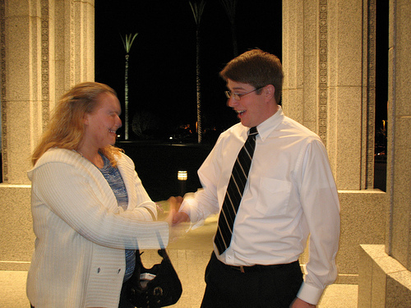
Effects of certain attributional styles on positive events
The apartment is yours! We are happy to welcome you as our new tenant!
Attribution: self (e.g. “I made a great impression. Of course my application was going to be accepted!”) | Disadvantage: ??? Man wirkt auf andere arrogant (Volksmundstinkt“) Advantage: ??? Selbstbewusstsein
Attribution: others/circumstances (e.g. “I must have been the only person interested. What a lucky coincidence!”) | Disadvantage: ??? Man wirkt auf andere arrogant (Volksmundstinkt“) Advantage: ??? gilt als bescheiden und sozial
(“Secret handshakes” by The infamous gdub ; “Smiley” by Ruth Veckenstedt)
Attributional style 4.12

Slide 13
Effects of certain attributional styles on positive events
The apartment is yours! We are happy to welcome you as our new tenant!
Attribution: self (e.g. “I made a great impression. Of course my application was going to be accepted!”) | Disadvantage: self-praise leaves an arrogant impression on others Advantage: self-praise increases self-esteem
Attribution: others/circumstances (e.g. “I must have been the only person interested. What a lucky coincidence!”) | Disadvantage: self-esteem is not increased Advantage: You are deemed to be modest and have a good social etiquette
(“Secret handshakes” by The infamous gdub ; “Smiley” by Ruth Veckenstedt)
Attributional style 4.13
Notes:
13

Slide 14
Effects of certain attributional styles on positive events
The apartment is yours! We are happy to welcome you as our new tenant!
More balanced responses (i.e. combine influences from self, others, or situation; offer different explanations):
“I must have made a good impression on the landlord. We did get along well right from the start. Besides, it is certainly to his advantage that I am providing the kitchen furniture!”
(“Secret handshakes” by The infamous gdub ; “Smiley” by Ruth Veckenstedt)
Attributional style 4.14

Slide 15

Card game
Please silently choose one of these cards and concentrate on it.
Don’t point at it or name it and do not tell me which card you have chosen. After you have memorized the card, I will turn the page…
(“Cards-Trick” by Linney und Peters, 2007)
Attributional style 4.15

Slide 16
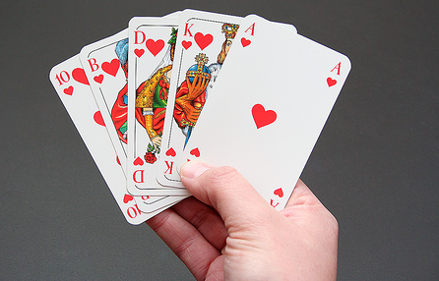
Card game
The card you have chosen will now be selected and removed from the deck.
I will turn the page now…
(“Royal Flush” by mawel)
Attributional style 4.16

Slide 17

Card game
Has your card been removed?
How do you think this was done?
(“Cards-Trick” by Linney und Peters, 2007)
Attributional style 4.17

Slide 18
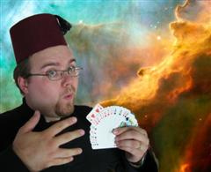
Card game
How do you think this was done?
Telepathy?
Magic?
…
No: It’s a card trick!
Strange phenomena or situations that seem to have supernatural causes sometimes also occur in everyday life. Please consider: Most of the time there are simple explanations for strange events.
(“Royal Flush” by mawel; “RAOK Suggestion #5 Do a magic trick” by Garethjmsaunders)
Attributional style 4.18

Slide 19
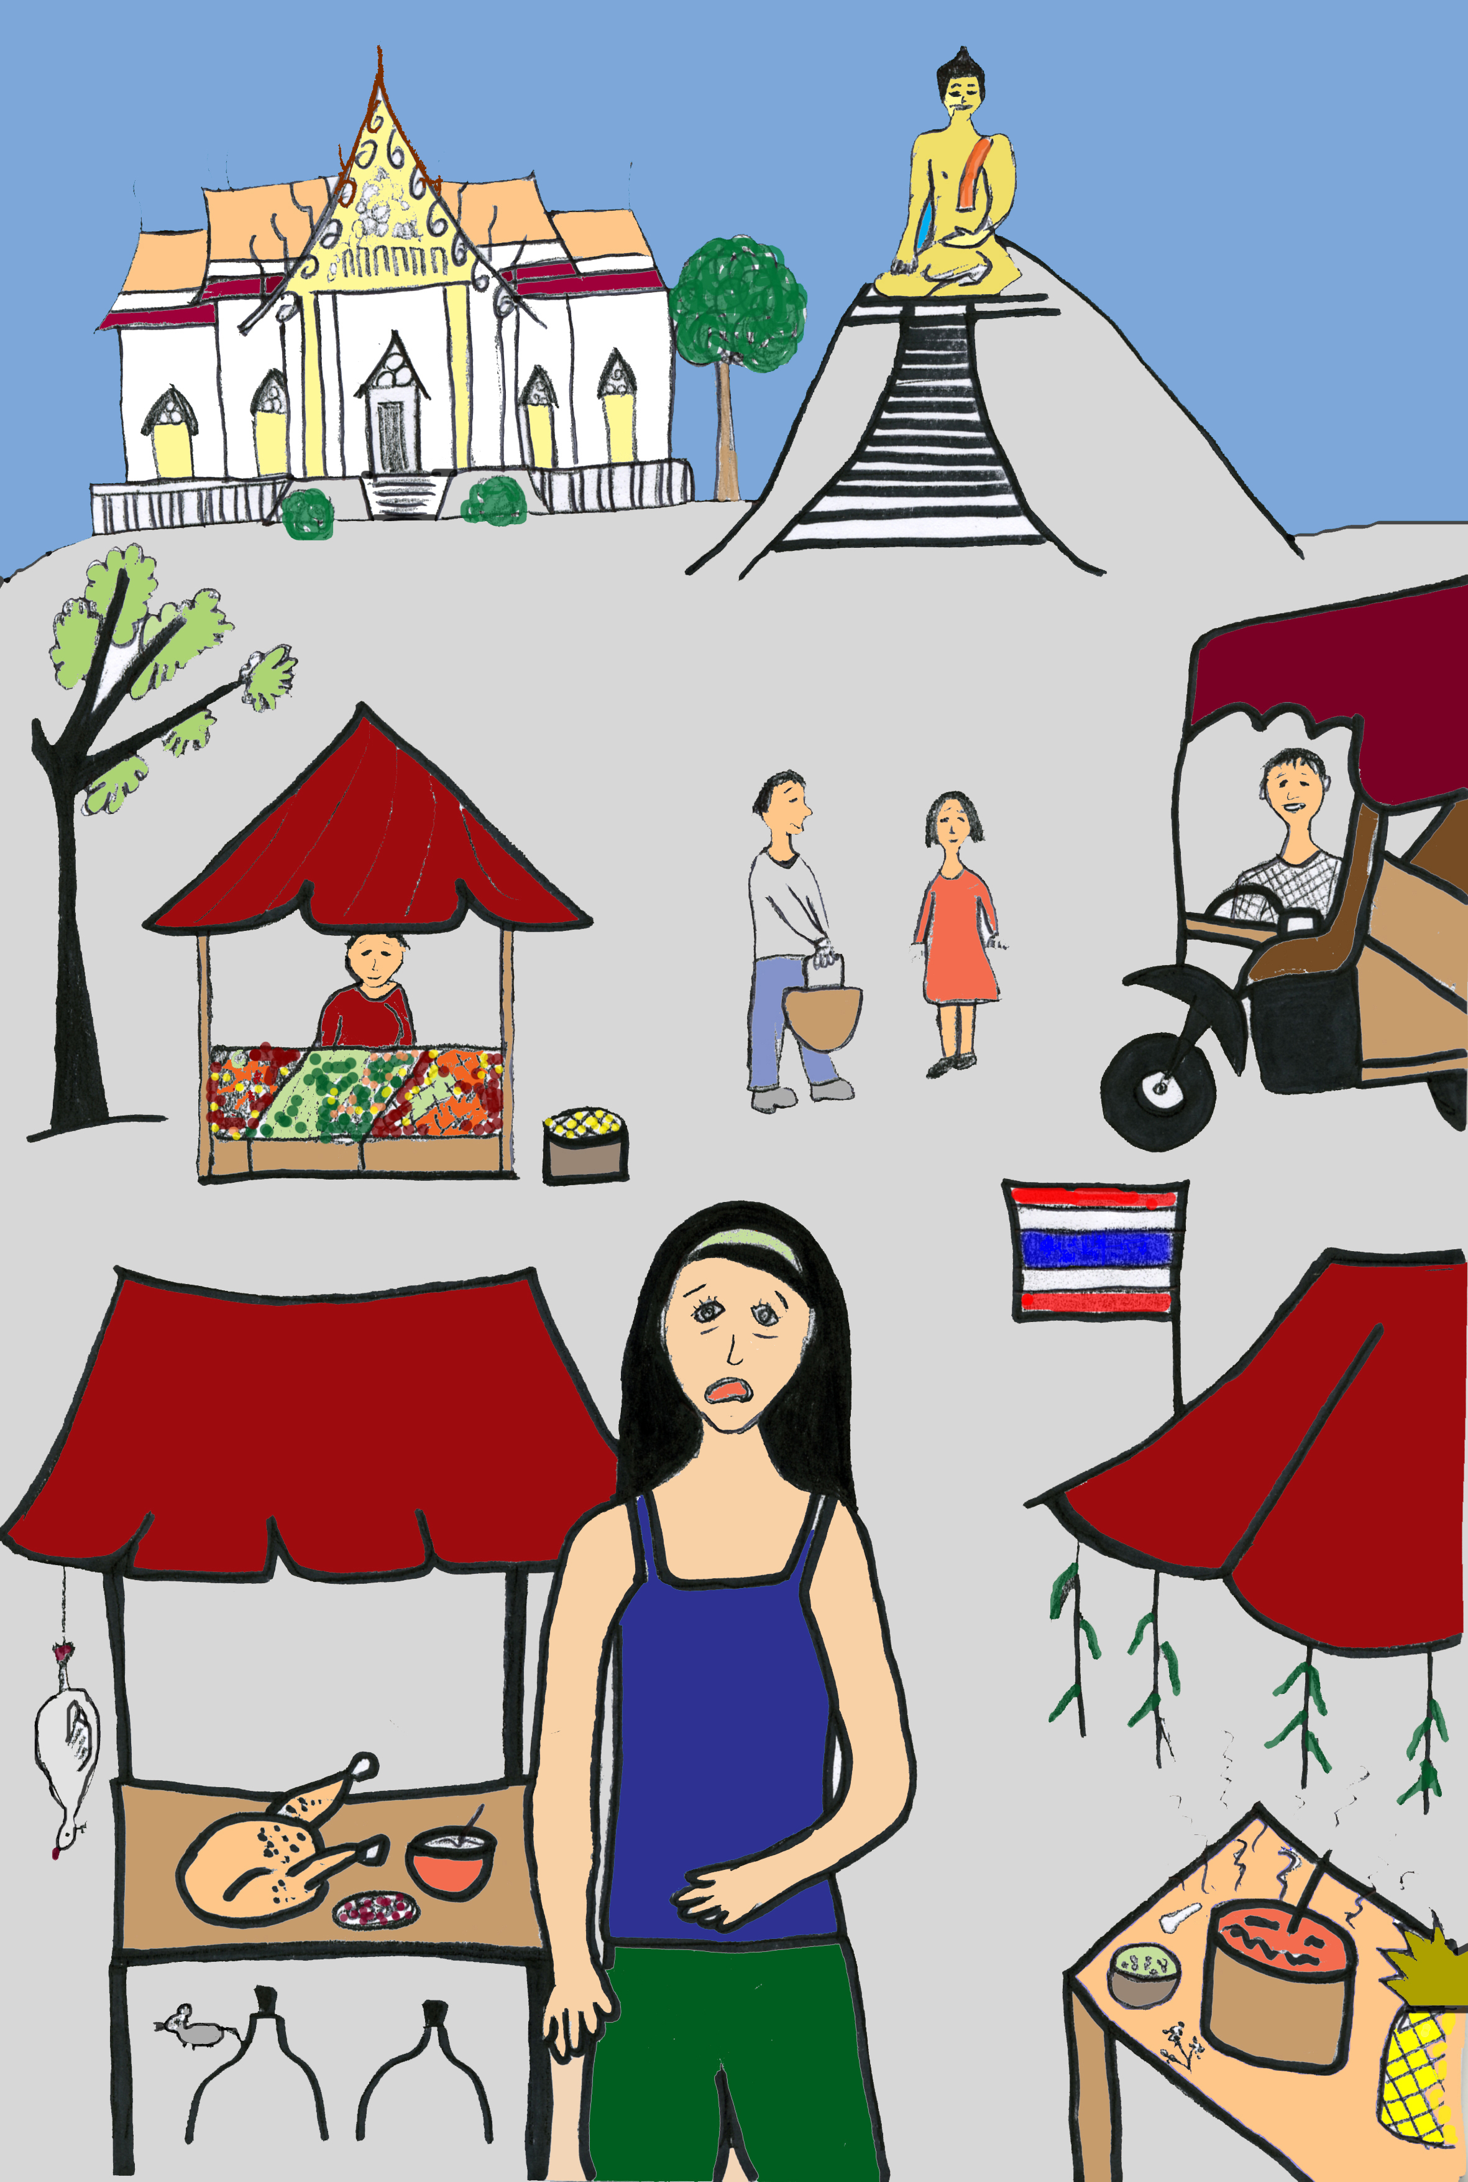
Persecution/strange smells
Pros and cons?
Example:
Tina notices the smell of teargas in the streets of Bangkok.
Interpretation/ Attribution:
She is convinced that her neighbour followed her to Bangkok and is trying to harm her with poison, just as he tried to poison her when she was at home.
Which alternative explanations/causes could be possible
???
(“Straßen von Bangkok” by Lisa Schilling)
Attributional style 4.19

Slide 20
Persecution/strange smells
Pros and cons?
Example: strange smells
What alternative explanations/causes could be possible?
Due to situation/circumstances: There are many smells unfamiliar to Tina and a lot of smog in Bangkok.
Due to others: There has been a police operation using teargas (unlikely).
Due to Tina herself:
(“Straßen von Bangkok” by Lisa Schilling)
Attributional style 4.20

Slide 21
Persecution/strange smells
Pros and cons?
Example: strange smells
What alternative explanations/causes could be possible?
Due to situation/circumstances: There are many smells unfamiliar to Tina and a lot of smog in Bangkok.
Due to others: There has been a police operation using teargas (unlikely).
Due to Tina herself: Tina is jetlagged and therefore feels nervous and strained. Moreover, she has a sensitive nose. Tina previously experienced a psychosis accompanied by misperceptions.
→ worksheet 4.2
(“Straßen von Bangkok” by Lisa Schilling)
Attributional style 4.21

Slide 22
Persecution/strange smells
Pros and cons?
Example: strange smells
What would be a more balanced interpretation, accounting for several causes?
Tina herself/others/situation:
Due to the long journey and jetlag, Tina was stressed and nervous. The unfamiliar smells, her sensitive nose and fear of her neighbour reinforced the perceptions and promoted the development of misinterpretations.
(“Straßen von Bangkok” by Lisa Schilling)
Attributional style 4.22

Slide 23

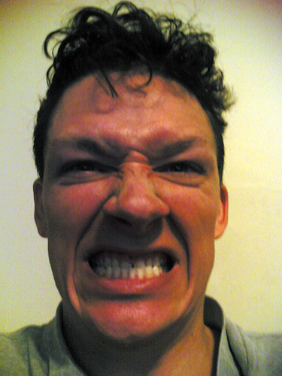
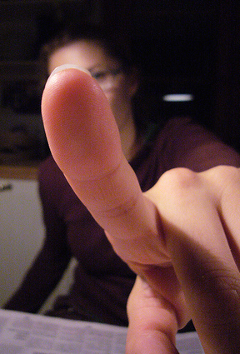
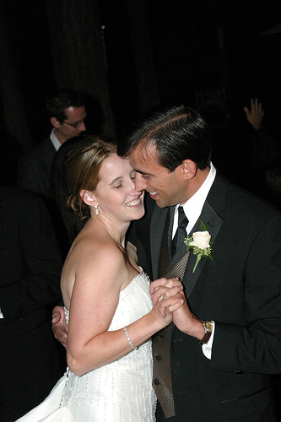

Negative event during the past week
(stress, argument, grief, disappointment…)
What happened?
What did you ascribe as cause of the event?
What consequences have resulted from your explanation?
What are other possible explanations for the event?
→ worksheet 4.3
(f.l.t.r.: “Loneliness” by The unnamed; “Anger” by Mr.Gunn; “Index” by Sami Keinänen)
Attributional style 4.23

Slide 24
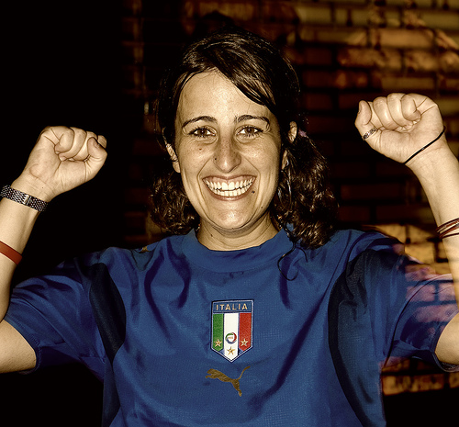
Positive event during the past week
(compliment, acquaintance, invitation…)
What happened?
What did you ascribe as cause of the event?
What consequences have resulted from your explanation?
What are other possible explanations for the event?
→ worksheet 4.4
(f.l.t.r.: “The Happy couple” by The Geary´s; “Thumbs up” by Joeltelling; “the same bundle of (sheer) joy” by Ali Brohi)
Attributional style 4.24

Slide 25
What is your attributional style?
 |  |  |  | attribution
 |  |  |  | self | others
 |  |  | self | self-centred | “self-serving bias”
 |  |  | others | depressive style | powerlessness/loss of control
-
-
+
attribution
+
positive event
negative event
(“Index” by Sami Keinänen; “Smileys” by Ruth Veckenstedt)
Attributional style 4.25

Slide 26
Persecution:
Circumstances, other people, myself!
Example: Peter thinks his neighbours want to force him out of his apartment. The conflict escalates when he calls the police while being under the influence of drugs. What factors did contribute to the escalation?
other people: mean neighbours (30%)
circumstances: alcohol, drugs (40%)
Peter himself: overly sensitive (30%)
→ worksheet 4.5
Attributional style 4.26

Slide 27
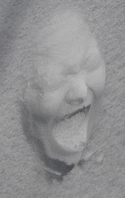
An inner voice tells you you’re no good
Possible attributions…
... oneself
... others
... situation/circumstances
(“Mask of horror” by Chrystalline Radical)
Attributional style 4.27

Slide 28
An inner voice tells you you’re no good
Possible attributions…
... due to oneself:
self-accusations, underlying self-hatred
symptom of mental illness
spontaneous discharge in brain (e.g. in language centre)
your own thoughts, simply perceived in an intense way
... due to others:
something has been implanted into your brain (transmitter, electrode) or transmitted from the outside
someone has seized control over thoughts
other
... due to situation or chance:
stress
song stuck in your head, rumination, turning over thoughts in
one’s mind e.g. following an argument
(“Mask of horror” by Chrystalline Radical)
Attributional style 4.28

Slide 29
An inner voice tells you you’re no good
Typical attribution during psychosis:
something has been implanted into your brain (transmitter, electrode) or transmitted from the outside
someone has seized control over my thoughts
other
→ worksheet 4.6
(“Mask of horror” by Chrystalline Radical)
Attributional style 4.29

Slide 30
Hearing voices
Your own thoughts or controlled by an external source?
Pros and cons
Controlled from the outside? | Are there perhaps other explanations?
“I can hear it clearly. In contrast, my own thoughts are completely silent!”
“These thoughts are uncontrollable. When I try to stop them, it gets even worse. That shows me that someone really wants to put me down.”
“I would never think such evil thoughts. I could never do any harm to anyone. But still, I constantly hear aggressive voices.”
???
???
???
(“Mask of horror” by Chrystalline Radical)
Attributional style 4.30

Slide 31
Hearing voices
Your own thoughts or controlled by an external source?
Pros and cons
Controlled from the outside? | Are there perhaps other explanations?
“I can hear it clearly. In contrast, my own thoughts are completely silent!” | Approximately 15-20% of the general population hear voices from time to time. Intensive thought can be almost audible (catchy tunes; rumination; when reading a letter of a well-known person, some people “hear” his or her voice) or be accompanied by respective inner perceptions.
“These thoughts are uncontrollable. When I try to stop them, it gets even worse. That shows me that someone really wants to put me down.” | Our thoughts are not fully controllable – otherwise there would be no such events as sudden inspirations, brainstorms or ruminations. If we try to counteract those thoughts, they automatically become stronger. Experiment: Do not think of the number 8 for the next minute! – You will not succeed.
“I would never think such evil thoughts. I could never do any harm to anyone. But still, I constantly hear aggressive voices.” | Thoughts that oppose our usual way of thinking are frequent. Thoughts ≠ Action: 20% of the general population have passing thoughts about committing suicide, however they don’t do so. Even if it’s towards the people we love, we sometimes have (slightly) aggressive thoughts (e.g. a mother and her crying child).
(“Mask of horror” by Chrystalline Radical)
Attributional style 4.31

Slide 32
Hearing voices
Your own thoughts or controlled by an external source?
Pros and cons
The assumption of remote-controlled thoughts or voices raises more questions than answers, for example:
Technically feasible?
When and how did the implantation take place?
Who would be interested in harming you this way? Who would have the time and money to do so?
There are easier ways to harm someone. Why should such a complex method be chosen?
(“Mask of horror” by Chrystalline Radical)
Attributional style 4.32

Slide 33
Application to everyday life
Learning objectives:
Always consider three possibilities that could have contributed to the outcome of a specific event: myself, others and circumstances.
We should try to be as realistic as possible in everyday life:
It is not justified to always cast the blame on others – just as it is not always our fault when things go wrong!
Most of the time, multiple factors contribute to an event.
Attributional style 4.33

Slide 34
What does this have to do with psychosis?
Many (but not all!) people with psychosis tend to explain complex events with one single reason only.
Often, other people get blamed for one’s own personal failures. Some, in contrast, only ever blame things on themselves.
What aspects of the therapy unit ‘attributional style’ do I find particularly useful or helpful?
When and in what concrete situation could I apply what I learned in the near future? How could it be helpful (e.g. to feel less tense)?
→ worksheet 4.7
Attributional style 4.34

Slide 35
What does this have to do with psychosis?
Example: Anna suffers from a severe stomach ache.
Attribution/own belief: Anna thinks her food was poisoned.
But: Anna has had a lot of stress and pressure at work lately. She therefore didn’t sleep much and didn’t eat regularly. Anna often has stomach trouble as a reaction to stress.
Attributional style 4.35

