Slide 1
Metacognitive Therapy
THERAPY UNIT 5:
DECISION MAKING

Slide 2
Jumping to conclusions
We often make decisions without knowing “the whole truth”.
Reasons/advantages: ??? Zeitersparnis, gibt Sicherheit, man wirkt auf andere eventuell entschlossen und kompetent (Redewendung: „Besser eine falsche Entscheidung als
Disadvantages: ??? Risiko, schwerwiegende Fehlentscheidungen zu begehen...
Decision making 5.2

Slide 3
Jumping to conclusions
We often make decisions without knowing “the whole truth”.
Reasons/advantages: saves time, reinforces prior knowledge, may make you appear determined and competent (proverb: “Better a wrong decision than none at all.”)
Disadvantages: risk in making the wrong decision.
A happy medium should be found between:
making a hasty decision
and
being overly lost in detail
Decision making 5.3

Slide 4
Why are we doing this?
Studies show that many (but not all!) people with psychosis tend to make hasty decisions (without enough background information).
This style of decision making often leads to errors. Therefore, it is favourable – in particular when it concerns important issues – to consider as much information as possible.
Decision making 5.4

Slide 5
How jumping to conclusions promotes misinterpretations (e.g. during a psychosis): examples
Event | Explanation during psychosis | Alternative explanations
Stomach-ache, headache | You have been poisoned | You ate something bad; beginning of a stomach flu
In your letterbox you find an advertising flyer for an online pharmacy. | Proof that the pharmaceutical industry is making people ill via the post and internet or that ill people’s data, including your own, have been sold to that company. | The advertising flyer was distributed to all mail boxes in the neighbourhood. Online deliveries are strongly advertised for many products.
Possible consequences of the hasty conclusion?
Decision making 5.5

Slide 6

Possible consequences of different decision making styles
Event stomachache, headache
Hasty explanation (jumping to conclusions) You have been poisoned. | Possible consequences experience of anxiety and threat blaming others, possibly insulting a caring person true medical cause remains undiagnosed (see below)
Alternative explanations You ate something bad, beginning of a stomach flu | Possible consequences see the doctor medication may be advisable
→ worksheet
5.1 a, b
Decision making 5.6

Slide 7
Task 1
In the following you will see a series of pictures. At first only one detail of the picture is shown, then another detail is added; this continues until the whole picture is revealed.
Your task is to identify the object.
Please estimate how likely you find the different alternative interpretations that are presented and tell me when you have made a decision.
Decision making 5.7

Slide 8
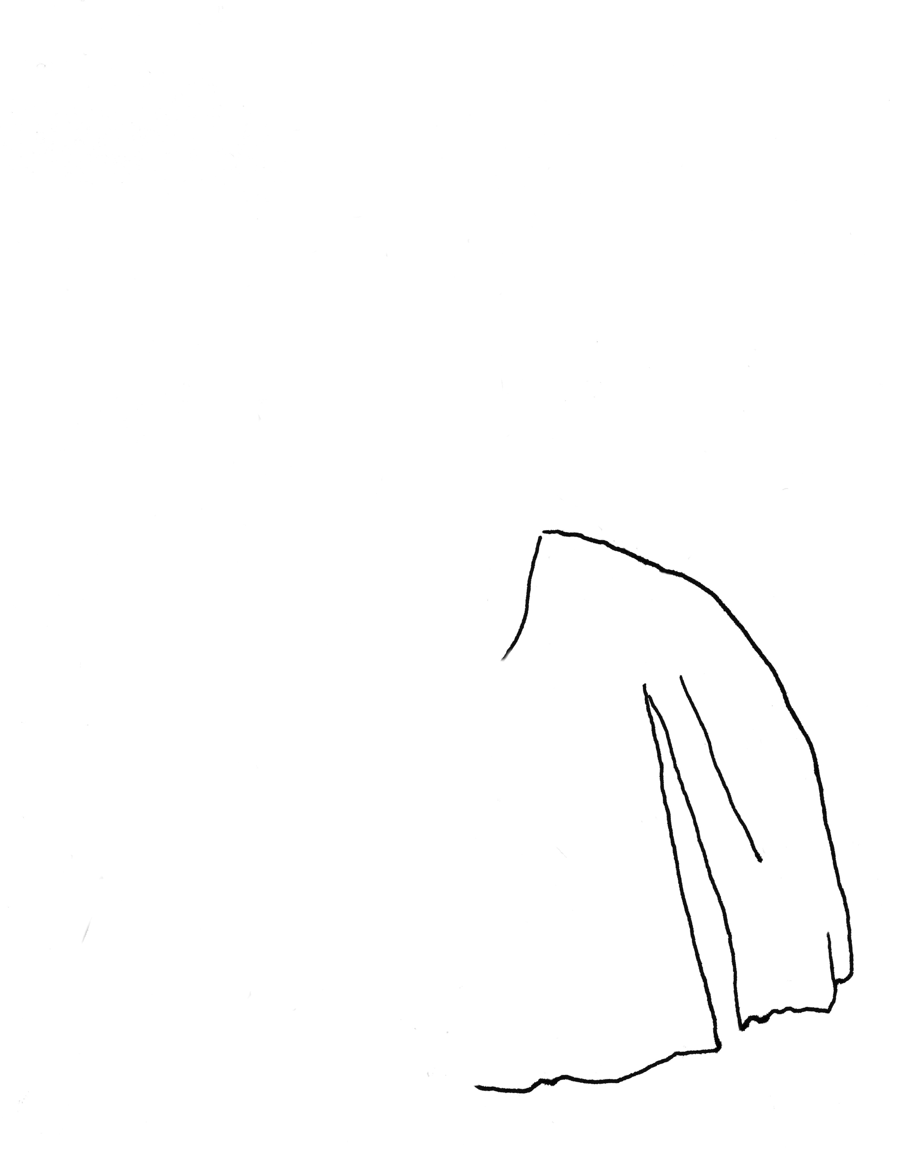
What is it? How sure are you?
shirt
rocky hill
cave
girl
old tent
fountain
exclude, unlikely, possible, likely, DECISION
(“ohne Titel” by Christiane Schmidt)
Decision making 5.8

Slide 9
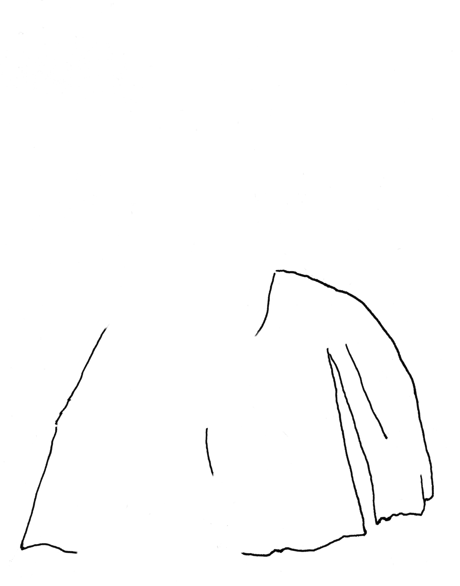
5.10
What is it? How sure are you?
shirt
rocky hill
cave
girl
old tent
fountain
exclude, unlikely, possible, likely, DECISION
(“ohne Titel” by Christiane Schmidt)
Decision making 5.9

Slide 10
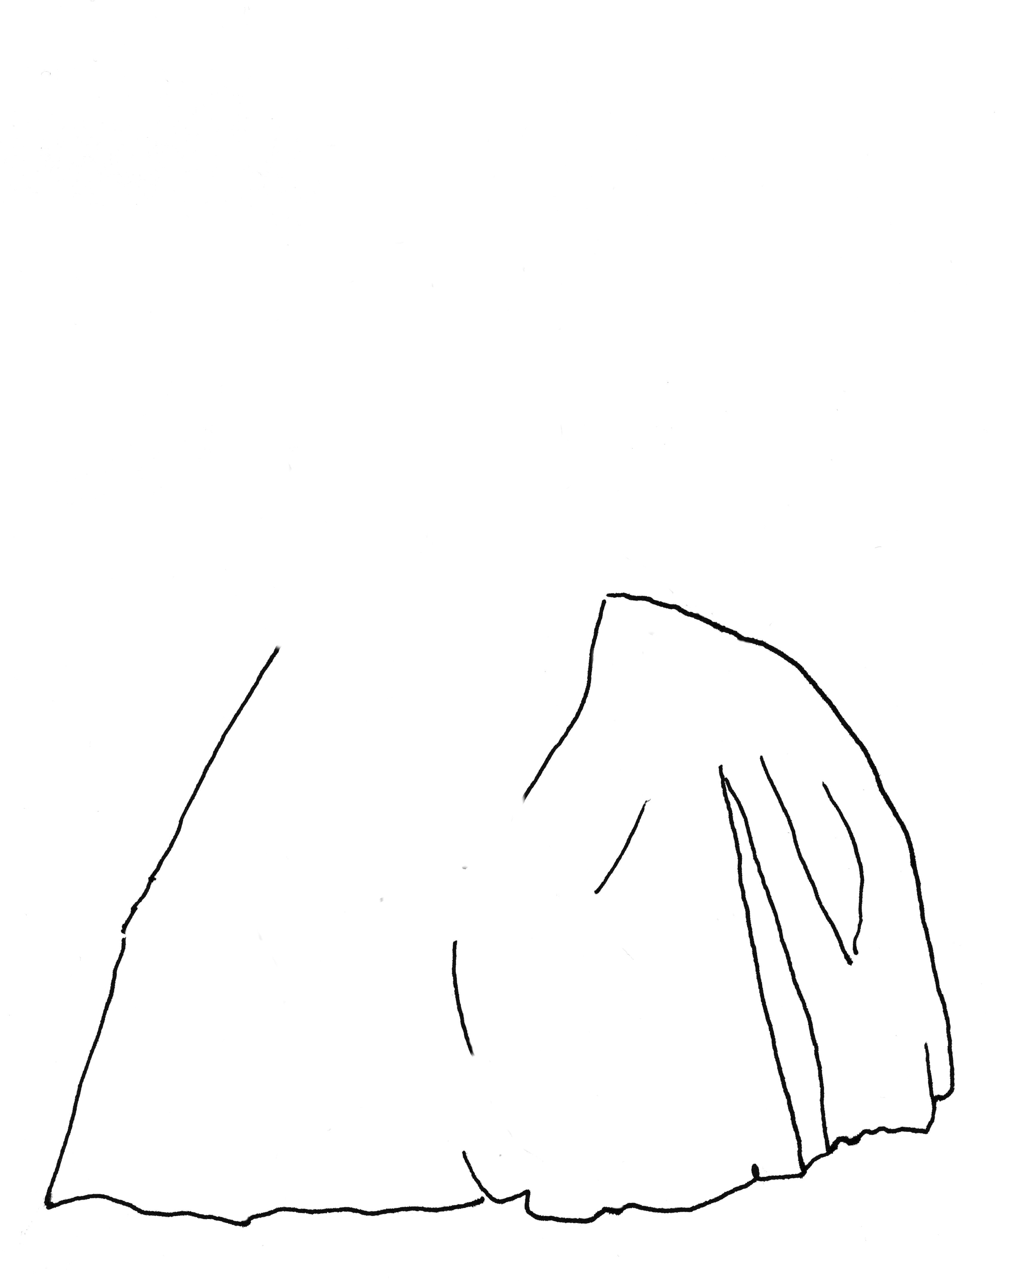
What is it? How sure are you?
shirt
rocky hill
cave
girl
old tent
fountain
exclude, unlikely, possible, likely, DECISION
(“ohne Titel” by Christiane Schmidt)
Decision making 5.10

Slide 11
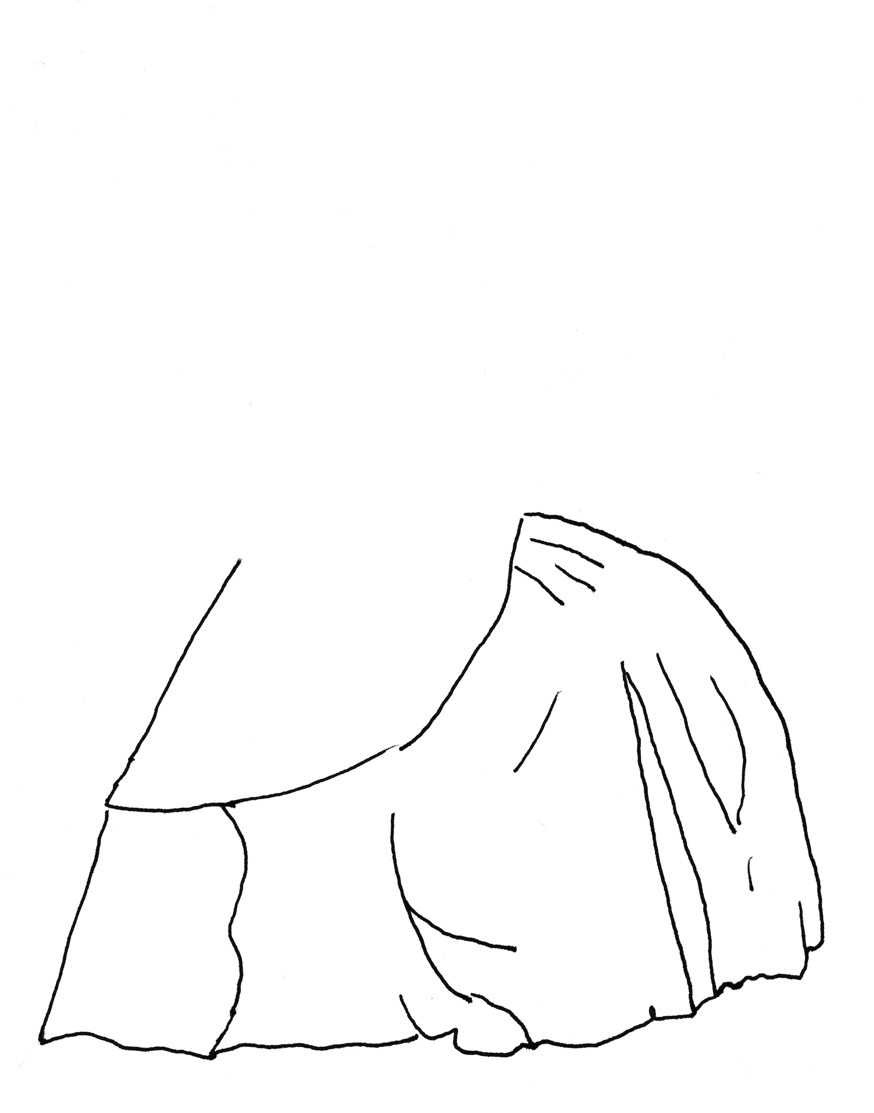
What is it? How sure are you?
shirt
rocky hill
cave
girl
old tent
fountain
exclude, unlikely, possible, likely, DECISION
(“ohne Titel” by Christiane Schmidt)
Decision making 5.11

Slide 12

What is it? How sure are you?
shirt
rocky hill
cave
girl
old tent
fountain
exclude, unlikely, possible, likely, DECISION
(“ohne Titel” by Christiane Schmidt)
Decision making 5.12

Slide 13

What is it? How sure are you?
shirt
rocky hill
cave
girl
old tent
fountain
exclude, unlikely, possible, likely, DECISION
(“ohne Titel” by Christiane Schmidt)
Decision making 5.13

Slide 14
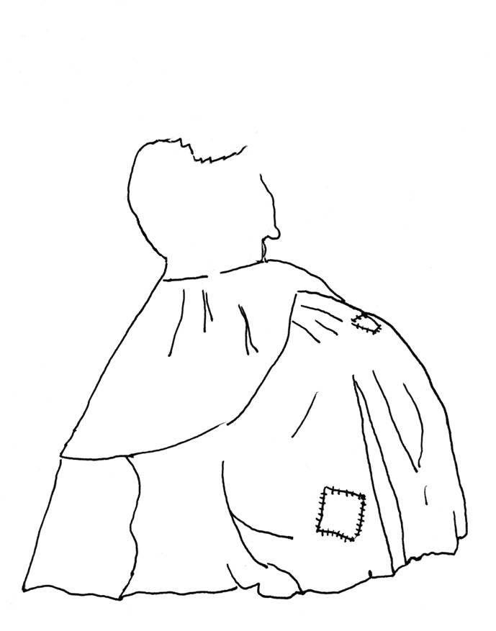
What is it? How sure are you?
shirt
rocky hill
cave
girl
old tent
fountain
exclude, unlikely, possible, likely, DECISION
(“ohne Titel” by Christiane Schmidt)
Decision making 5.14

Slide 15

What is it? How sure are you?
shirt
rocky hill
cave
girl
old tent
fountain
exclude, unlikely, possible, likely, DECISION
(“ohne Titel” by Christiane Schmidt)
Decision making 5.15

Slide 16
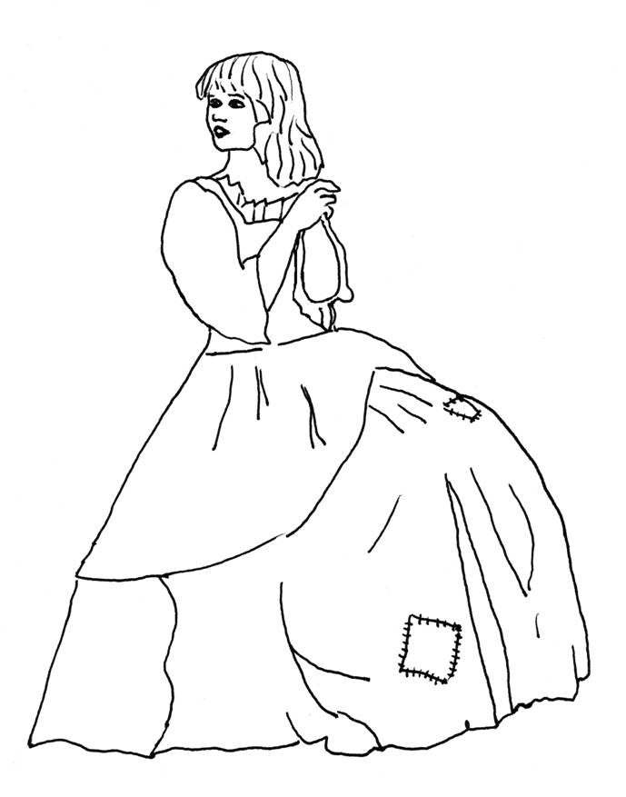
Hasty decisions can lead to mistakes
shirt
rocky hill
cave
girl
old tent
fountain
exclude, unlikely, possible, likely, DECISION
(“ohne Titel” by Christiane Schmidt)
Decision making 5.16

Slide 17
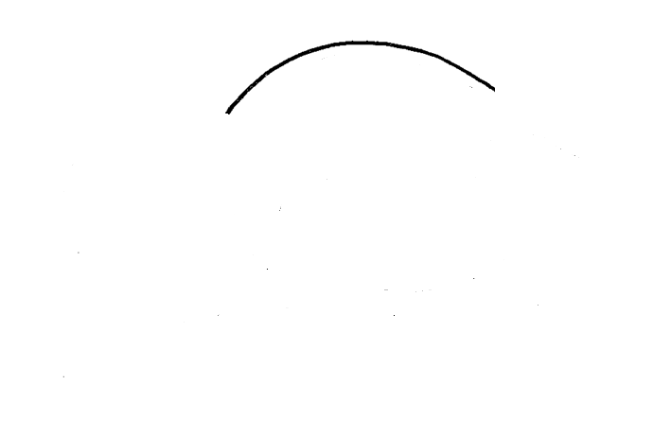
What is it? How sure are you?
lemon
turtle
sea shell
nut
colour palette
mouth
exclude, unlikely, possible, likely, DECISION
(“ohne Titel” by Heike Platow and Karen Riedesel)
Decision making 5.17

Slide 18
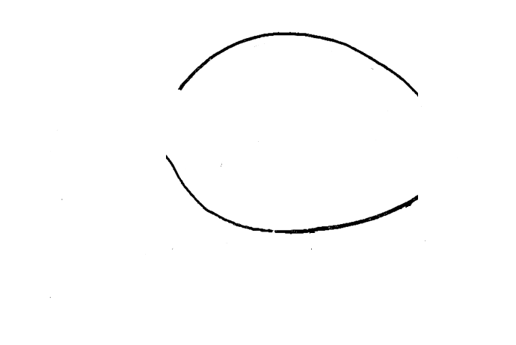
What is it? How sure are you?
lemon
turtle
sea shell
nut
colour palette
mouth
exclude, unlikely, possible, likely, DECISION
(“ohne Titel” by Heike Platow and Karen Riedesel)
Decision making 5.18

Slide 19
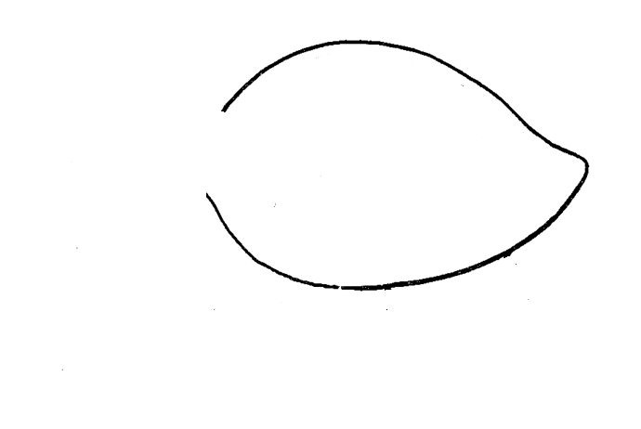
What is it? How sure are you?
lemon
turtle
sea shell
nut
colour palette
mouth
exclude, unlikely, possible, likely, DECISION
(“ohne Titel” by Heike Platow and Karen Riedesel)
Decision making 5.19

Slide 20
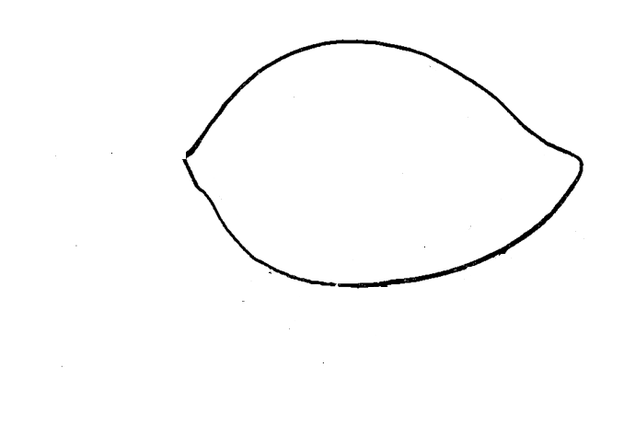
What is it? How sure are you?
lemon
turtle
sea shell
nut
colour palette
mouth
exclude, unlikely, possible, likely, DECISION
(“ohne Titel” by Heike Platow and Karen Riedesel)
Decision making 5.20

Slide 21
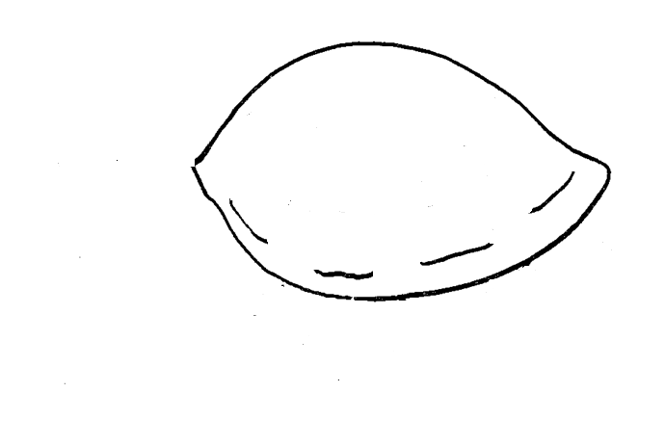
What is it? How sure are you?
lemon
turtle
sea shell
nut
colour palette
mouth
exclude, unlikely, possible, likely, DECISION
(“ohne Titel” by Heike Platow and Karen Riedesel)
Decision making 5.21

Slide 22
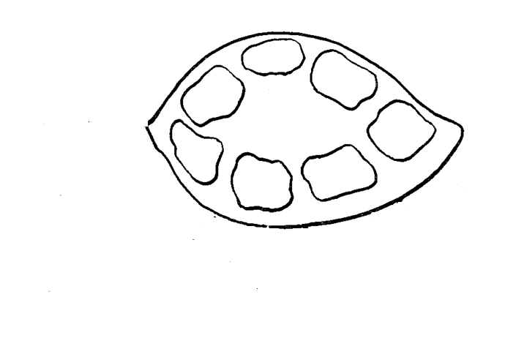
What is it? How sure are you?
lemon
turtle
sea shell
nut
colour palette
mouth
exclude, unlikely, possible, likely, DECISION
(“ohne Titel” by Heike Platow and Karen Riedesel)
Decision making 5.22

Slide 23
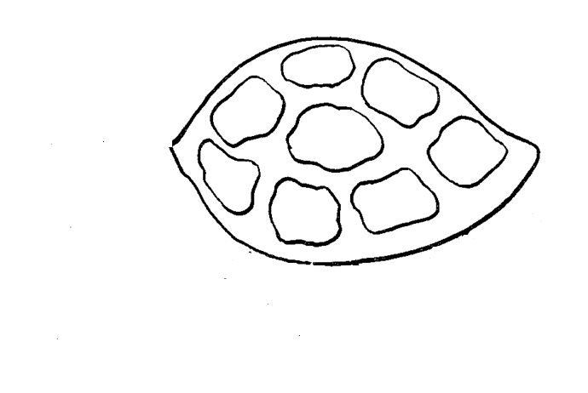
What is it? How sure are you?
lemon
turtle
sea shell
nut
colour palette
mouth
exclude, unlikely, possible, likely, DECISION
(“ohne Titel” by Heike Platow and Karen Riedesel)
Decision making 5.23

Slide 24
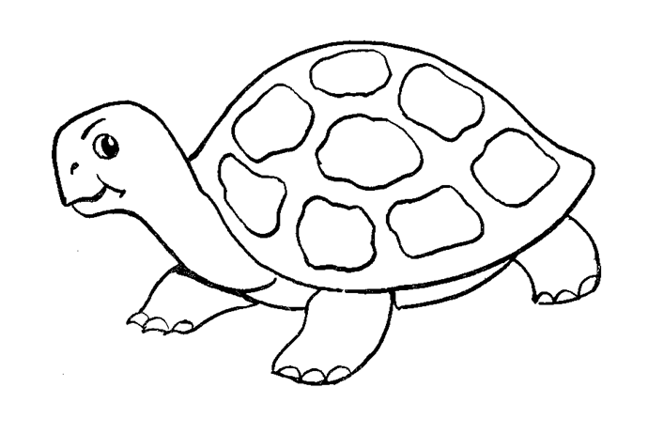
Hasty decisions can lead to mistakes
lemon
turtle
sea shell
nut
colour palette
mouth
exclude, unlikely, possible, likely, DECISION
(“ohne Titel” by Heike Platow and Karen Riedesel)
Decision making 5.24

Slide 25

What is it? How sure are you?
bottle in wine cellar
stork bringing a baby
balloon
Santa with sack
laboratory
globe
exclude, unlikely, possible, likely, DECISION
(“ohne Titel” by Sarah Riker)
Decision making 5.25

Slide 26

What is it? How sure are you?
bottle in wine cellar
stork bringing a baby
balloon
Santa with sack
laboratory
globe
exclude, unlikely, possible, likely, DECISION
(“ohne Titel” by Sarah Riker)
Decision making 5.26

Slide 27
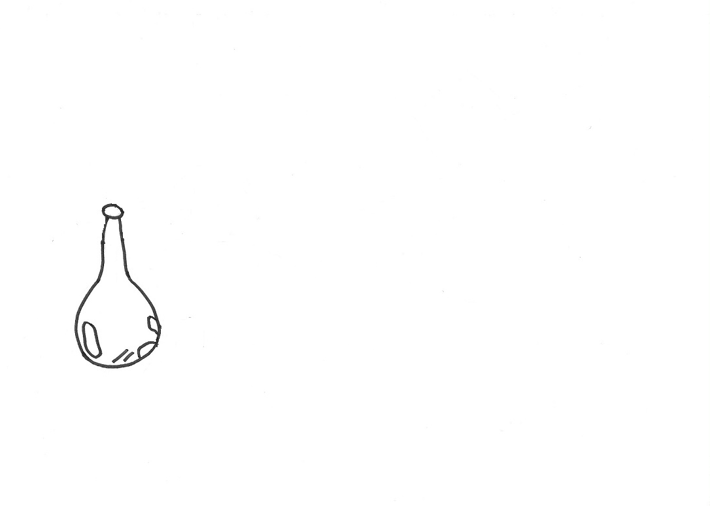
What is it? How sure are you?
bottle in wine cellar
stork bringing a baby
balloon
Santa with sack
laboratory
globe
exclude, unlikely, possible, likely, DECISION
(“ohne Titel” by Sarah Riker)
Decision making 5.27

Slide 28
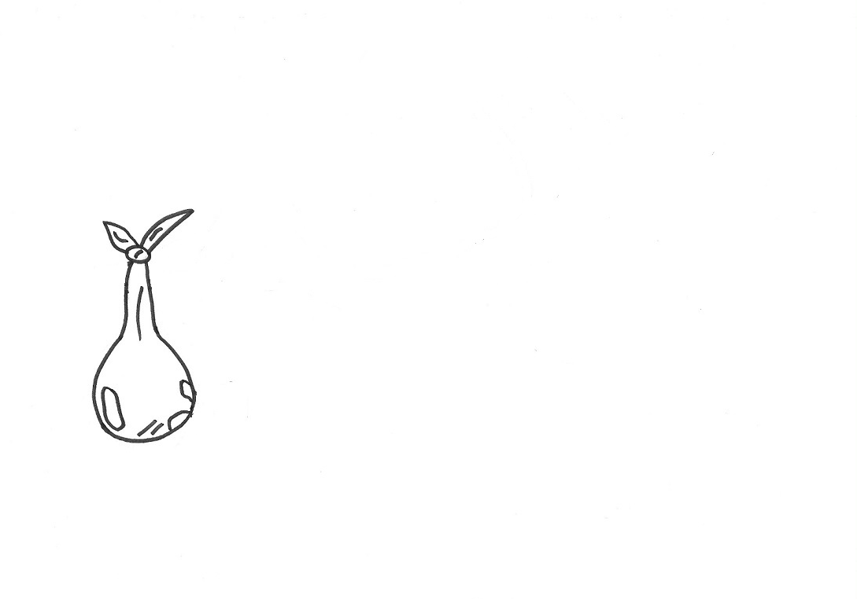
What is it? How sure are you?
bottle in wine cellar
stork bringing a baby
balloon
Santa with sack
laboratory
globe
exclude, unlikely, possible, likely, DECISION
(“ohne Titel” by Sarah Riker)
Decision making 5.28

Slide 29
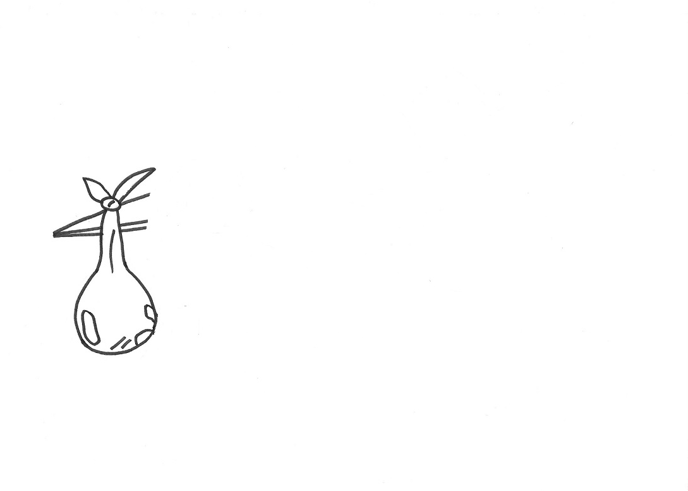
What is it? How sure are you?
bottle in wine cellar
stork bringing a baby
balloon
Santa with sack
laboratory
globe
exclude, unlikely, possible, likely, DECISION
(“ohne Titel” by Sarah Riker)
Decision making 5.29

Slide 30
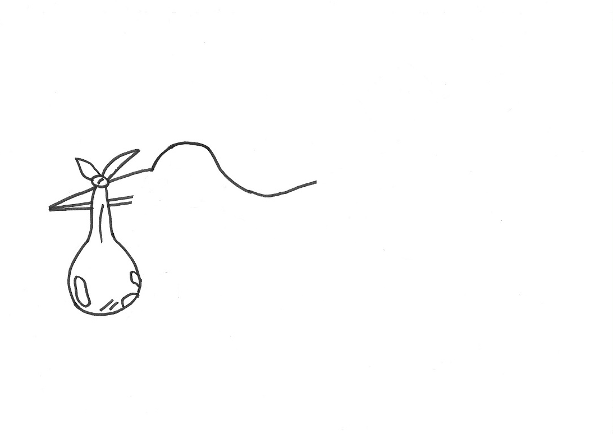
What is it? How sure are you?
bottle in wine cellar
stork bringing a baby
balloon
Santa with sack
laboratory
globe
exclude, unlikely, possible, likely, DECISION
(“ohne Titel” by Sarah Riker)
Decision making 5.30

Slide 31
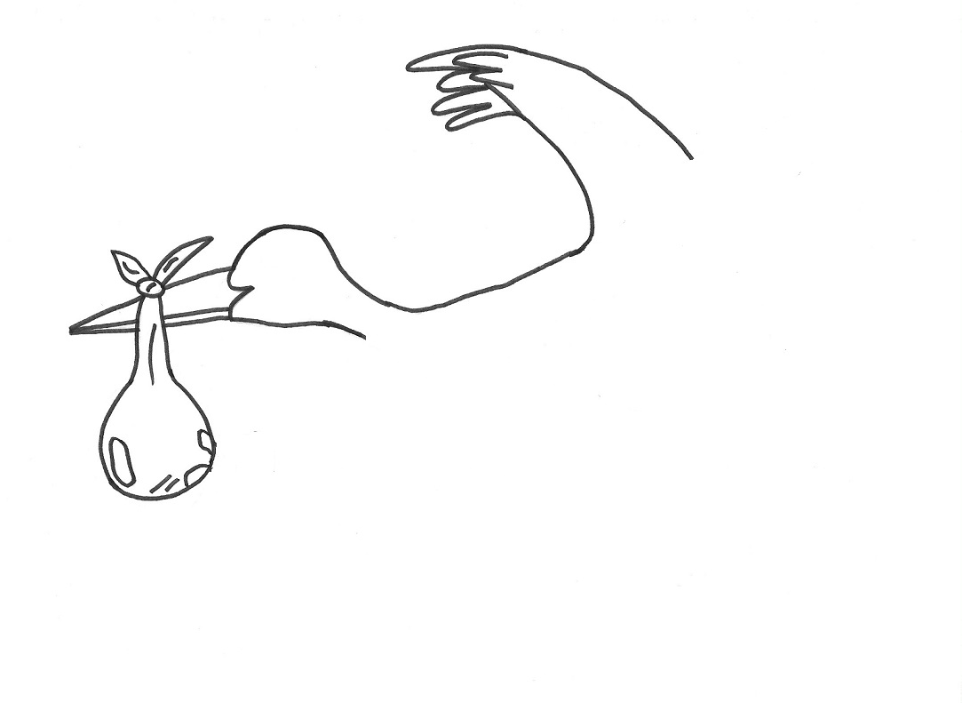
What is it? How sure are you?
bottle in wine cellar
stork bringing a baby
balloon
Santa with sack
laboratory
globe
exclude, unlikely, possible, likely, DECISION
(“ohne Titel” by Sarah Riker)
Decision making 5.31

Slide 32
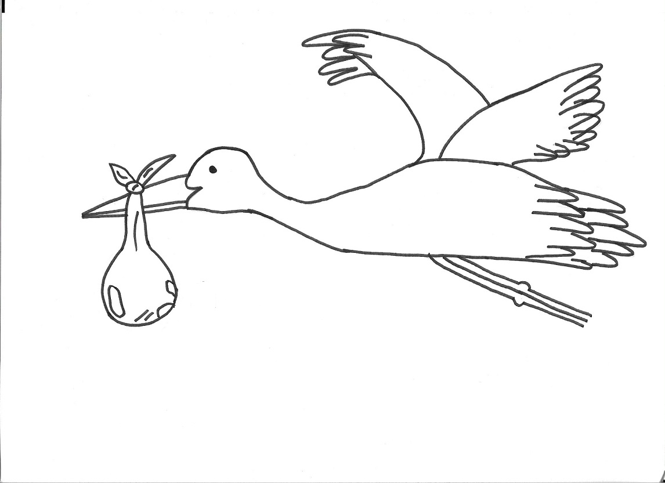
What is it? How sure are you?
bottle in wine cellar
stork bringing a baby
balloon
Santa with sack
laboratory
globe
exclude, unlikely, possible, likely, DECISION
(“ohne Titel” by Sarah Riker)
Decision making 5.32

Slide 33
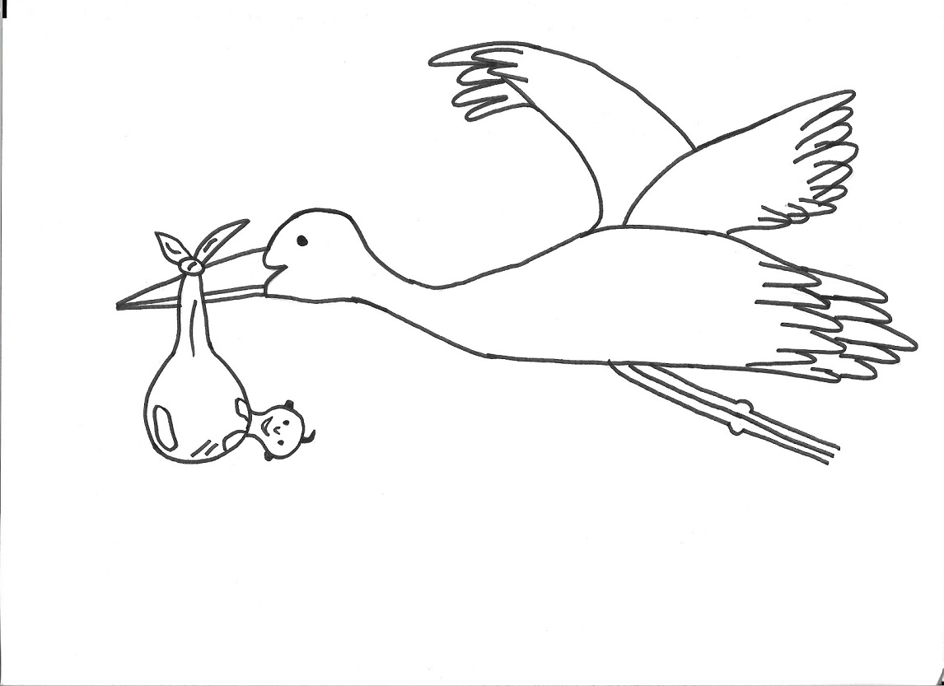
Hasty decisions can lead to mistakes
bottle in wine cellar
stork bringing a baby
balloon
Santa with sack
laboratory
globe
exclude, unlikely, possible, likely, DECISION
(“ohne Titel” by Sarah Riker)
Decision making 5.33

Slide 34
Task 2
In the following task, please try to identify the correct title of a painting and rule out the “misfits”.
Consider the pros and cons for each of the interpretations. Pay special attention to features that clearly rule out one interpretation.
Decision making 5.34

Slide 35

What is the correct title? How sure are you?
Confession of adultery
Courtship
Announcement of a relative’s death
The flower seller
Decision making 5.35

Slide 36
Confession of adultery
Courtship (Karl Zewy, 1896)
Announcement of a relative’s death
The flower seller
Decision making 5.36

Slide 37
The woman’s facial expression is flirtatious rather than furious or sad, which speaks against alternative a “Confession of adultery” (a).
The man has brought her a gift (flower) and is in a devotional posture looking shyly at the floor. This is evidence for the correct title “Courtship” (b).
The woman’s facial expression is scarcely scared. This also speaks against the interpretation “Announcement of a relative’s death” (c).
A flower seller would normally not make house calls, and certainly not with only one flower. This is evidence against the alternative answer “The flower seller” (d).
Decision making 5.37

Slide 38
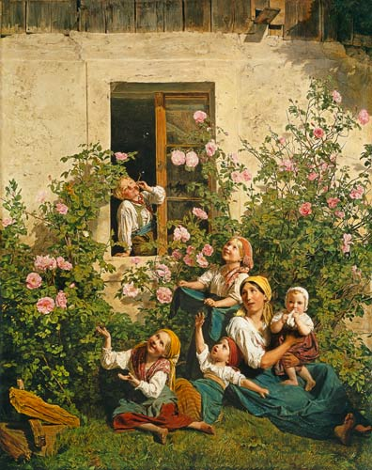
What is the correct title? How sure are you?
Rose garden
Family photo
Children blowing bubbles
Father comes home
Decision making 5.38

Slide 39
Rose garden
Family photo
Children blowing bubbles (Ferdinand Georg Waldmüller 1842)
Father comes home
Decision making 5.39

Slide 40
Though roses can be seen, they are not the focal point of the painting. This speaks against (a).
This is a painting from a time when the development of photography was only just beginning. Besides, the depicted people would be looking at the camera and not into space, which speaks against (b).
The boy in the window is blowing bubbles into the air. The other children are looking at them or trying to catch them, which is evidence for the correct title (c).
There are no real clues that the father is coming home, which is evidence against (d).
Decision making 5.40

Slide 41
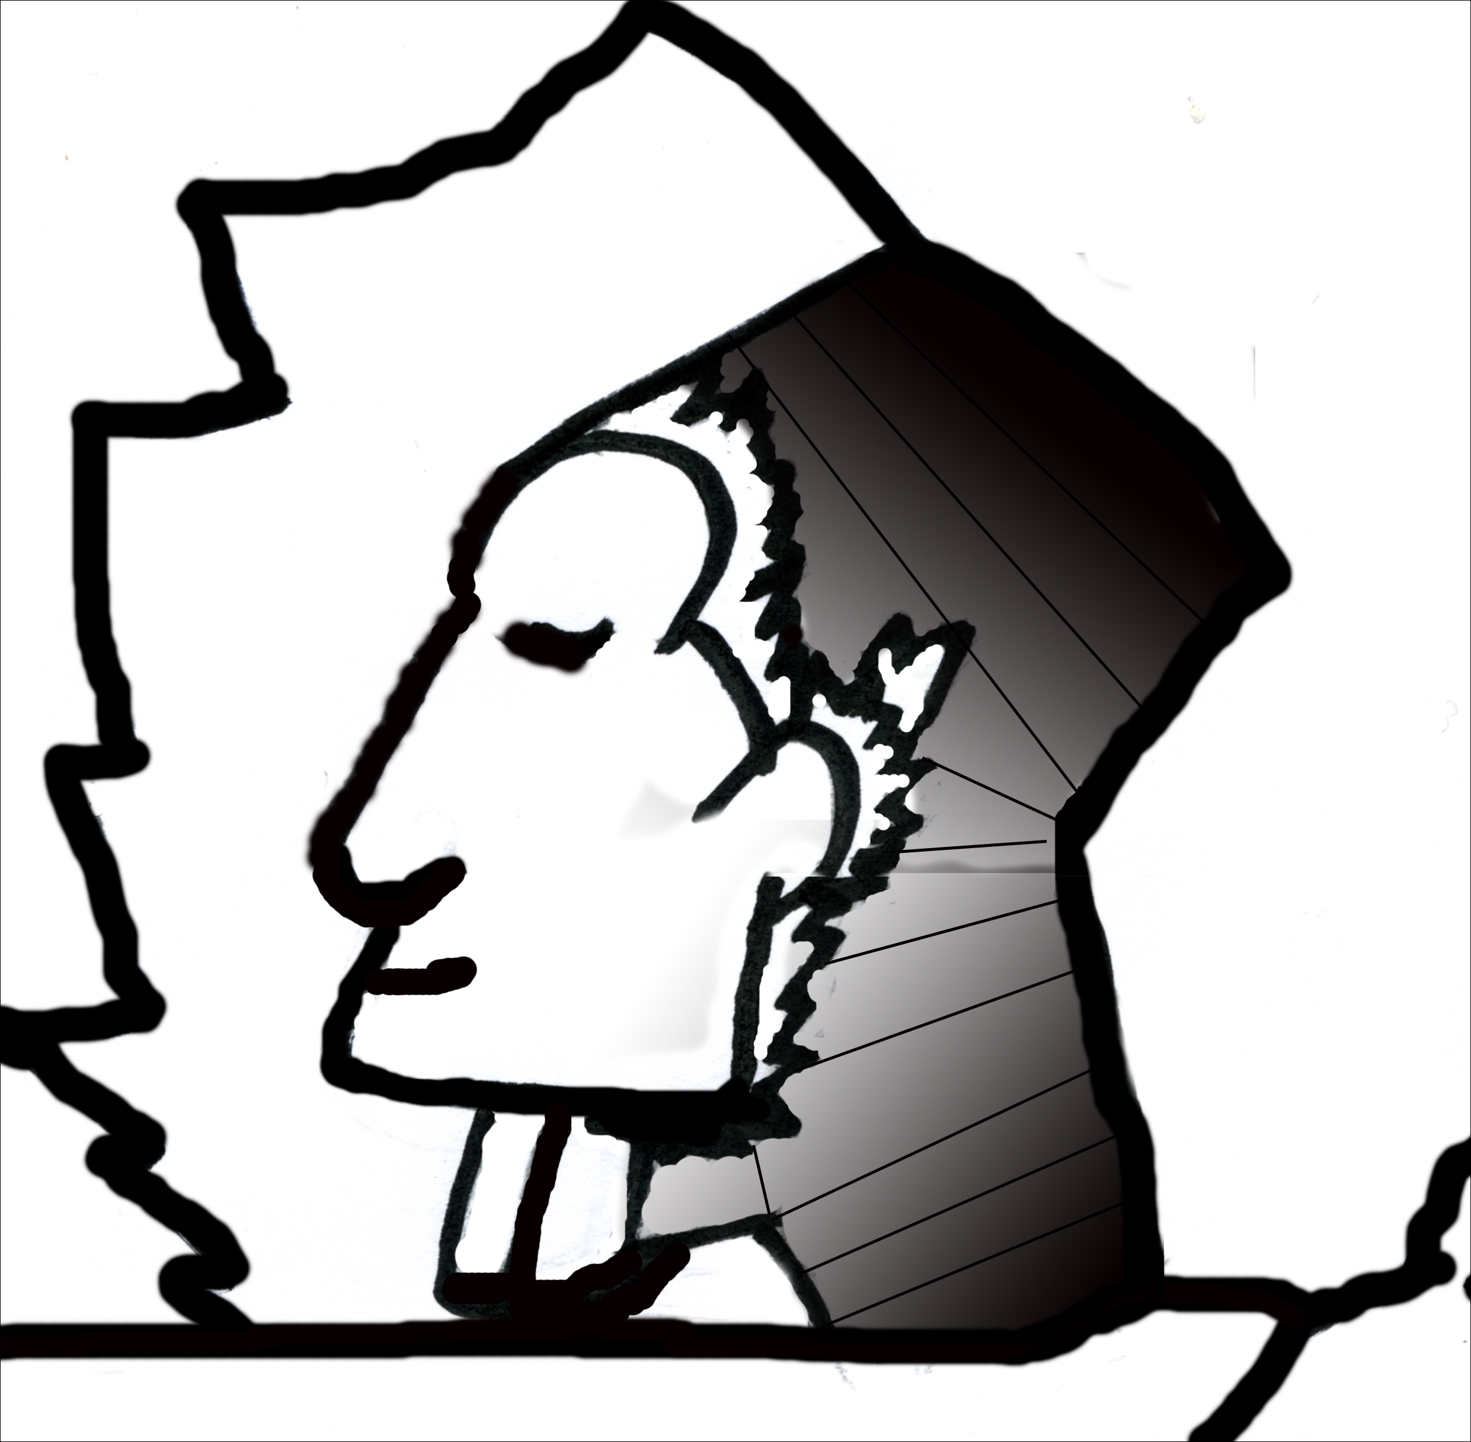
Task 3: What do you see?
Decision making 5.41

Slide 42
Hasty decisions do not always lead to errors
but sometimes tell only half the story!
Pharaoh
Eskimo
(“Pharao” by Nathalie Weß)
Decision making 5.42

Slide 43
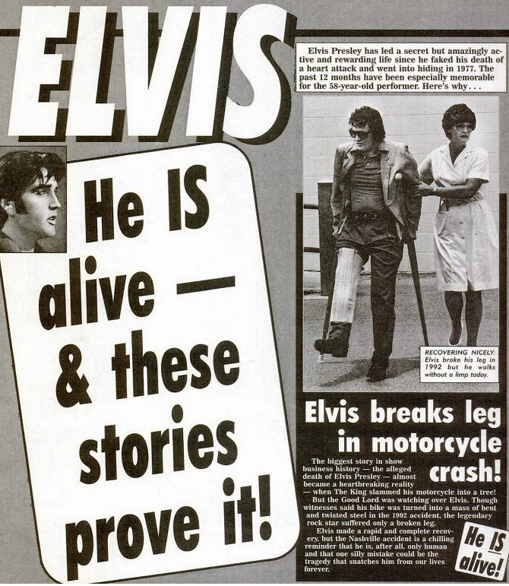
Special ideas in the general public – modern legends
Legend: Elvis Presley is alive!
American newspapers are reporting it:
“Elvis Presley has led a secret but amazingly active and rewarding life since he faked his death of a heart attack and went into hiding in 1977…”
Decision making 5.43

Slide 44
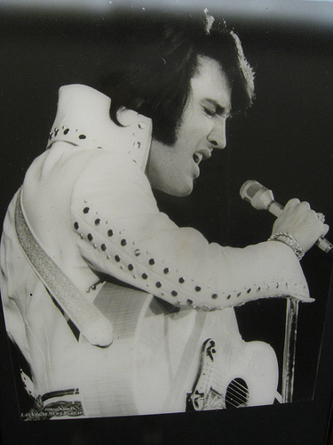
Special ideas in the general public – modern legends
Legend | Evidence for | Evidence against
Elvis lives! | ??? | ???
Decision making 5.44
(f.l.t.r.: “Elvis Presley, Las Vegas Hilton, 1971” by danperry.com)
Notes:
44

Slide 45
Special ideas in the general public – modern legends
Legend | Evidence for | Evidence against
Elvis lives! | His life insurance has never been payed out. The funeral took place only a day after his death. Fans were not invited. Fans saw a picture of the dead body in a magazine which did not look like the “King”. Elvis’ name was “Elvis Aron Presley“, the tombstone, however, reads Aaron. Many people reported to have seen Elvis after his death. | He never took out life insurance. A ceremony was held at Graceland where he was buried a week after. Elvis is said to have been vain. He probably didn’t want to show himself in his condition and therefore might have been wearing make-up when he was still alive. It is said that he wanted to change his name some day (to “Aaron”). It could never be proven that the sightings really were Elvis.
Decision making 5.45
(f.l.t.r.: “Elvis Presley, Las Vegas Hilton, 1971” by danperry.com)
Notes:
45

Slide 46
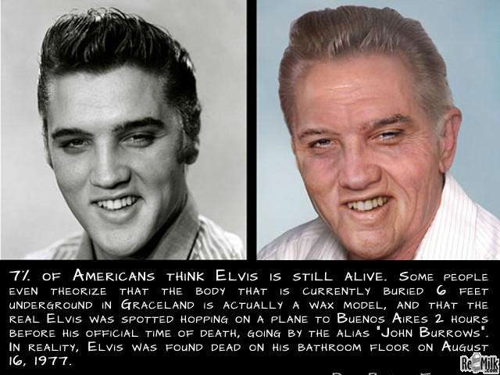
Special ideas in the general public – modern legends
Is Elvis alive and was his death just a fake?
No!
No!
According to a study in Germany with 1143 respondents, 72% know this legend and 9.45% still believe it!
How did this modern legend and other conspiracy theories arise?
Decision making 5.46

Slide 47
How did this modern legend and other conspiracy theories arise?
Legends are often more thrilling than reality!
Popular newspapers sell well if they produce “scandalous reports”. Can you think of a recent example?
Legends are based on statements that are difficult to fact check or prove (e.g. that the dead body didn’t resemble the “real” Elvis), which some people readily believe.
They conceal alternative explanations (e.g. that Elvis’ middle name had often been misspelled Aa during his lifetime).
Legends are sometimes based on facts that are taken out of context and thus largely exaggerate their significance. Elvis’ manager’s statement: “Elvis isn’t dead, only his body. I talked to him today and he was fine...” was interpreted as if he were still alive. The sentence could also mean that indeed is body is dead, but not his music, and he lives on in our hearts.
Often, such legends arise due to the fact that they create a strong bond between a group of people; for example, there are fan communities that yearn for proof that their King is still alive.
Decision making 5.47

Slide 48
How well known are conspiracy theories and how many people in the general population believe them?
Conspiracy theory | Familiarity in 1143 respondents (in %) | Agreement (in %)
In the Bermuda Triangle, a disproportionate number of ships/planes mysteriously disappear | ??? | ???
The moon landing in 1969 was staged by the NASA | ??? | ???
Lady Di was murdered | ??? | ???
On 1-dollar notes there is evidence for an infiltration of the US Federal Reserve by secret societies. | ??? | ???
Decision making 5.48

Slide 49
How well known are conspiracy theories and how many people in the general population believe them?
Conspiracy theory | Familiarity in 1143 respondents (in %) | Agreement (in %)
In the Bermuda Triangle, a disproportionate number of ships/planes mysteriously disappear | 98.2% | 44.6%
The moon landing in 1969 was staged by the NASA | 92.7% | 26.7%
Lady Di was murdered | 93.3% | 31.1%
On 1-dollar notes there is evidence for an infiltration of the US Federal Reserve by secret societies. | 71.0% | 21.3%
This online-survey by Sebastian Bartoschek only dealt with those conspiracy theories that were officially resolved. According to current knowledge, there is no sufficient proof supporting these theories.
Decision making 5.49

Slide 50
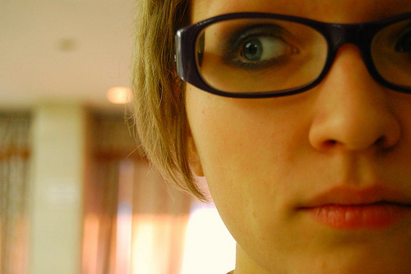
Bullying/Conspiracy?
Example: In the morning, Marina enters the office and her boss does not greet her as usual. The week before, a colleague acted coldly towards her. Due to these incidents, Marina withdraws herself from her colleagues (e.g. no lunch together). She assumes that she will slowly but surely be elbowed out of the company.
Is there sufficient evidence to assume bullying?
What are other possible explanations for the behaviour shown by Marina’s boss and colleagues?
(“paranoid” by ulisseya)
Decision making 5.50

Slide 51
What speaks for and against Marina’s convictions?
Collect pros and cons for Marina’s conviction!
What if… (consequences)?
→ worksheet
5.2 a, b
(“paranoid” by ulisseya)
Decision making 5.51

Slide 52
What if…?
Convictions and their consequences
Assumption Reality | Marina is being bullied by her colleagues. | Marina is not being bullied by her colleagues.
Marina is being bullied by her colleagues. | There are good reasons for Marina’s worries and she should approach her union or work council with her concern. | Marina trusts people blindly. Without her noticing, people harm her and talk behind her back. Hopefully it is not too late to contact the work council or a lawyer for employment law.
Marina is not being bullied by her colleagues. | Marina is mistakenly blaming others. Her performance at work suffers due to her worries, anger and resentment. Her suspicious attitude has now evoked the distrust of the others. | Everything’s fine!
(“paranoid” by ulisseya)
Decision making 5.52

Slide 53
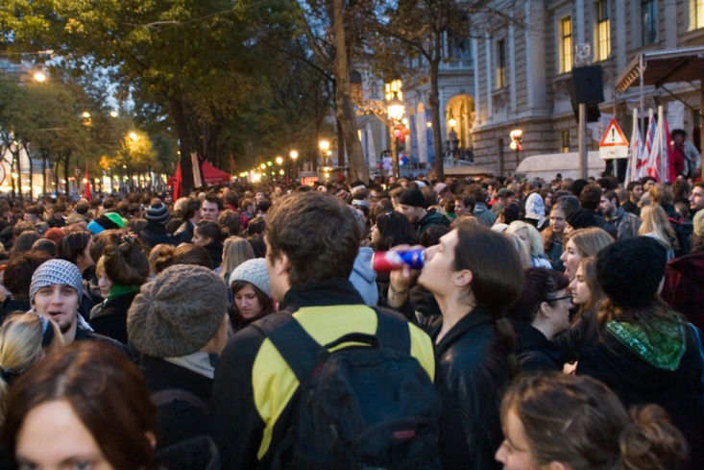
Being investigated?
Schlussfolgern
5.31
Example: Gary is an active environmentalist. He attended a demonstration at which the police and media were present. During the course of the demonstration, riots broke out between police and protesters. Gary went home before the police started arresting some of the protesters. Later, the evening news showed pictures of the demonstration and Gary recognises himself in the crowd. Because his picture was shown, Gary infers that he is being investigated as a public enemy.
Is the evidence sufficient to assume future allegations?
How could Gary’s pictures on television be explained?
(“Uni brennt Demonstration Wien” by ketu)
Decision making 5.53

Slide 54

What speaks for and against Gary’s conviction?
Collect pros and cons for Gary’s conviction!
What if… (consequences)?
→ worksheet
5.3 a, b
(“Uni brennt Demonstration Wien” by ketu)
Decision making 5.54

Slide 55
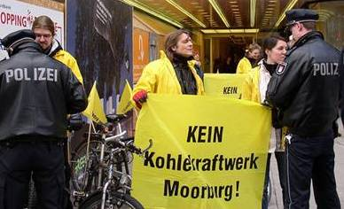
What if…?
Convictions and their consequences
Assumption Reality | Gary was filmed and is being investigated. | The protests were filmed but he is not being investigated.
Gary was filmed and is being investigated. | Gary has good reasons to be worried. He should hire a lawyer who will settle this for him. On the other hand he just exercised his basic democratic rights. | Gary may be too naive. If he is to be accused, he can hire a good lawyer – he actually did nothing wrong but just made use of his right to demonstrate.
The protests were filmed but he is not being investigated. | Gary is worried without any reasons. He spends a lot of money in vain for a lawyer and safety procedures (e.g. new door locks). He neglects important things in his life (e.g. contact with friends, his job). | Everything’s fine!
(“Vor Vattenfall #2” by Rainer Zimmermann)
Decision making 5.55
Notes:
55

Slide 56
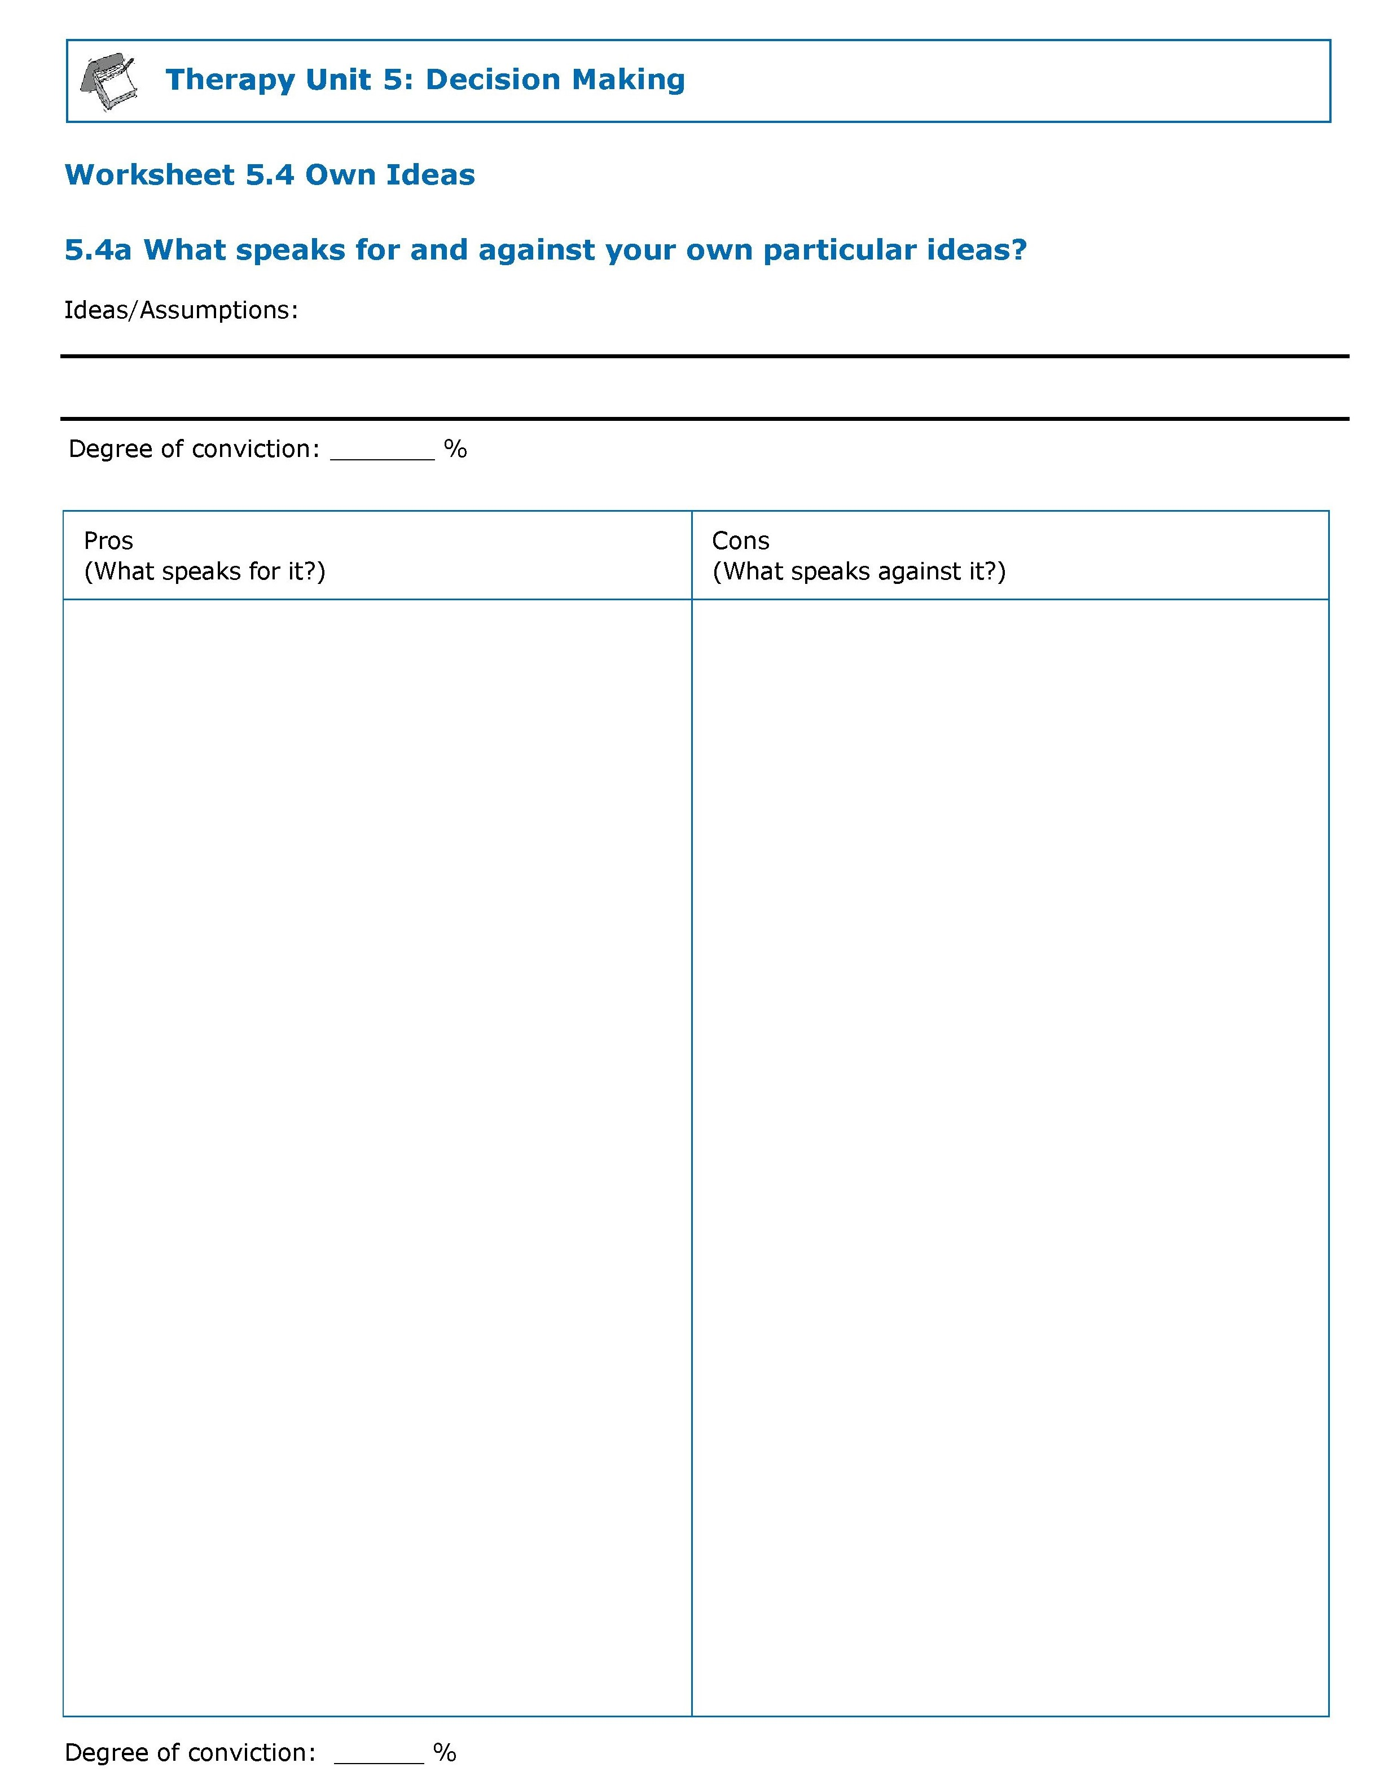
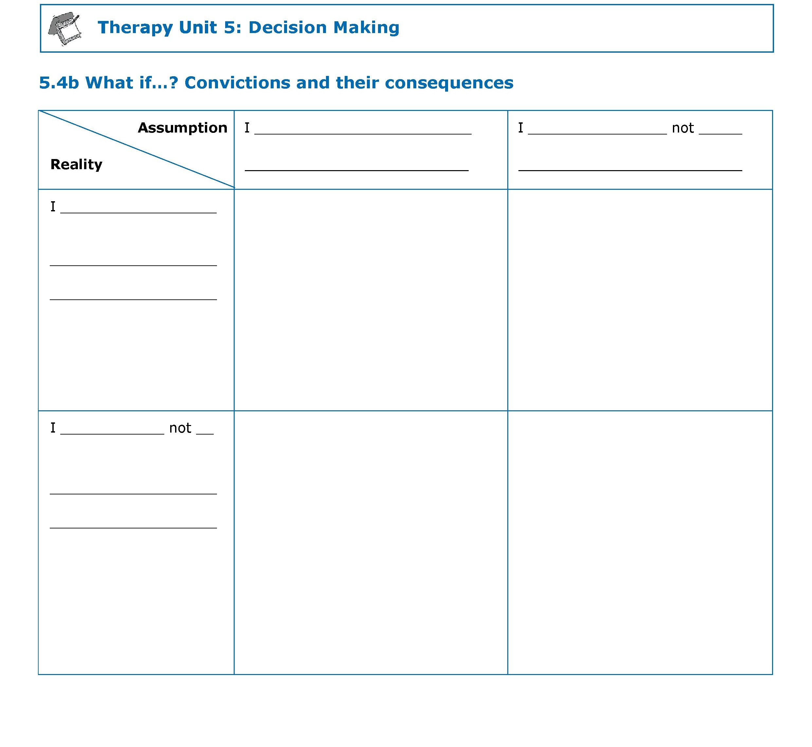
What speaks for and against your special ideas?
What if…?
Pros & cons
Convictions and their consequences
worksheet
worksheet
→ worksheet
5.4 a, b
Decision making 5.56

Slide 57

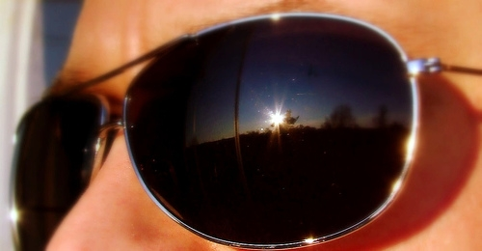
Negative consequences of false convictions: avoidance and safety behaviours
Avoidance and safety behaviours: What is it?
(f.l.t.r.: “road trip day three~ a squircle grows in little five points” by striatic; “Sunglasses” by Marcus Vegas)
Decision making 5.57

Slide 58
Negative consequences of false convictions: avoidance and safety behaviours
Avoidance
Defined as actively avoiding situations, people, or places that are perceived as threatening (e.g. avoiding demonstrations, police officers, or public places due to fear of surveillance). In extreme cases, an affected person may not even leave the house and break off all social contacts.
Safety behaviours
Defined as actions carried out in order to prevent feared events from happening (e.g. covering up, using lucky charms).
Even though avoidance and safety behaviours can reduce fear for the short-term, in the long run they might even promote fear by installing the idea that the behaviour prevented harm… even though the situation would not have been harmful anyway!
(f.t.t.b.: “road trip day three~ a squircle grows in little five points” by striatic; “Sunglasses” by Marcus Vegas)
Decision making 5.58

Slide 59
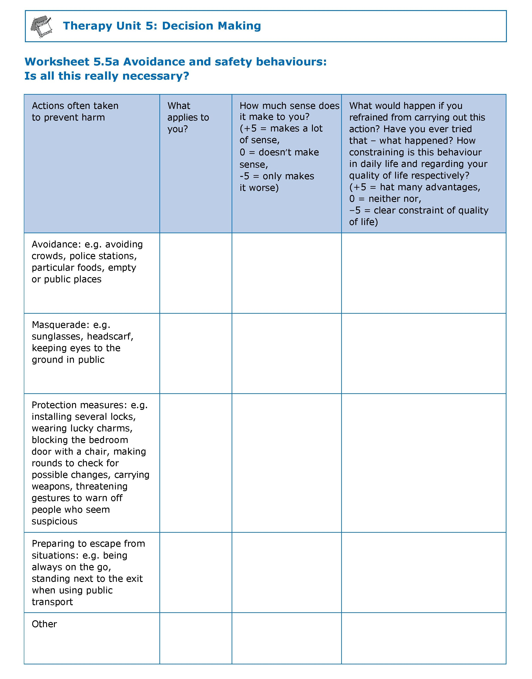
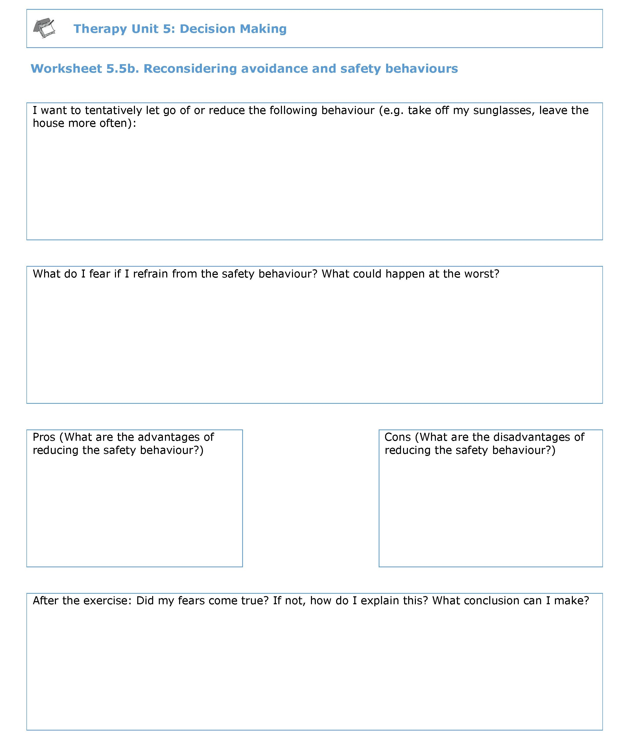
Is this all really necessary?
worksheet
worksheet
→ worksheet
5.5 a & 5.5 b
Decision making 5.59

Slide 60
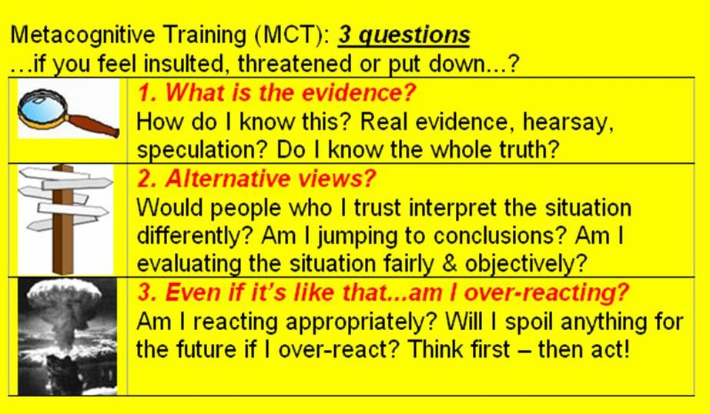
Schlussfolgern
5.39
Whenever you feel insulted/threatened:
Ask yourself the three questions on the yellow card
(U.S. Army/ U.S federal government)
Decision making 5.60

Slide 61
Application to everyday life
Learning objectives:
Quick decisions often lead to mistakes and only “half the truth” is perceived.
Therefore, look for as much information as possible and exchange views with others – especially if decisions involve strong emotions or important actions (e.g. don’t attack your neighbours if you have the feeling that they are after you).
Evaluate the pros and cons of your assumptions und and reconsider whether there might be other possible explanations.
For events of minor importance, one should decide quickly (e.g. choosing a yoghurt brand or a type of desert to order, picking lottery numbers).
“Everyone makes mistakes” – be prepared for the possibility that you are wrong.
Decision making 5.61

Slide 62
What does this have to do with psychosis?
Many (but not all!) people with psychosis tend to jump to conclusions and form extreme opinions, without having collected sufficient information. This can contribute to the formation of incorrect convictions.
Before making important decisions you should consider many pieces of information and discuss a variety of explanations and opinions with people you trust.
What aspects of the therapy unit Decision Making do I find particularly useful or helpful?
When and in what specific situation could I apply what I learned in the near future? What could it help me with (e.g. to feel less tense)?
→ worksheet 5.6
Decision making 5.62

Slide 63
What does this have to do with psychosis?
Example: Thomas feels persecuted by the secret service. He is about to pack up his things and go into hiding.
Background: The last time he went for a walk a black Mercedes slowly passed him and he had the impression that the driver looked evilly in his direction.
But: It was an angry driver from another town who got lost and was trying to find his way by looking intently at street names and house numbers.
Decision making 5.63

