Slide 1
THERAPY UNIT 6:
CHANGING BELIEFS
Metacognitive Therapy

Slide 2
Changing one’s own point of view
Humans tend to stick with first impressions (e.g.: prejudice, “the first impression is the only impression” - attitude).
Reasons: ???; “confirmation bias” (you only see what you want to see); thoughtlessness; simple “truths” facilitate orientation/view of the world; pride
Problems: ???
Changing beliefs 6.2

Slide 3
Changing one’s own point of view
Humans tend to stick with first impressions (e.g.: prejudice, “the first impression is the only impression” - attitude).
Reasons: laziness; “confirmation bias” (you only see what you want to see); thoughtlessness; simple “truths” facilitate orientation/view of the world; pride
Problems: false judgements (→ prejudices) persist; false overgeneralization (“seen one – seen them all”); someone who might have deserved it is not granted a second chance
Changing beliefs 6.3

Slide 4
Why are we doing this?
Studies show that many (but not all!) people with psychosis continue to cling to their opinion or belief about an event, even when confronted with information that speaks against this belief.
This may lead to interpersonal problems and may obstruct a realistic appraisal of situations.
Changing beliefs 6.4

Slide 5

6.5
Inflexibility in the general public
(“tunnel-vision”)
Field | Example
Society | Many people are convinced that women are inferior drivers, even though according to statistics, women cause fewer or at least not more accidents than men.
Environmental protection | Agents of big industries and several governments deny that human activity contributes to climate change (e.g. due to greenhouse effect), even though part I of the UN climate report 2014 as well as almost every expert in this field have affirmed human responsibility for climate change.
Psychosis | Fixed belief in false or biased convictions (e.g. being chosen for a higher lot) despite challenging arguments against these beliefs.
(“getting ready for work” by Paul Keleher)
Changing beliefs 6.5

Slide 6
Korrigierbarkeit
Medication for psychosis
Frequent prejudices and false beliefs
6.6
Statements: | Counterarguments:
To take psychotropic drugs means that I am weak and not normal. | ???
The side effects of antipsychotics (formerly: neuroleptics; e.g. Haldol, Risperidon) are very strong compared to small benefit, so that taking them is not worth it. | ???
Antipsychotics should only be taken episodically, e.g. when symptoms become acute. | ???
Antipsychotic medications cause dependency! | ???
All antipsychotics actually have the same effect. If one doesn’t help, others won’t either. | ???
Changing beliefs 6.6
Notes:
6

Slide 7
Korrigierbarkeit
Medication for psychosis
Frequent prejudices and false beliefs
6.6
Statements: | Counterarguments:
To take psychotropic drugs means that I am weak and not normal. | Many other people also need medication that affect the brain – e.g. for heart problems or Parkinson’s disease.
The side effects of antipsychotics (formerly: neuroleptics; e.g. Haldol, Risperidon) are very strong compared to small benefit, so that taking them is not worth it. | Like all pharmaceuticals, antipsychotics have side effects, some of which can be burdening. But: strong and continuous psychotic symptoms or relapse usually mean a much larger burden. In the case of an intolerance, the doctor can prescribe a different substance.
Antipsychotics should only be taken episodically, e.g. when symptoms become acute. | The effect of antipsychotics is preventive. After the first psychosis, a constant low-dose treatment is recommended for the following 12 months.
Antipsychotic medications cause dependency! | Unlike for example Benzodiazepines (tranquilizer), antipsychotics do not lead to physical dependency.
All antipsychotics actually have the same effect. If one doesn’t help, others won’t either. | Antipsychotics influence different receptor systems in the brain. In case of ineffectiveness of one, a different substance may well be effective.
Changing beliefs 6.7
Notes:
7

Slide 8
Korrigierbarkeit
Frequent prejudices and false beliefs about depot medication
6.8
Statements: | Counterarguments:
The fact that my doctor prescribes me depot medication means that he distrusts me. | ???
It is degrading to get undressed in front of the doctor in order to get an injection. | ???ere are many kinds of physical examinations or vaccinations where it is common to get undressed in front of the doctor. In addition, there are now depot preparations which can be injected into the upper arm.
I’d rather decide for myself what and how much I take! | ???
Changing beliefs 6.8

Slide 9
Frequent prejudices and false beliefs about depot medication
6.8
Statements: | Counterarguments:
The fact that my doctor prescribes me depot medication means that he distrusts me. | The prescription of depot medication is also common in other fields of medicine, as many patients have difficulties with remembering to take meds regularly. Plus, it can be annoying to take pills every day.
It is degrading to get undressed in front of the doctor in order to get an injection. | There are many kinds of physical examinations or vaccinations where it is common to get undressed in front of the doctor. In addition, there are now depot preparations which can be injected into the upper arm.
I’d rather decide for myself what and how much I take! | Neuroleptics should be taken on a regular basis and not be started or stopped on a daily basis. Any change in dose should be made gradually and in consultation with the doctor. Stopping meds for several days can even remove the effect and the protection against relapse.
Changing beliefs 6.9
Notes:
9

Slide 10
These three numbers follow a rule. What is the rule?
Korrigierbarkeit
1 3 5
Suggest the following numbers for the sequence in order to find out the rule. I will confirm or disconfirm your suggestions by answering “yes” or “no”. When you are sure about the rule, present your solution.
Changing beliefs 6.10

Slide 11
Korrigierbarkeit
These three numbers follow a rule. What is the rule?
6.11
Rule: The numbers simply increase!
Possible following numbers:
1 3 5 6 8 21…
Frequent mistake: To only look for information confirming one’s own assumption (supposed rule: numbers progress by twos), but not challenging it. Neither alternative possibilities are taken into account, nor is the assumption critically reviewed (confirmation bias). In the example, the numbers 6 and 8 could have been considered. Unexpectedly, both would have led to a “yes” as well, challenging your hypothesis.
Changing beliefs 6.11

Slide 12
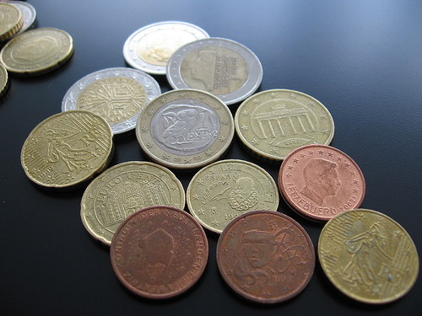

1. According to statistics, the “perceived increase” in prices associated with the introduction of the Euro in Germany was three times as high as the actual increase. This could be due to the fact that some products became disproportionately expensive (e.g. meals at a restaurant) and because general skepticism towards the new currency was high.
Consumers primarily registered those prices which increased, prices that remained stable or decreased were hardly noticed or considered as exceptions.
2. When in a hurry, it seems like all traffic lights turn red and other drivers deliberately slow down just to annoy you.
Seeing what you want or expect to see
(confirmation bias in everyday life)
(“De donde son tus euros?” by Andrea Guerra; “Taxi Ampel rot” by elephanteum)
Changing beliefs 6.12

Slide 13
Korrigierbarkeit
6.13
Seeing what you want or expect to see
(confirmation bias in everyday life)
Random events suddenly seem to be meaningful due to excessive attention. This can lead to anxiety. Examples:
Suspicion: The house could be blasted.
Evidence: Several neighbors are on holiday at the same time. Construction workers ae scarifying the road surface in front of the house.
What is overlooked/ignored? It is the summer holidays and many people are going on vacation. More and more parts of the street surface have been scarified since weeks to renew pipes.
Suspicion: I am being tailed by the CIA.
Evidence: There are black cars standing in front of the house. In films the CIA always drives black cars.
What is overlooked/ignored? There are many black cars in other streets of the neighborhood, as this is just a popular color for a car.
One is virtually couching (in state of alertness) and sees what one wants to see. Do you experience this sometimes or have you experienced this in the past?
Changing beliefs 6.13

Slide 14
Task 1
Three pictures illustrating a scenario will be shown to you, along with various interpretations.
The pictures are shown in reverse order, the final event being shown first.
After a picture is shown, you will be asked to rate the plausibility or likelihood of each of the provided interpretations. These have to be reassessed each time a new picture is revealed for that scenario.
Changing beliefs 6.14

Slide 15

Please rate the probability
3
The men are arguing over a parking space in the shade.
The man is right in telling the other person off for occupying two parking spaces.
The driver of the grey car is wrongly being criticized.
The man in the blue shirt is yelling at the other one because he hit his red car when parking.
(picture story painted by Janne Hottenrott)
Changing beliefs 6.15

Slide 16
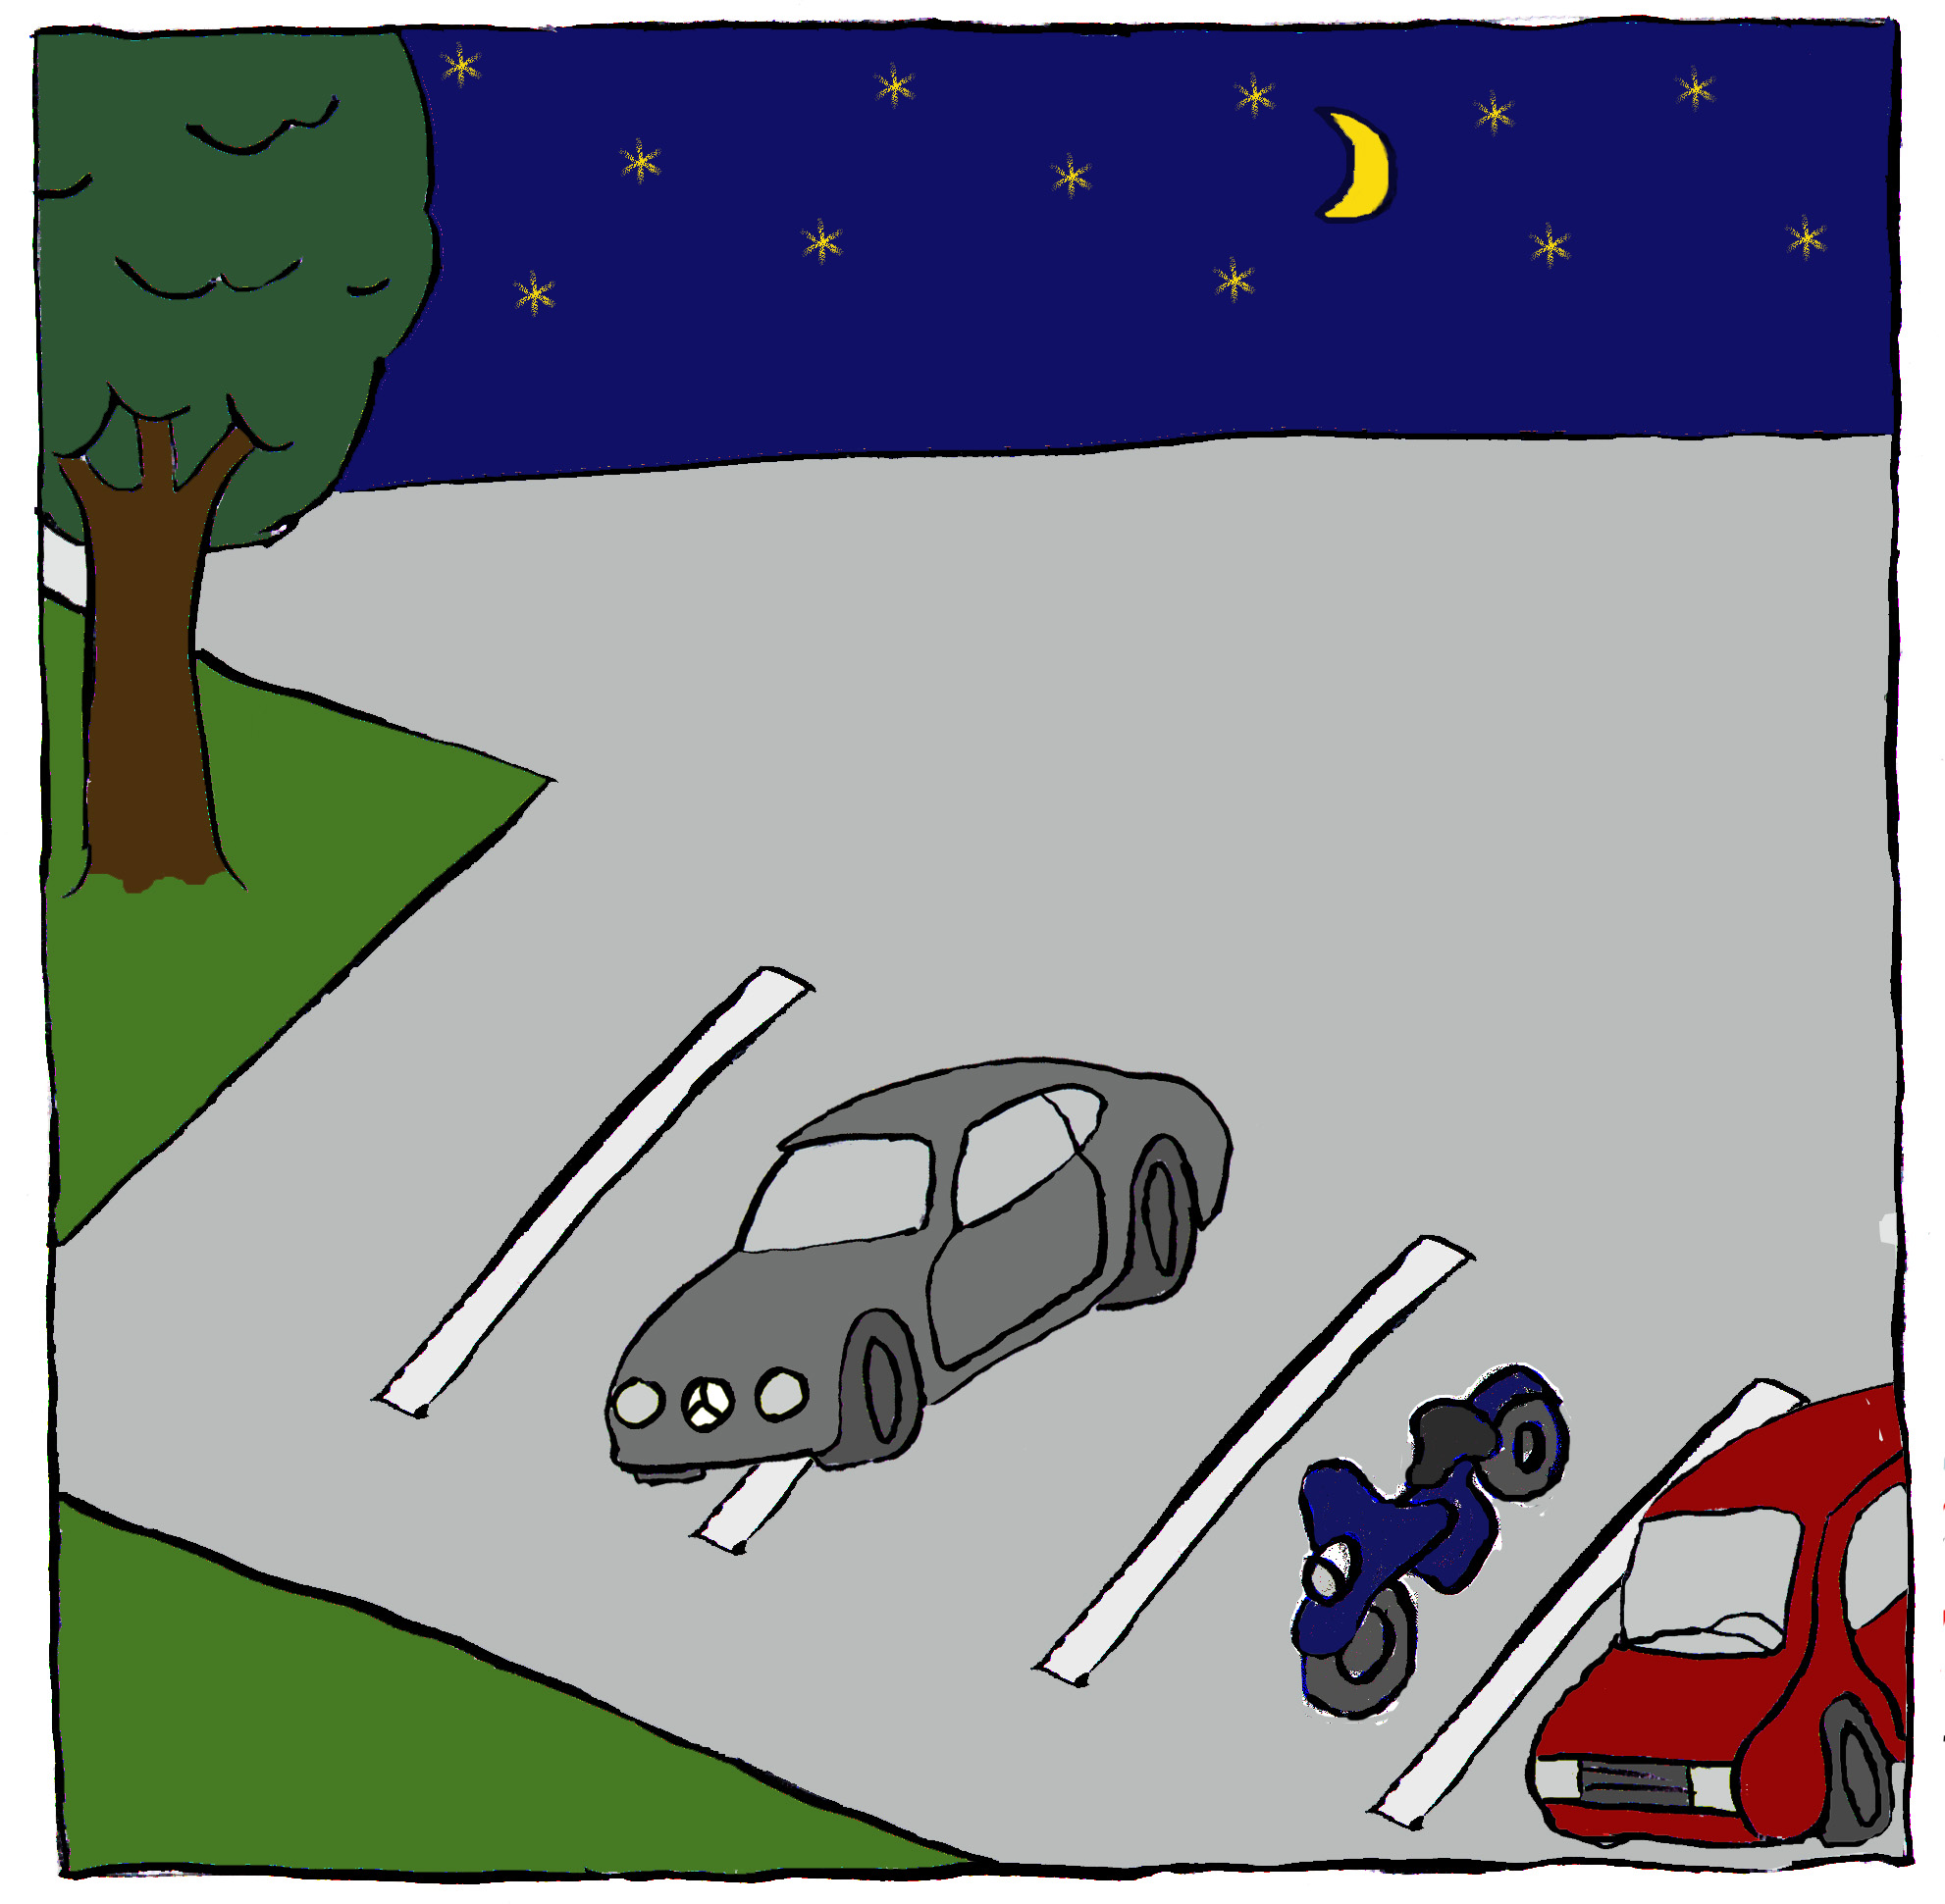
Please re-rate the probability
2
3
The men are arguing over a parking space in the shade.
The man is right in telling the other person off for occupying two parking spaces.
The driver of the grey car is wrongly being criticized.
The man in the blue shirt is yelling at the other one because he hit his red car when parking.
(picture story painted by Janne Hottenrott)
Changing beliefs 6.16

Slide 17

Please re-rate the probability
1
2
3
The men are arguing over a parking space in the shade.
The man is right in telling the other person off for occupying two parking spaces.
The driver of the grey car is wrongly being criticized.
The man in the blue shirt is yelling at the other one because he hit his red car when parking.
(picture story painted by Janne Hottenrott)
Changing beliefs 6.17

Slide 18
Please re-rate the probability
1
2
3
The men are arguing over a parking space in the shade.
The man is right in telling the other person off for occupying two parking spaces.
The driver of the grey car is wrongly being criticized.
The man in the blue shirt is yelling at the other one because he hit his red car when parking.
(picture story painted by Janne Hottenrott)
Changing beliefs 6.18
Notes:
18

Slide 19
In order to make a final decision,
All pictures must be looked at
As the Mercedes is occupying two parking spaces, interpretation 2 initially seems to be likely. The man in the blue shirt points at the red car which makes interpretation 4 likely also.
1
2
3
Obvious interpretation: The man is right in telling the other person off for occupying two parking spaces. But: The situation is different: The driver of he grey Mercedes was unable to park properly because the adjacent cars did not use the appropriate parking spaces.
Conclusion: There are situations in everyday life that we misjudge on the first glance. Try to stay open for different views and to correct false judgement!
(picture story painted by Janne Hottenrott)
Changing beliefs 6.19

Slide 20
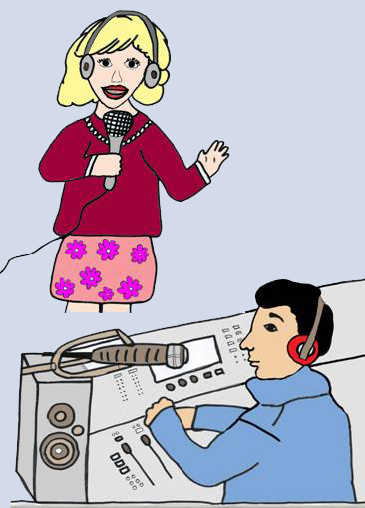
Task 2: Please rate the probability
3
The woman won the lottery and wants to give away her money via the radio.
The woman is reporting her missed dog.
The woman wants to start a singing career regardless of her family.
The woman wants to find the man of her dreams via the radio.
(picture story drawn by Lisa Schilling)
Changing beliefs 6.20

Slide 21
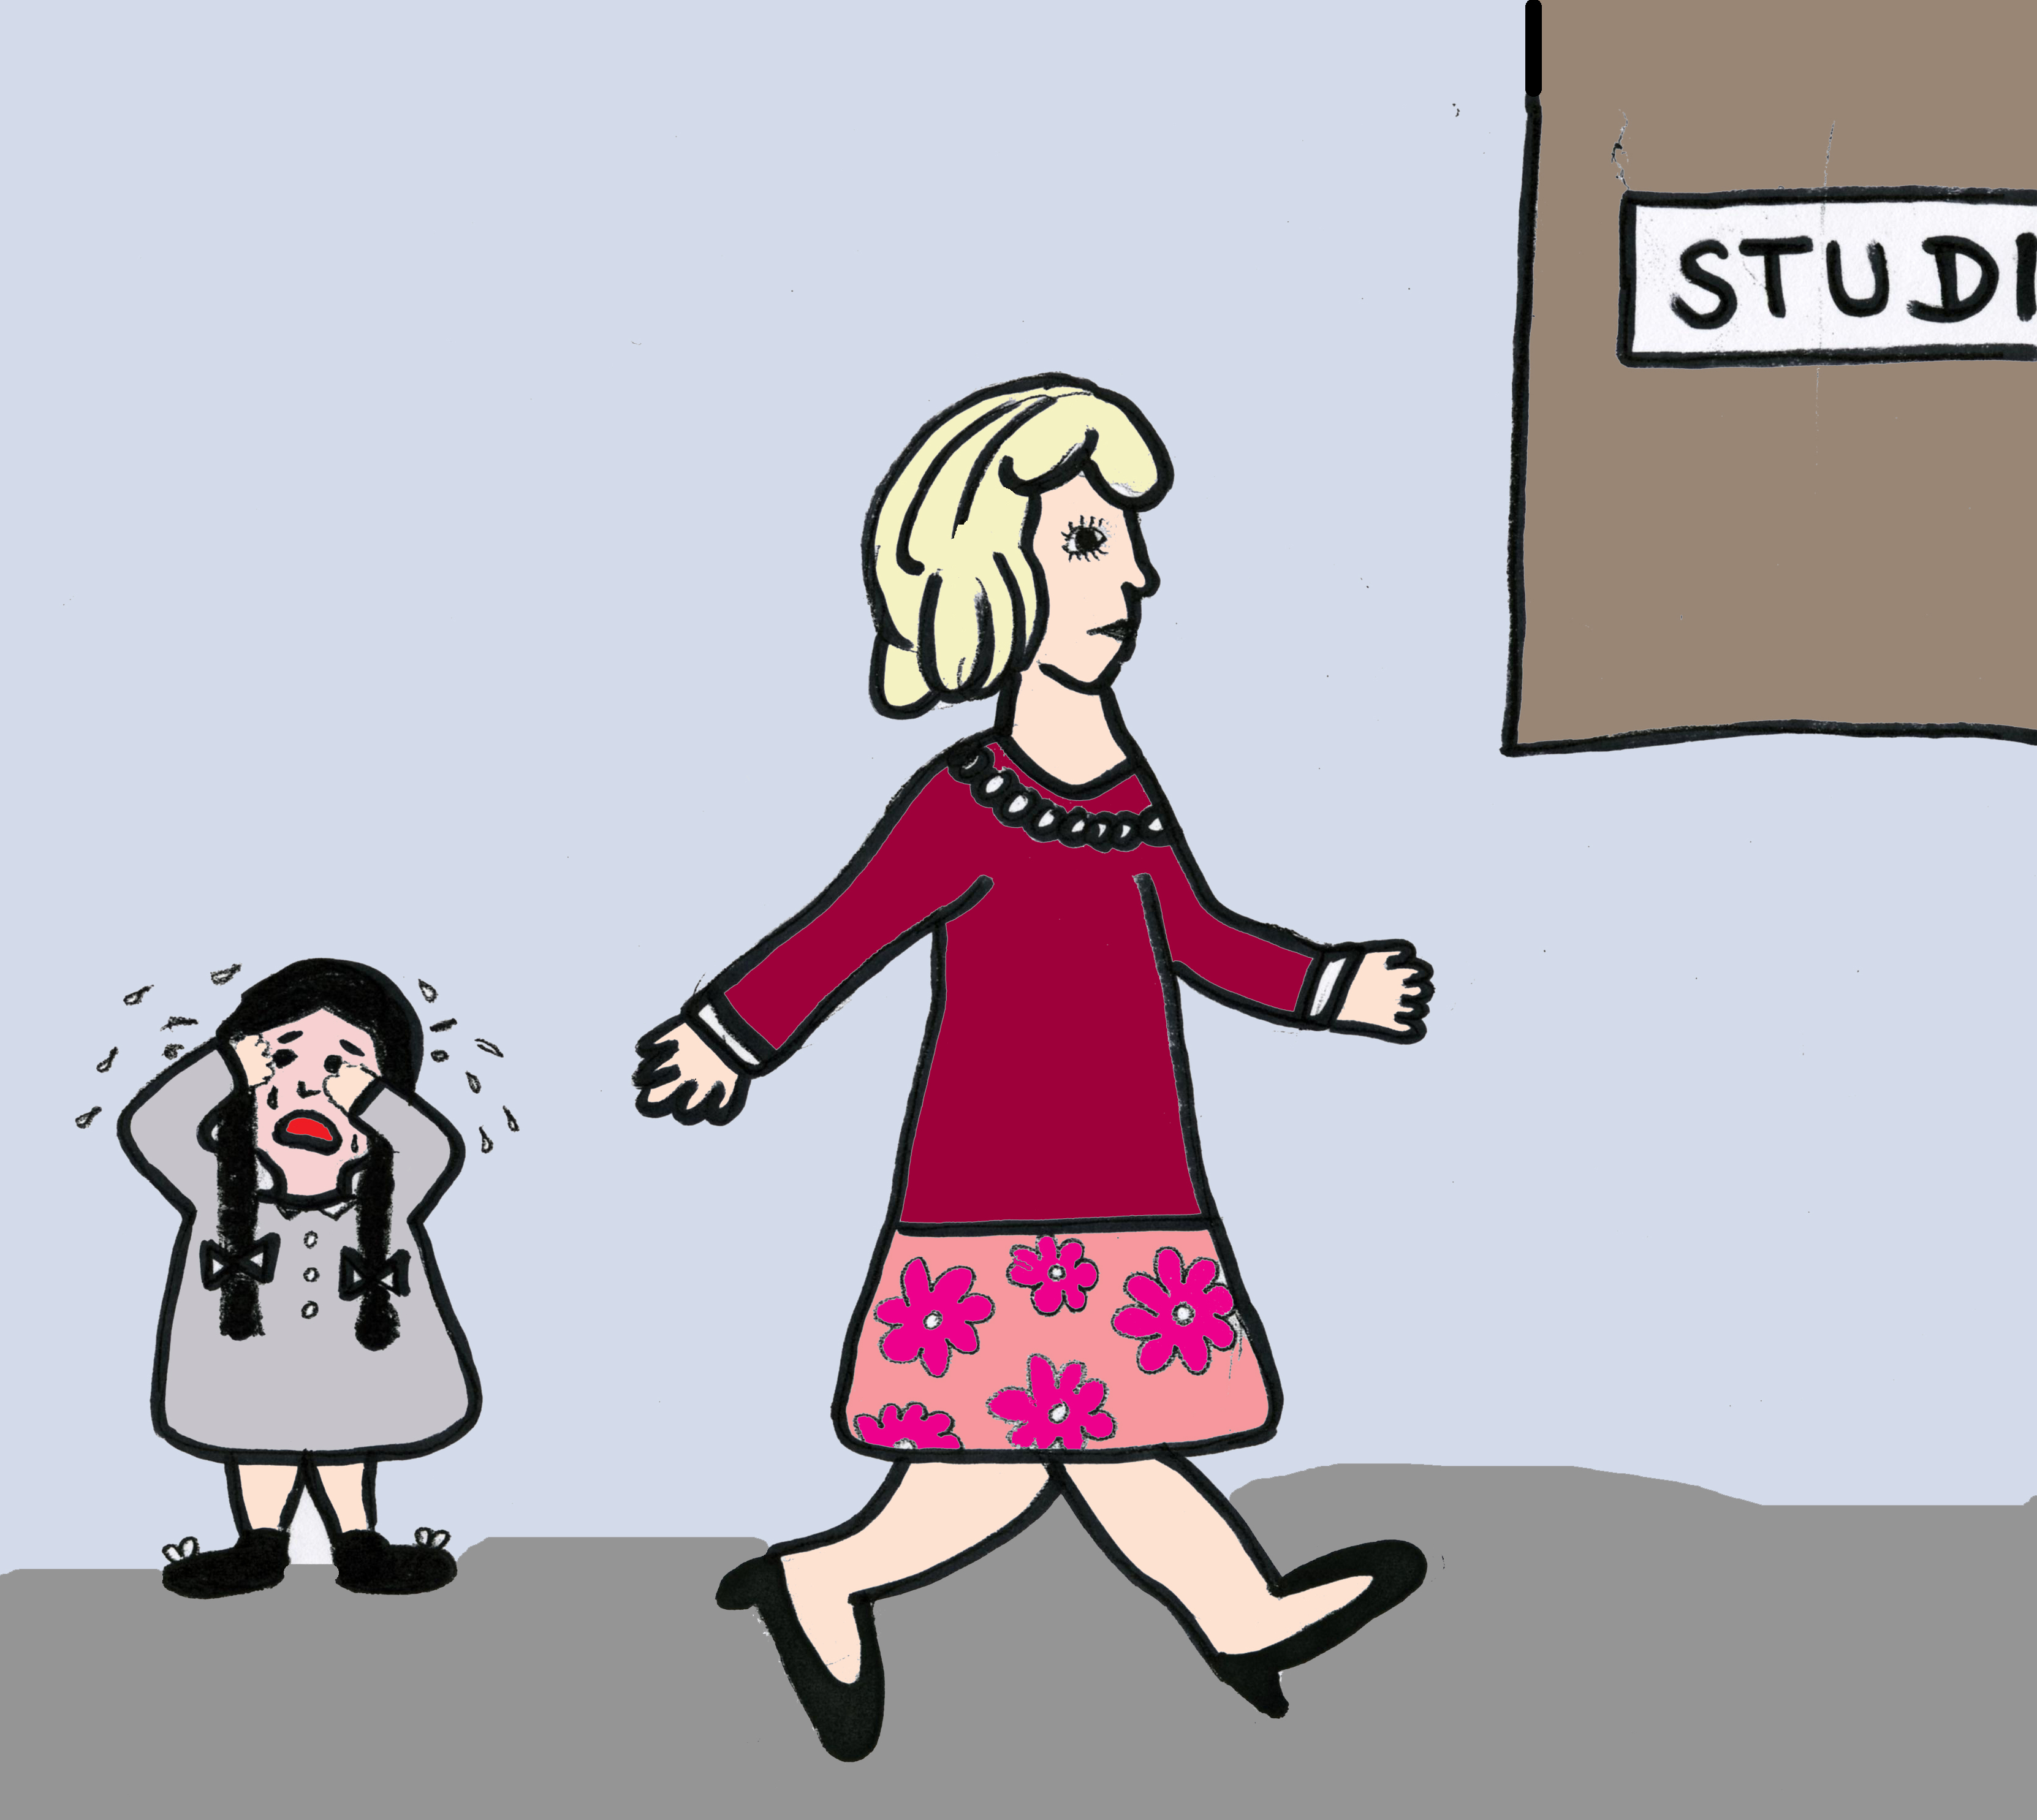
Please re-rate the probability
2
3
The woman won the lottery and wants to give away her money via the radio.
The woman is reporting her missed dog.
The woman wants to start a singing career regardless of her family.
The woman wants to find the man of her dreams via the radio.
(picture story drawn by Lisa Schilling)
Changing beliefs 6.21

Slide 22
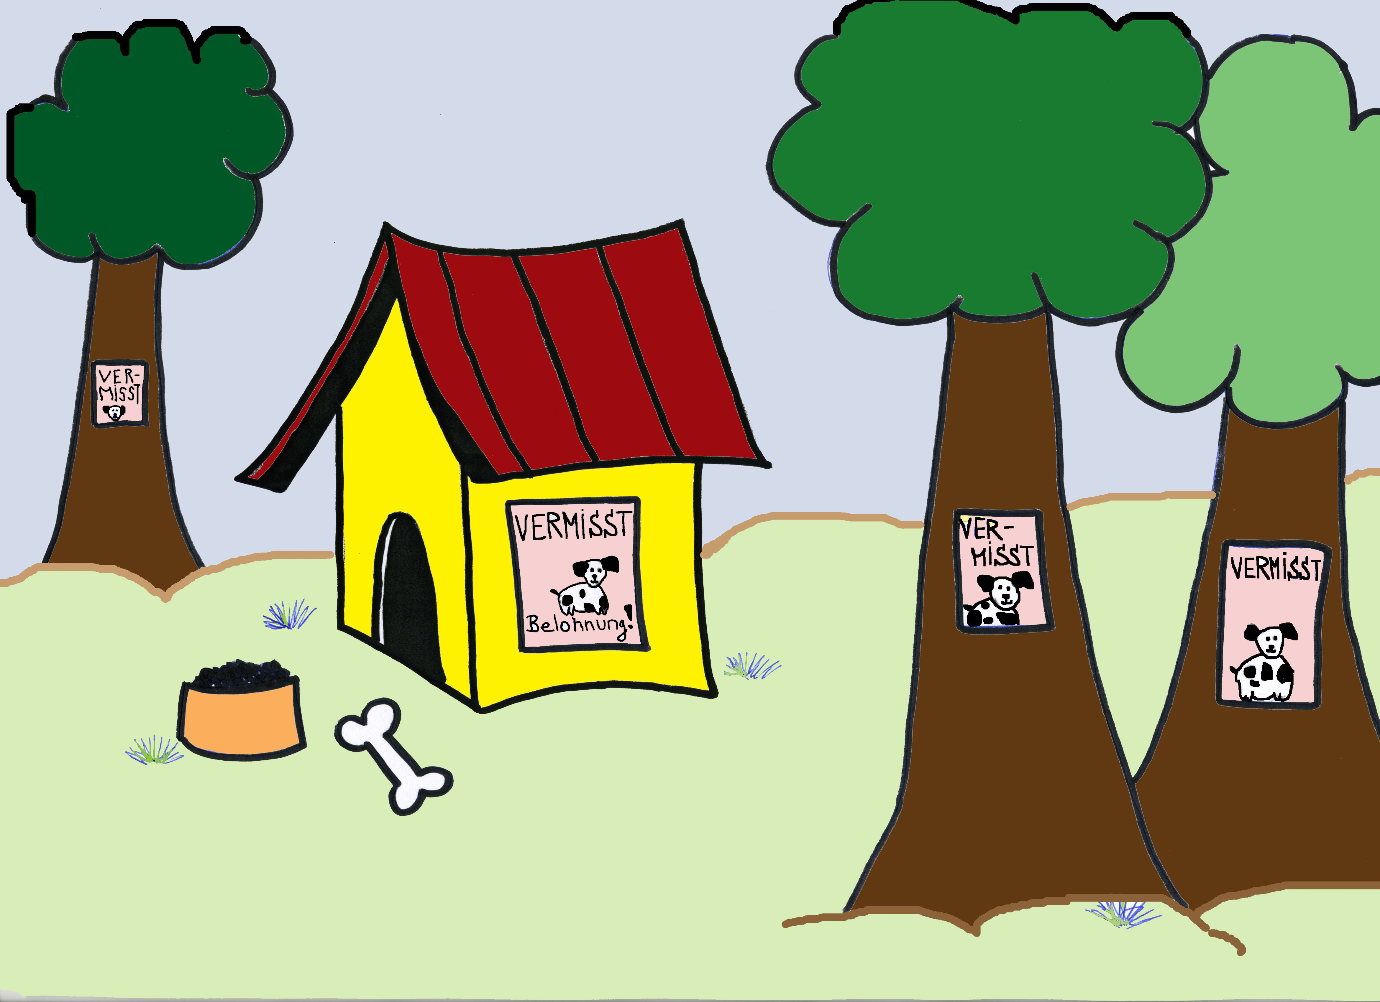
Korrigierbarkeit
Please re-rate the probability
6.22
1
2
3
The woman won the lottery and wants to give away her money via the radio.
The woman is reporting her missed dog.
The woman wants to start a singing career regardless of her family.
The woman wants to find the man of her dreams via the radio.
(picture story drawn by Lisa Schilling)
Changing beliefs 6.22

Slide 23
Please re-rate the probability
1
2
3
The woman won the lottery and wants to give away her money via the radio.
The woman is reporting her missed dog.
The woman wants to start a singing career regardless of her family.
The woman wants to find the man of her dreams via the radio.
(picture story drawn by Lisa Schilling)
Changing beliefs 6.23

Slide 24
In order to make a final decision,
All pictures must be looked at
As the woman is shown at the radio station, interpretations 3 and 4 initially seem likely.
1
2
3
Obvious interpretation: The woman wants to start a singing career regardless of her family.
But: The situation is different: The family’s dog ran away and the mother wants to report the missing pet via the radio.
Conclusion: There are situations in everyday life that we misjudge on the first glance. Try to stay open for different views and to correct false judgement!
(picture story drawn by Lisa Schilling)
Changing beliefs 6.24

Slide 25
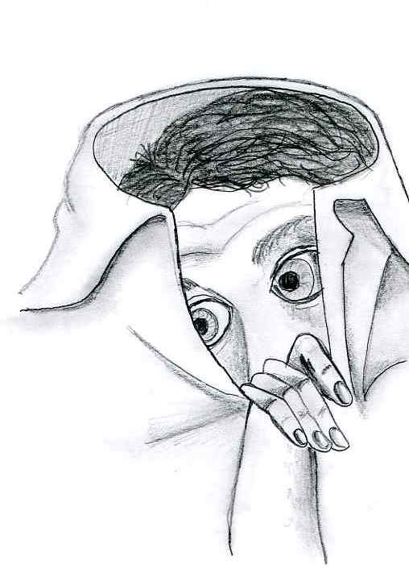
Case study:
Real persecution or illusion?
Example: John thinks he is being persecuted and threatened by Scientologists. Therefore, he barely leaves the house. As ample proof he notes the following:
Threatening voices, various suspicious cars in front of his apartment, a cross on a building looking somewhat like the Scientology symbol nearby his apartment.
What could challenge John’s conviction/Is the room for doubt?
???
(“Verstecken” by Jana Pöttgen, borrowed from the brochure “Schizophrenie: Eine Krankheit verliert ihre Dämonie”, 1988 by Troponwerke GmbH & Co. KG)
Changing beliefs 6.25

Slide 26
Case study:
Real persecution or illusion?
Example: Persecuted by Scientologists
What could challenge John’s conviction? Is there room for doubt?
Do the parked cars or the cross represent conclusive evidence? Coincidence?
Why would the Church of Scientology put so much time and effort into persecuting John?
…
How can John check upon his conviction?
???
(“Verstecken” by Jana Pöttgen, borrowed from the brochure “Schizophrenie: Eine Krankheit verliert ihre Dämonie”, 1988 by Troponwerke GmbH & Co. KG)
Changing beliefs 6.26

Slide 27

Case study:
Real persecution or illusion?
Example: Persecuted by Scientologists
How can John check upon his convictions?
Different views: asking friends, family or experts (e.g. doctor) for advice: do they share his conviction?
Personal experiences: Is John prone to false perceptions and special ideas when he is stressed out?
Does he have a tendency towards being anxious or distrustful?…
Possible consequences of the conviction?
→ worksheet 6.1
(“Verstecken” by Jana Pöttgen, borrowed from the brochure “Schizophrenie: Eine Krankheit verliert ihre Dämonie”, 1988 by Troponwerke GmbH & Co. KG)
Changing beliefs 6.27

Slide 28
Case study:
Real persecution or illusion?
Example: Persecution
possible consequences
John is convinced that he is being persecuted | He is highly restricted in his everyday life, as he barely leaves the house (e.g. problems with looking after himself, social isolation) Trouble at work due to absence without permission His life is determined by strong fear and constant feelings of threat
Alternative explanation: John identifies his ideas as an expression of a mental-health problem | Feelings of fear and threat cease Possible feelings of shame may arise, as he has firmly clung to his idea and tried to convince others He is able to accept professional help as well as support from his friends and family. His situation improves. He spends time with his friends again and takes care of his future, both in private and professional life.
(“Verstecken” by Jana Pöttgen, borrowed from the brochure “Schizophrenie: Eine Krankheit verliert ihre Dämonie”, 1988 by Troponwerke GmbH & Co. KG)
Changing beliefs 6.28

Slide 29
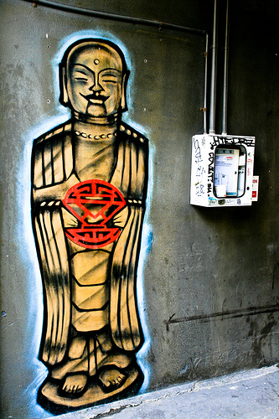
Case study:
Enlightenment or illusion?
Example: Simon is convinced that he is a “chosen” one. He feels determined to lead the Tibetan Buddhists as their next Dalai Lama. He buys a plane ticket to China from his last savings.
Evidence: On his way home from work, where he had an argument with his boss, Simon saw a Buddha graffiti and instantly felt enlightened. Ever since this experience he has had a feeling of godlike power.
What could challenge Simon’s conviction?
Is there room for doubts?
???
(“Electro Graffito Buddha” by JamesEverett)
Changing beliefs 6.29

Slide 30
Case study:
Enlightenment or illusion?
Example: Enlightenment
What could challenge Simon’s conviction? Is there room for doubts?
Are the graffiti and feeling of enlightenment conclusive evidence? coincidence?
What does the creator of the graffiti have to do with Simon’s “enlightenment”?
Why should Simon become the religious leader of the Tibetan Buddhists if he stems from a Christian cultural background?
…
In any case, it is overly hasty to leave everything behind based on just a feeling!
How could Simon check upon his conviction?
???
(“Electro Graffito Buddha” by JamesEverett)
Changing beliefs 6.30

Slide 31
Case study:
Enlightenment or illusion?
Example: Enlightenment
How could Simon check upon his conviction?
Different views: asking friends, family or experts (e.g. doctor) for advice: do they share his conviction?
Personal experiences: Is John prone to false perceptions and special ideas when he is stressed out?
Logic: Is the new Dalai Lama already chosen or otherwise predetermined?
Is Simon prone to unjust euphoria or grandiose ideas?
Possible consequences of the conviction?
→ worksheet 6.2
(“Electro Graffito Buddha” by JamesEverett)
Changing beliefs 6.31

Slide 32
Case study:
Enlightenment or illusion?
Example: Enlightenment
possible consequences
Simon is convinced that he is a religious leader | He spends his last savings and will be left with no money He might run into trouble as he cannot foresee the consequences of his actions (e.g. conflicts with competitors, powers in China occupying Tibet) Increasing isolation and problems with social environment: People he trusts may avoid him due to his ideas or he will lose social contacts as he will be abroad Increase of his self-esteem!
Alternative explanation: Simon identifies his ideas as an expression of a mental-health problem | He “kicks the habit” in time and thus the above-described negative consequences of his ideas can be avoided. He can take care of his private and professional future (e.g. getting in contact with friends again) He awakes from a beautiful dream! Possible feelings of disappointment and shame, as he had clung to a false belief. He should realize that he has psychiatric problems that require treatment and needs support.
(“Electro Graffito Buddha” by JamesEverett)
Changing beliefs 6.32

Slide 33
Your ideas – personal examples
What speaks for and against your ideas?
How can you check upon these ideas?
What are the consequences of clinging to or rejecting an idea?
→ worksheet
6.3 a, b, c
Changing beliefs 6.33

Slide 34
Changes in the environment! Is it really true?
Own observation: a striking number of people in your neighborhood wear sunglasses; neighbors behave in a hostile way
Record and observe! (e.g. count the number of events for a couple of days)
Is it coincidence? Was it like that before? Is it my imagination? Are things the same outside my personal environment and thus hardly relate to me in any way?
B. Consider other explanations!
Are there alternative explanations? Many people wearing sunglasses: is it summer, are sunglasses currently “in vogue– even though the weather is bad? My neighbors behave in a hostile way: am I overreacting, do they behave like that towards others as well?
C. Look for more reasons for change! (e.g. maybe I am responsible for some of the changes)
Neighbors are not spies or members of the mafia, but they may be grumpy because I offended them by confronting them with my theories.
YES – nothing to worry about!
NO
YES – other reasons, it is not related to me in any way!
NO
YES!
NO… BUT, even if it’s true: How can I handle this situation in a better way?
→ worksheet 6.4
Changing beliefs 6.34

Slide 35

In your opinion, is exchanging with others important? Why?
You get a new perspective.
When you are tense or angry, exchanging with others may prevent you from doing stupid things.
By talking, you will get your troubles off your chest and often your concerns seem less serious.
It is almost impossible to get the full picture of everything from one single perspective (“Four eyes can see more than one”).
You may learn something new from discussions, enabling you to reflect on your prior behavior and opinions.
(“Conversations Silhouettes by Kirsty Pargeter” by b_d_solis)
Changing beliefs 6.35

Slide 36
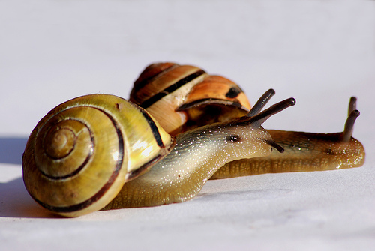
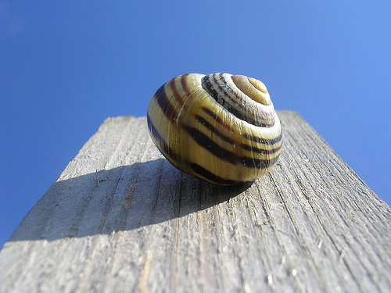
Exchanging with others during a psychotic crisis?
Have you always been open-minded towards different views and opinions?
Have you avoided discussing your special ideas with friends or family, for example in fear of conflicts or rejection?
Have you experienced people dissenting from your convictions as enemies or pursuers?
Have you gathered information from one-sided sources (e.g. websites about conspiracy theories)?
Other?
withdrawal
(f.l.t.r.: “Snails” by H Rickard; “Snail” by Kamil Porembiński)
Changing beliefs 6.36

Slide 37
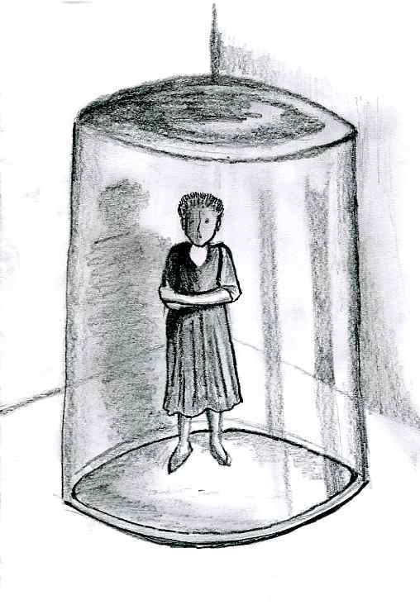
Exchanging with others vs. withdrawal during a psychotic crisis
Possible consequences of withdrawal during psychosis:
loneliness
depression
lack of distraction, so that thoughts are increasingly preoccupied with (threatening) topics and fantasies
without communication with other people, there are few possibilities left to check whether assumptions are false or whether they correspond with reality
…
(“Rückzug” by Jana Pöttgen, borrowed from the brochure “Schizophrenie: Eine Krankheit verliert ihre Dämonie”, 1988 by Troponwerke GmbH & Co. KG)
Changing beliefs 6.37

Slide 38
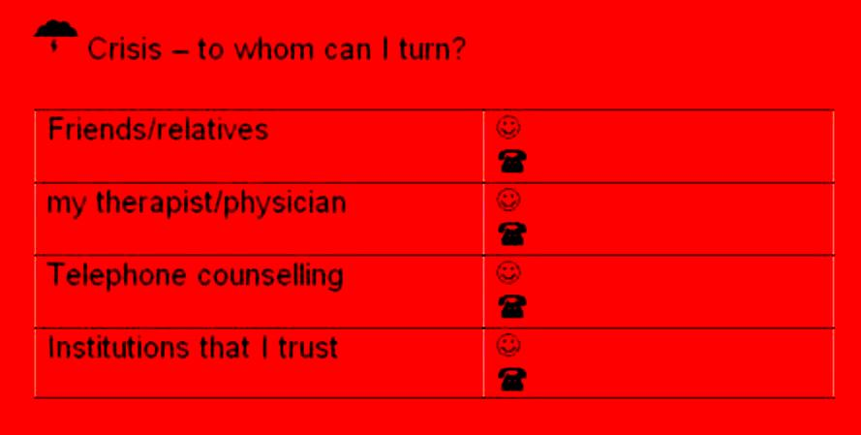
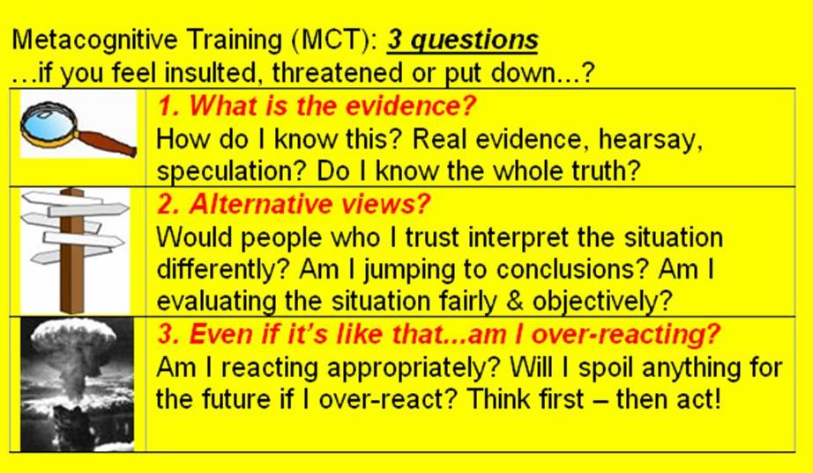
Are there people you’ve trusted throughout? Who comes to mind?
Please fill in the name
Exchanging views with people you trust helps you to correct false beliefs and prevent escalation!
Changing beliefs 6.38

Slide 39
Korrigierbarkeit
6.39
Application to everyday life
Learning objectives:
Sometimes events turn out differently than expected: premature decisions frequently lead to wrong conclusions!
Therefore, you should always consider extensive information as well as differing interpretations, before you make up your mind.
Stay flexible. Be open to correcting your assumption when there are conclusive counter-arguments.
Exchanging views with people you trust is important for checking your special ideas.
Changing beliefs 6.39

Slide 40
What does this have to do with psychosis?
Many (but not all!) people with psychosis maintain false beliefs despite conclusive counter-arguments. This may lead to one “getting lost” and not accepting objections. In some cases, one can lose touch with reality entirely.
It is difficult to “keep cool” when feeling threatened. Be careful when making judgements and ask people you trust for advice.
What aspects of the therapy unit do I find particularly useful/helpful?
When and in what specific situation could I apply/use what I learned in the near future? What could it help me with (e.g. to feel less tense)?
→ worksheet 6.5
Changing beliefs 6.40

Slide 41
What does this have to do with psychosis?
Example: Carol calls the police because she thinks that neighbors have stolen pieces of her underwear from the clothes line in the basement!
Context: She is convinced that her neighbors want to humiliate her and drive her out of the house.
But!: Even though there had been a conflict with one particular neighbor, others have been very friendly and helpful. For example, they accepted parcels for her. Although she finds the pieces of underwear which she thought to be stolen in her wardrobe a few days later, she does not dismiss her belief/conviction that her neighbors want to cause her harm.
Changing beliefs 6.41

