Slide 1
Metakognitive Therapie
Metacognitive Therapy
THERAPY UNIT 7:
EMPATHIZING

Slide 2
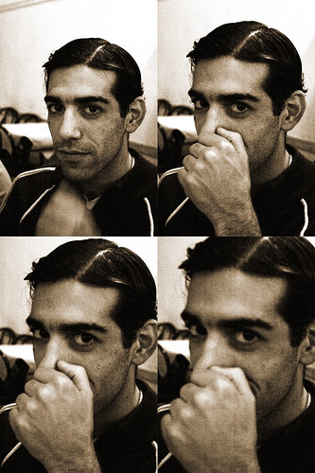
Facial expressions and behavior are often ambiguous!
Example: A person is scratching his/her nose.
Why? Itchy nose, derogative gesture (in some cultures), indicates lying or embarrassment?
What may help to answer the question?
(“Cristian Miño” by julianrod)
Empathizing 7.2

Slide 3
Facial expressions and behavior are often ambiguous!
What may help to answer the question?
Knowledge about the person → e.g.: Does the person have a cold?
Considering the situation→ e.g.: Does this person have an allergy and is there any pollen in the air?
Self-observation → In what situation do I touch my own nose? (Caution! You can’t always infer from yourself to others!)
Facial expression → Does the person look irritated, embarrassed, etc.?
(“Cristian Miño” by julianrod)
Empathizing 7.3

Slide 4
Why are we doing this?
Studies show that many (but not all!) people with psychiatric concerns (especially psychosis):
have difficulties detecting and evaluating the facial expressions of others (e.g. whether someone feels sad or happy).
have difficulties deducing motives of other people from their ongoing behavior.
tend to be overly certain of false conclusions (e.g. that someone on the train is watching them in a hostile manner).
Empathizing 7.4

Slide 5

How problems recognizing emotions promote misinterpretations
(e.g. during psychosis) – examples
The feeling of constantly being in danger leads to distorted perceptions of other people:
A friend’s sad facial expression is misinterpreted as feigned sympathy.
A friend hectically checking her watch during a conversation is interpreted as clearly indicating her indifference.
At a store, a salesman offering his help is taken as proof that you are suspected of being a thief.
→ worksheet 7.1
Empathizing 7.5

Slide 6
Please name some basic human emotions
???
Empathizing 7.6

Slide 7
Please name some basic human emotions
joy
surprise
fear
sadness/mourning
anger
disgust
guilt/shame
Empathizing 7.7

Slide 8
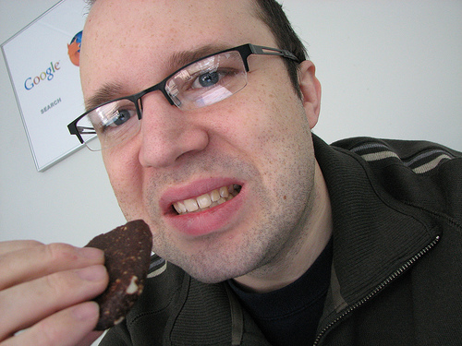
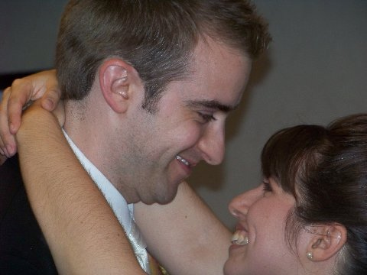
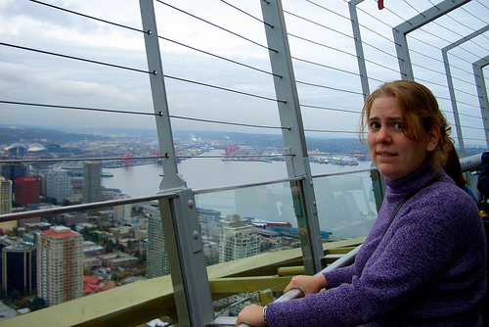
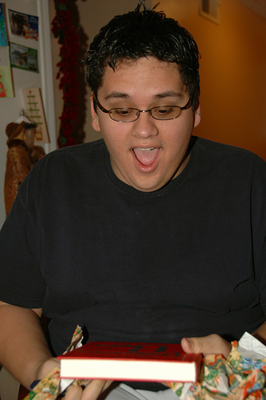
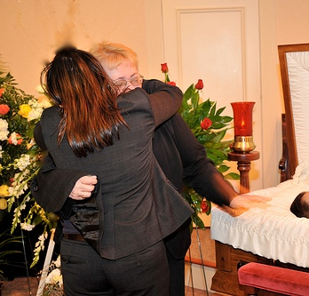
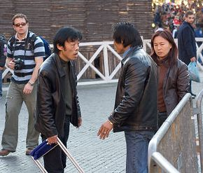
Sometimes it is easy to tell how someone feels, especially if you know the context...
???
???
???
???
???
???
Empathizing 7.8

Slide 9
Sometimes it is easy to tell how someone feels, especially if you know the context...
disgust
joy
fear
surprise
sadness
anger
(f.l.t.r.: top: “That‘s as close as I could get it to my mouth for the photo.” by ericskiff; “happy couple” by kthypryn; “July wasn‘t really scared…” by OctopusHat; bottom: “Now that's what I call a gift!” by billaday; “Danilo's Wake” by emilio labrador; “angry chinese people in piazza navona” by cking)
Empathizing 7.9

Slide 10
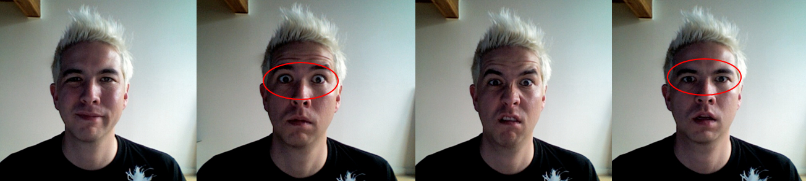
It is more difficult when you only see a face but do not know the person or the circumstances!
Joy ?
Surprise ?
Disgust ?
Fear ?
Surprise and fear can easily be confused: Eyes are wide open
(f.l.t.: “12-lip-corner-puller”; “05-upper–lid-raiser”; “10-upper-lip-raiser”; “11-nasolabial-deepener” by Buster McLeod)
Empathizing 7.10

Slide 11
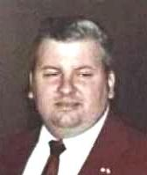
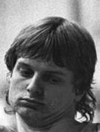
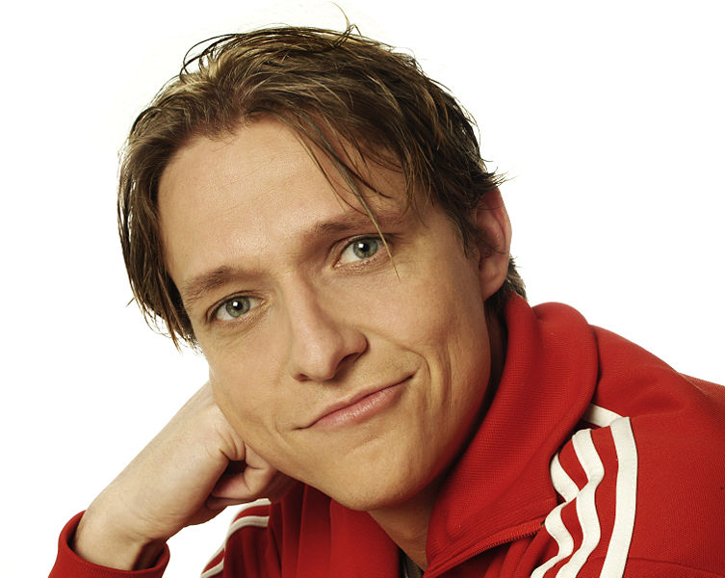
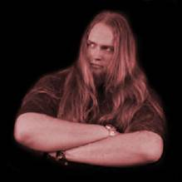
Can we make inferences about a person’s character or profession based on their appearance alone?
Which of these 4 gentlemen is an actor, an athlete, a psychologist or a serial killer?
Empathizing 7.11

Slide 12
7.11
Can we make inferences about a person’s character or profession based on their appearance alone?
Often, stereotypes dominate our first impressions. For example, not all actors are attractive and not all murderers look brutal etc.!
John Wayne Gacy: Serial killer
businessman who frequently performed as a clown – does not correspond with our image of a Monster
Thorsten Voß: Athlete
Stefan Behrens:
Psychologist
frequent but wrong answer: serial killer, due to hostile facial expression and pose (in his free time, Mr. Behrens is the singer of a rock band)
Sven Nagel: Actor
(“Johnwaynegacyrosalynncarter.jpg” by U.S. federal government; “Bundesarchiv Bild 183-1982-0124-013, Torsten Voß” by Rainer Weisflog; “Sven Nagel.jpg” by Pehlgrimm; “ohne Titel” by Stefan Behrens)
Empathizing 7.12

Slide 13
Task 1
In the following, you will see a picture (or part of a picture).
Please try to find out what is going on with the person or persons in the picture.
How certain are you about you judgement?
Empathizing 7.13

Slide 14
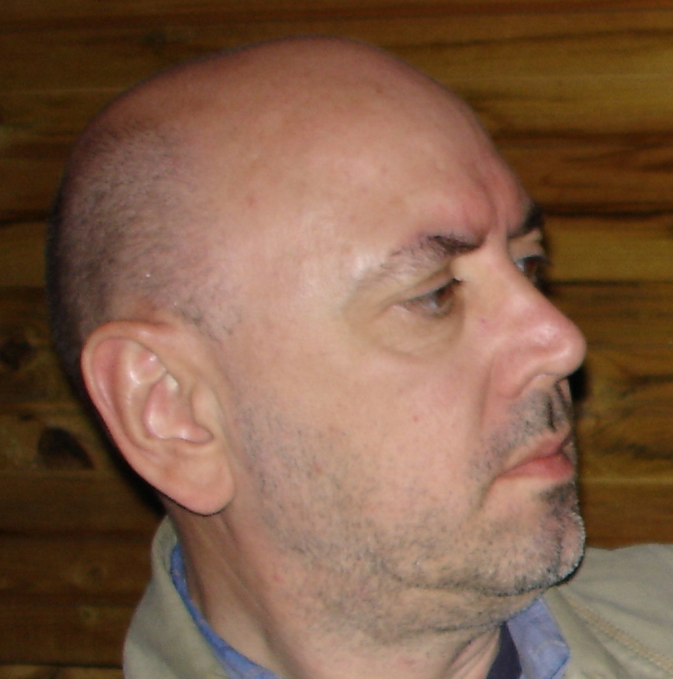
What is shown in the picture? How certain are you?
cutout!
Winner at the award ceremony
After jail release
Focused photographer
Man listens to his opponent at a debate
Empathizing 7.14

Slide 15
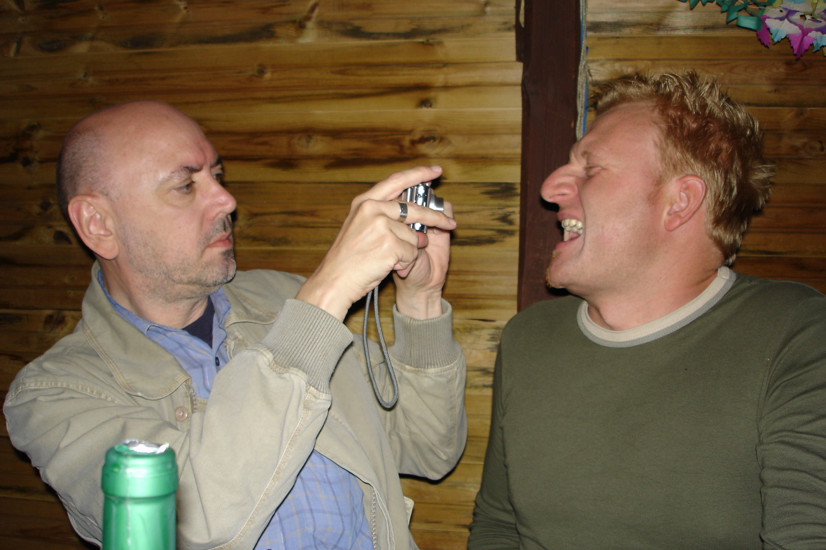
First impressions can deceive…
Often it is not until considering additional information that we can deduce what is going on with another person.
7.14
concentration!
Winner at the award ceremony
After jail release
Focused photographer
Man listens to his opponent at a debate
(“ohne Titel” by Steffen Moritz)
Empathizing 7.15

Slide 16
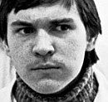
What is shown in the picture? How certain are you?
cutout!
After the verdict
Cook during a tasting
Boy is being teased
Businessman at a conference
Empathizing 7.16

Slide 17
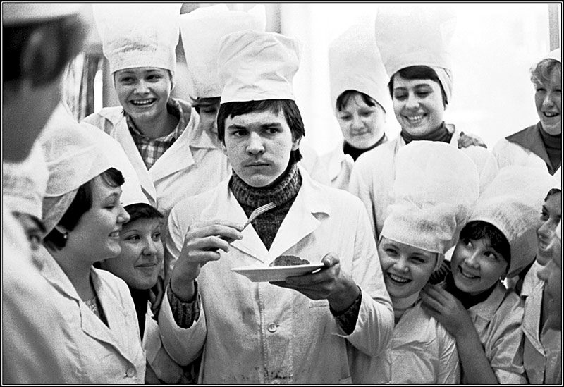
First impressions can deceive…
Often it is not until considering additional information that we can deduce what is going on with another person.
7.16
concentration!
After the verdict
Cook during a tasting
Boy is being teased
Businessman at a conference
(“In einer Kochschule”“ by Vladimir Rolov)
Empathizing 7.17

Slide 18

How do you feel when looking at the man in this picture?
Would you feel the same if you were in a good mood, sad, or anxious?
(“Men at work” by reynermedia)
Empathizing 7.18

Slide 19
Our mood influences our perception and appraisal!
situation:
your own mood:
possible appraisal:
happy
???
sad
???
suspicious
???
(“Men at work” by reynermedia; “Smileys” by Ruth Veckenstedt)
Empathizing 7.19

Slide 20
Our mood influences our perception and appraisal!
situation:
your own mood:
possible appraisal:
happy
… he looks nice, would like to chat to him…
sad
… someone like him would certainly think I’m boring…
suspicious
… he’s probably gossiping about me…
(“Men at work” by reynermedia; “Smileys” by Ruth Veckenstedt)
Empathizing 7.20

Slide 21
Our mood influences our perception and appraisal!
  Feelings don’t always have to be “true”!
  Just because I am scared, doesn’t mean that there is real danger.
  Therefore, feelings can’t always be trusted!
  People with psychiatric concerns often tend to give “emotional evidence”, i.e. they presume that negative feelings accurately reflect what is really happening (“I feel offended – so you must have insulted me!”).
Empathizing 7.21

Slide 22
The impact of external factors on mental states and thoughts
The following factors may easily promote misjudgment:
Stress/exposure: When stressed out, we often experience small issues as being greatly annoying or offensive (e.g. long queue at the supermarket counter)!
Sleeplessness/drugs/coffee: We often misinterpret the origin of our own physical tension and mistakenly ascribe it to other causes (e.g. annoying colleague)!
Music/noise: Certain music or noise may agitate us, leading us to make misinterpretations more easily!
Empathizing 7.22

Slide 23
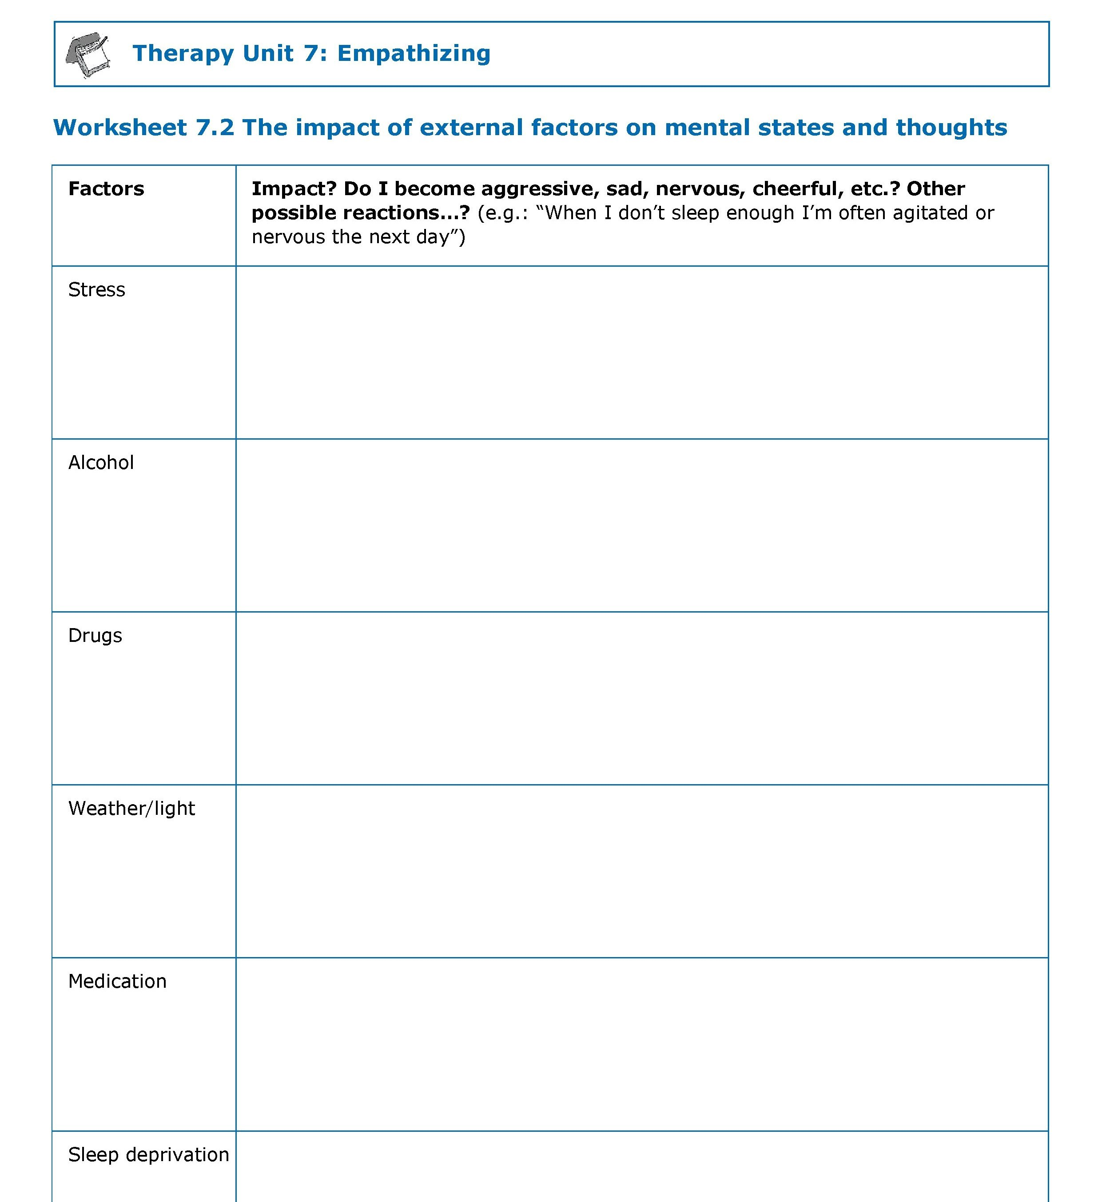
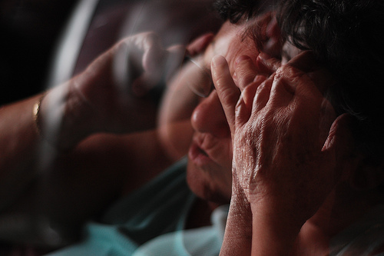
The impact of external factors on mental states and thoughts
worksheet
→ worksheet 7.2
(“stressed and worried” by Bhernandez)
Empathizing 7.23

Slide 24
First summary
It’s not always possible to clearly interpret facial expressions and gestures!
Caution: Many people – naturally or due to medical conditions (e.g. Parkinson’s) – hardly show distinctive facial expressions, which prevents us from deducing their emotions.
Further information (situation, knowledge about the person, direct enquiry) should be considered, before facial expressions and gestures of other people can be reliably interpreted.
Caution: Factors like stress, emotions (fear, sadness) and alcohol/drugs may impact our perception and thus lead to misinterpretation.
Empathizing 7.24

Slide 25
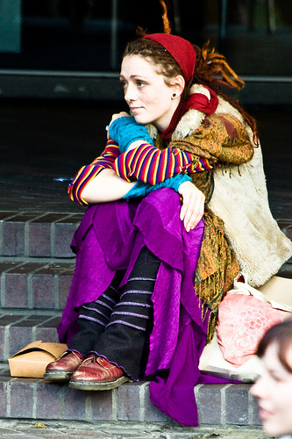
Empathy/evaluation of a person
When you meet someone, where do you look first? How reliable are these cues?
(“Neo-Hippy Chick” by garryknight)
Empathizing 7.25

Slide 26
7.24
Empathy/evaluation of a person
When you meet someone, where do you look first? How reliable are these cues?
hair/hairstyle?
eyes?
language?
hands?
body language/
posture?
clothes?
other?...
(“Neo-Hippy Chick” by garryknight)
Empathizing 7.26

Slide 27
7.25
Empathy/evaluation of a person
When you meet someone, where do you look first? How reliable are these cues?
prior knowledge about the person (hearsay): e.g., a friend’s remark
prior knowledge on similar persons/groups: e.g., hippy, rapper
“gut feeling”/intuition
something written: e.g., emails, internet chats
… none of these cues (e.g. language, body language, gut feeling, etc.) can be completely trusted on their own!
As many aspects as possible should be considered!
In combination, they help with reliably judging a complex situation…
(“Neo-Hippy Chick” by garryknight)
Empathizing 7.27

Slide 28
Task 2
In the following, you will be presented with a picture. Please consider what the characters in the story may think about each other.
Important:
You have to distinguish between information available to you and information the characters have about one another.
Consider what additional information is needed to provide a definite answer.
Empathizing 7.28

Slide 29

What might the man walking the dog think?
(picture story by Marina Ruiz)
Empathizing 7.29

Slide 30
What might the man walking the dog think?
Likely (but wrong): The man with the hat is a burglar!
Seems unlikely – but is correct: The man forgot the key to his house and is climbing through an open window to get it.
Additionally: It is not clear if the dog-walker knows the man – if this is not the case, he probably thinks that the man is breaking into the house.
(picture story by Marina Ruiz)
Empathizing 7.30

Slide 31
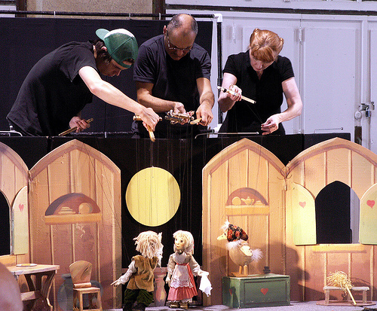
Change of perspective
Not all people have the same knowledge or feel the same way. This may lead to misunderstandings and conflicts!
Therefore it is important:
to take other people’s perspectives into account, in order to understand why they act in their own particular way.
to communicate, in order to make the reasons for our own behavior comprehensible to others.
(“Marionette Show” by Sister72)
Empathizing 7.31

Slide 32
Change of perspective
Imagine the following situation:
You are tired and on your way home from work. You stop to do some quick grocery shopping and the supermarket is packed. You’ve got everything in your cart and you are waiting in line. Right in front of you, an elderly man brings his groceries to the register, insecurely and very slowly. When the cashier tells his the price, the elderly man searches his bag for a long time, as he cannot find his wallet. While searching, he accidentally pushes a bottle of oil off the till. The bottle breaks on the floor.
→ worksheet 7.3
Empathizing 7.32

Slide 33
Change of perspective
7.31
What do you think/feel in this situation? | Example: It makes me angry as I am very tired and exhausted and want to finally get home. Or: I feel compassion and sympathy for the elderly man.
What does the cashier think/feel? | Example: She is annoyed because the queue is getting longer and longer and she will now have to take care of the broken bottle on top of that. Or: She feels sympathy because she knows this elderly man.
What does the elderly man think/feel? | Example: He is ashamed and angry with himself. He feels embarrassed.
What may help you to take the perspective of the elderly man? | Example: I think of my grandparents and reflect on them becoming slower and more insecure with age, possibly leading to similar problems. Or: I wonder how I would feel if I had accidentally broken a bottle. Maybe a similar thing has happened to me once and I remember how bad it made me feel at the time.
Empathizing 7.33

Slide 34
What makes a good conversation partner?
???
Empathizing 7.34

Slide 35

What makes a good conversation partner?
Listening, letting others finish speaking
Asking questions
Keeping eye contact but not staring
Respecting different opinions
Showing interest for the other person
Avoiding speaking constantly about oneself
Appropriate openness throughout the conversation (no divulging/telling intimate details in the first conversation, not being too reserved towards an old friend)
Expressing criticism in an appropriate way, avoiding insults (e.g. instead of “Your new hairstyle looks awful!”, rather “I liked our hair better before”).
(“zuhören” by stefan.eissing)
Empathizing 7.35

Slide 36
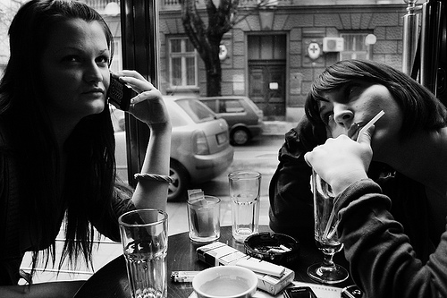
What makes a good conversation partner?
Being appreciative but also honest and natural (e.g. you don’t need to burst out laughing if you didn’t think the joke was funny).
Gossiping about absent people often seems distasteful and does not foster trust.
(“ohne Titel” by DonDonney)
Empathizing 7.36

Slide 37
What makes a good conversation partner?
Especially when first getting to know each other:
  Proceed slowly and step by step, do not ask questions that are too personal right away, no insisting/pushing
  Do not divulge issues that are too intimate when first getting to know each other (e.g. telling story of one’s life, strokes of fate)
  Be aware of non-verbal signals (e.g. if someone turns away or checks his/her watch all the time, he/she might not be interested in the conversation or might have forgotten something), however, do not overrate such behavior!
  Keep appropriate distance, do not be too touchy/clingy – especially when meeting someone for the first time (e.g. shake hands but do not embrace)
Empathizing 7.37

Slide 38
Implicit social laws
???
Empathizing 7.38

Slide 39
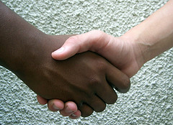
Implicit social laws
Be on time
Address older people or people you do not know in a formal way
Courtesy: say “please”, “thank you”, “excuse me” etc. where appropriate
Adapt the tone and volume of your voice to the situation/place, do not talk too loudly (or too softly)
→ worksheet 7.4
(“hermandad – friendship” by ruurmo)
Empathizing 7.39

Slide 40
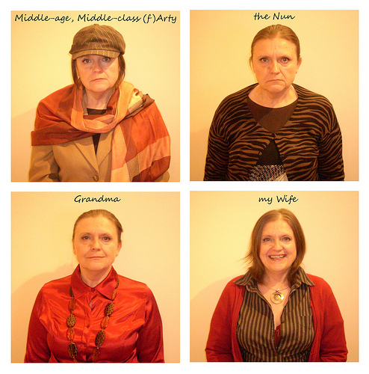
Implicit social laws
Dress appropriately for situation/occasion (e.g. not wearing tracksuit pants/sneakers to a funeral or job interview)
Take care of personal hygiene (e.g. regular showering, no stained clothes)
(“008-People We Know” by gingerpig2000)
Empathizing 7.40

Slide 41

Implicit social laws
“good manners”, e.g.:
  No belching in public – otherwise, excuse yourself
  Putting your hand before your mouth when yawning
  Turning away from other person/table when blowing your nose
  No smoking while others are eating
  No talking with a full mouth
  No spitting on the floor
  No swearing
(“No Toser / No Coughing Zone” by Michael Slichenmyer (www.flickr.com/photos/notunlike)
Empathizing 7.41

Slide 42
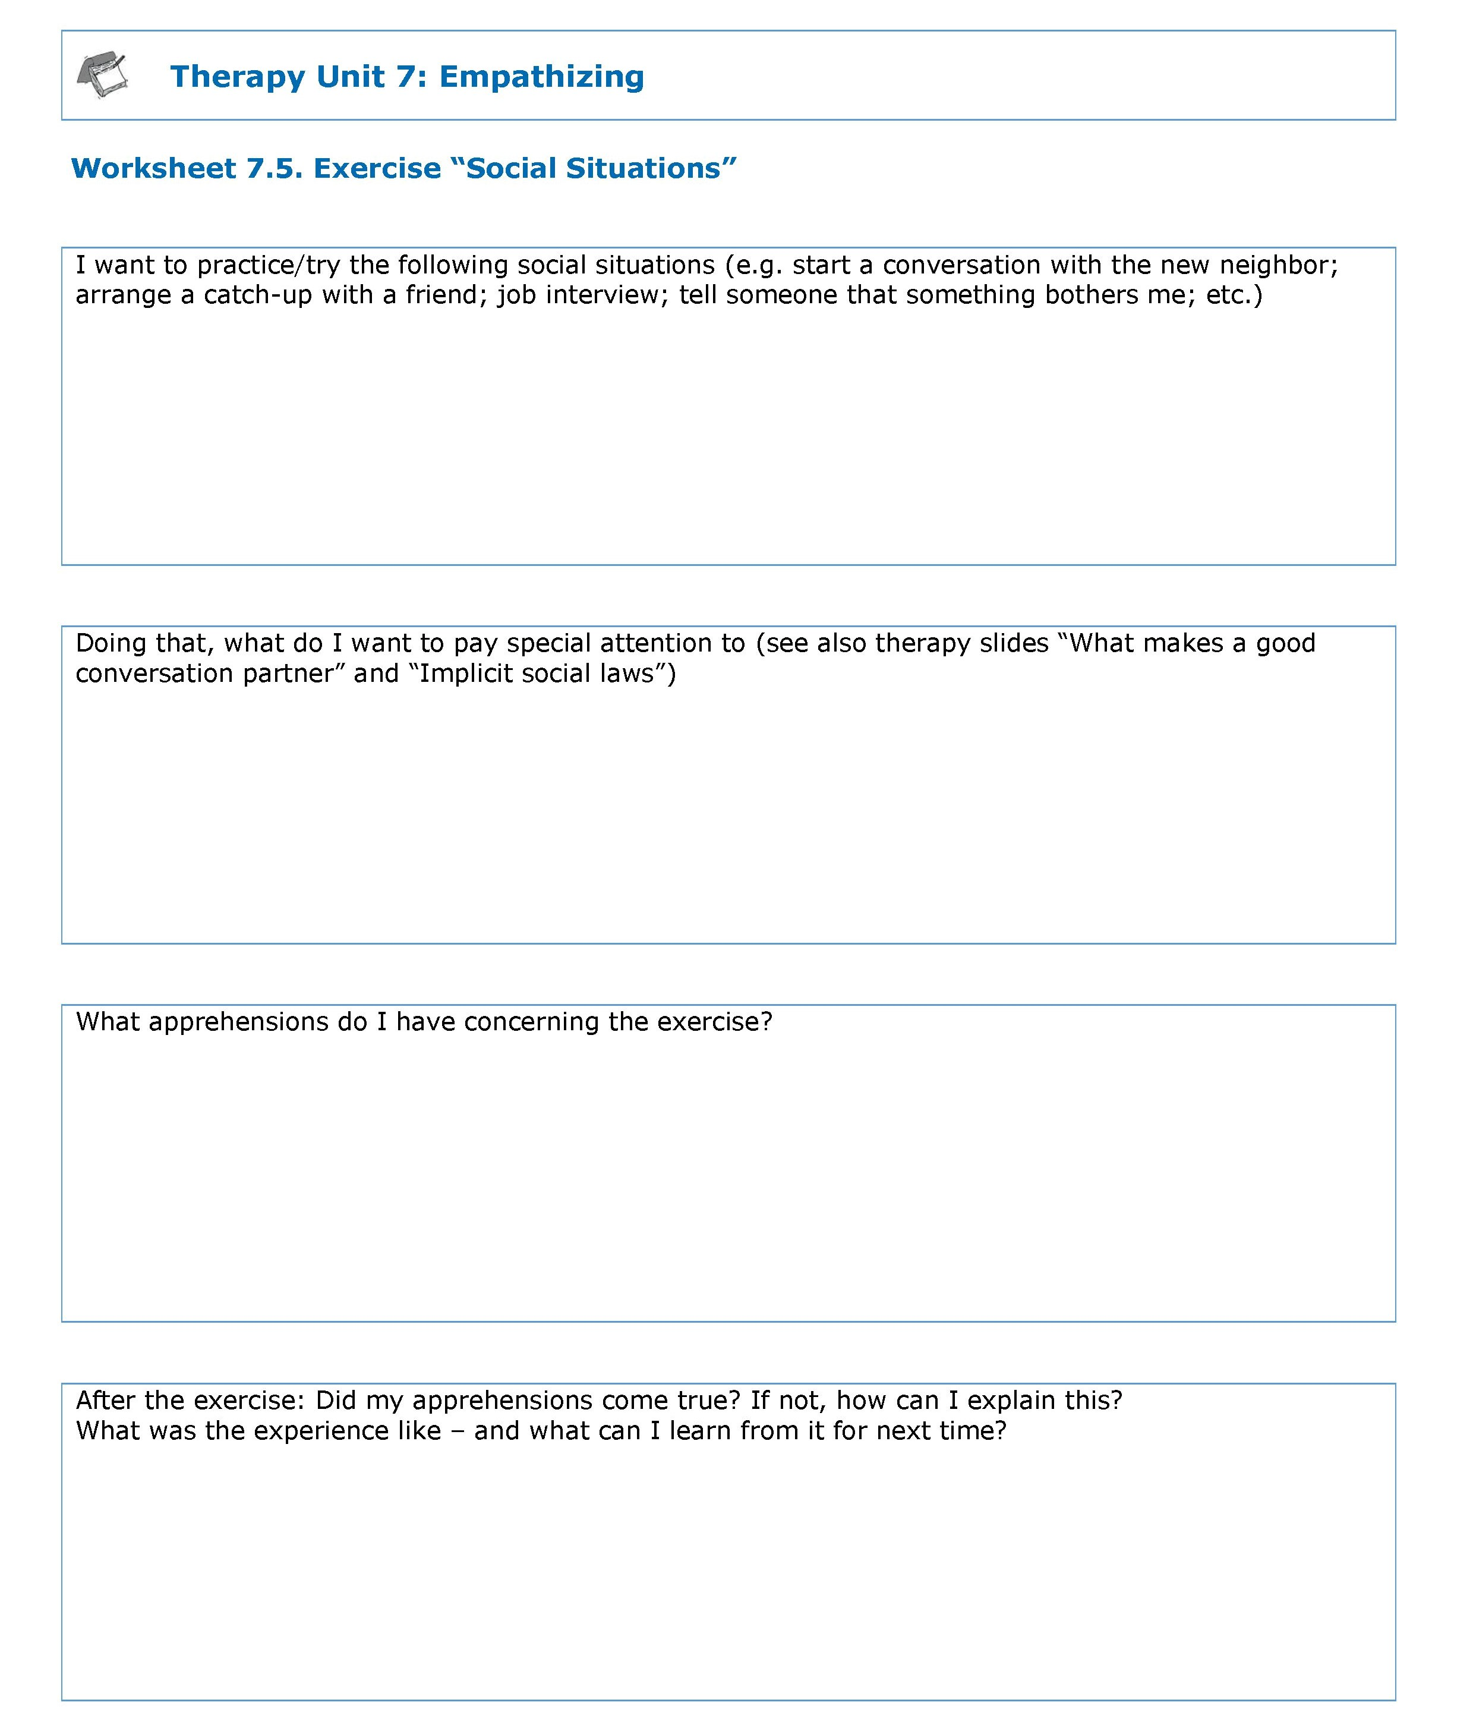
“From the therapy room into daily life”
worksheet
→ worksheet 7.5
Empathizing 7.42

Slide 43
Application to everyday life
Learning objectives:
You should only draw firm conclusions about another person if you know the person well or if you have watched the person closely.
Facial expression and gestures are important clues for what a person feels, but can be misleading sometimes!
When evaluating complex situations or other people’s behavior, it is crucial to consider all available information.
Caution: Our current state of mood influences how we perceive our environment (e.g. how you assess a person).
When interacting with other people, there are many (implicit) social rules which should be attended to.
Empathizing 7.43

Slide 44
Application to everyday life
Learning objectives:
Make it a habit to always consider at least 2-3 explanations when you feel confused, irritated, or stressed by other people’s behavior.
Also consider the other person’s lifestyle, e.g. is someone an early bird or a night owl – or the circumstances a person currently deals with. If someone makes a nasty comment, he or she is not necessarily evil or mad but maybe just thoughtless. No one reacts fairly and appropriately at all times.
Be honest: you are not always able to be fair and appropriate either.
Empathizing 7.44

Slide 45
What does this have to do with psychosis?
During psychosis, people tend to misinterpret or over-interpret facial expressions and actions of others.
Many things are in the eye of the beholder. Our mood affects our perception of our environment (e.g. feelings of suspicion when anxious; feelings of determination and fate when euphoric).
What aspects of the therapy unit do I find particularly useful or helpful?
When and in what specific situation could I apply what I learned in the near future? What could it help me with (e.g. to feel less tense)?
→ worksheet 7.6
Empathizing 7.45

Slide 46
Einfühlen
What does this have to do with psychosis?
Example: Daniel avoids using busses or the underground.
Background: Daniel repeatedly felt convinced that passengers on public transport were looking at him disapprovingly or even laughed at him.
But!: During and after his last psychosis Daniel was feeling very insecure. He payed a lot of attention to other people’s reactions. For example, when other passengers were absorbed in their newspapers, he interpreted their facial expressions as hostile or rejecting. Some passengers actually did stare at him; however, this was a reaction to his unusual behavior (looking around nervously, wearing sunglasses in winter etc.).
Empathizing 7.46
Notes:
46

