Slide 1
8.1
Metacognitive Therapy
THERAPY UNIT 8:
MEMORY AND OVERCONFIDENCE

Slide 2
Memory
Our capacity to memorize information is limited.
Example: Approximately 40% of the details of a story we have heard half an hour ago can not actively be recalled.
Advantage: ??? Unser Gehirn wird nicht mit Nebensächlichkeiten überstrapaziert, aber…
Disadvantage: ??? viele wichtige Erinnerungen gehen ebenfalls verloren (Termine, Urlaubserinnerungen, Schulwissen...).
Memory and overconfidence 8.2

Slide 3
Memory
Our capacity to memorize information is limited.
Example: Approximately 40% of the details of a story we have heard half an hour ago can not actively be recalled.
Advantage: Our brain is not overloaded with useless information, but…
Disadvantage: ... Many important memories are also lost (appointments, holiday memories, knowledge acquired in school...).
Memory and overconfidence 8.3

Slide 4
Are people with psychosis generally forgetful?
???
Memory and overconfidence 8.4

Slide 5
Are people with psychosis generally forgetful?
Yes and no!
Studies show that many people with psychosis don’t do as well in memory and attention tests as people who do not have psychosis. However, the following has to be taken into account:
These findings are based on average results that are not necessarily true for all individual cases. There are many people with psychosis that don’t show deficits.
The discovered deficits are far smaller than those of people with dementia (e.g. Alzheimer’s).
The deficits – if there are any – can improve. Rumination, inner distraction due to hearing voices or a lack of motivation can all intensify these problems or even cause them. There are specific techniques (presented later) that can compensate these problems.
Memory and overconfidence 8.5

Slide 6
Task 1
You will be shown a scene.
Afterwards you will be asked to recall what you saw in the picture.
Please also state how confident you are about your observations.
Try to remember all details correctly!
Memory and overconfidence 8.6

Slide 7
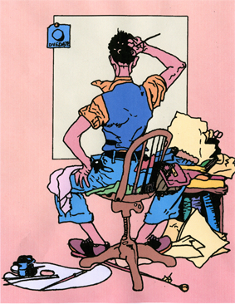
(by L. Müller)
Memory and overconfidence 8.7
Notes:
7

Slide 8
The artist
What did you see? How confident are you?
tin
chair
paint brush
easel
waistcoat
shoes
palette with paint
paper
Memory and overconfidence 8.8
Notes:
8

Slide 9
The artist
tin
chair
Paint brush
easel
waistcoat
shoes
palette with paint
paper
= not presented
(by L. Müller)
Memory and overconfidence 8.9
Notes:
9

Slide 10
Why are we doing this?
Many (but not all) people with psychosis have memory deficits that are sometimes intensified due to rumination or distraction by hearing voices.
Studies show that many people with psychosis (but not all!) are more confident in their false memories than people without psychosis.
At the same time, the confidence for true memories (i.e. things that really happened) is decreased in psychosis.
Conclusion: The ability to differentiate between true and false memories is affected! This can lead to misjudgments! When not absolutely certain, it should be considered that one is mistaken. To be sure, other people should be asked to confirm.
Memory and overconfidence 8.10
Notes:
10

Slide 11

How memory errors and being overconfident of one’s own judgments promote misinterpretations during psychosis – examples
Event | False memory | Actual situation
You’re at the supermarket and want to pay for your groceries at the register, but your wallet is empty. | Recollection that you got money out from the cash machine. Thereupon accusing your flat mate of having taken the money. | You only had the intention of going to the cash machine but then forgot about it.
Meeting old friends | Allegedly you were taunted by others for being currently out of work. | Others heard that you are unemployed when you were talking about it to a friend. There was an awkward silence for a moment, but no one reacted with taunting.
→ worksheet 8.1
Memory and overconfidence 8.11
Notes:
11

Slide 12
Task 2
You will be shown a complex scene.
Afterwards you will be asked to recall what you saw in the picture.
Please also state how confident you are about your observations.
Try to remember all details correctly!
Memory and overconfidence 8.12
Notes:
12

Slide 13
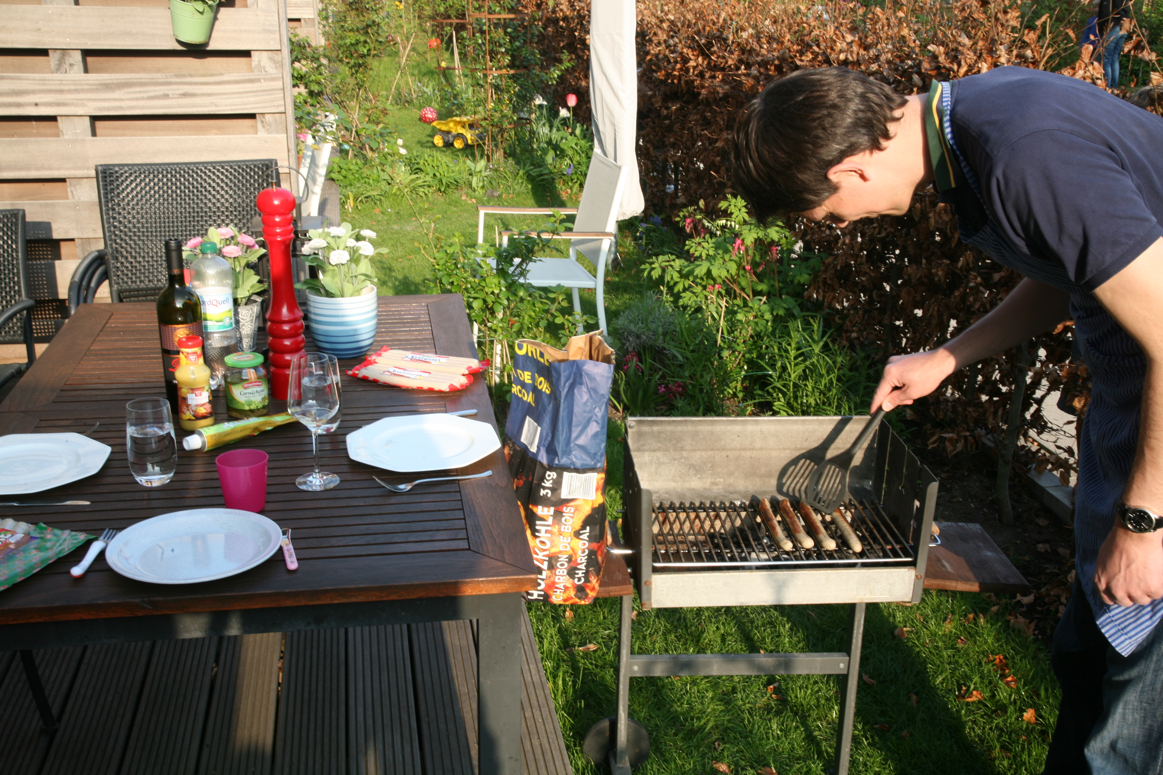
11
(© Heike Platow)
Memory and overconfidence 8.13
Notes:
13

Slide 14
Brainstorming
What do you typically see at a barbecue?
…
…
…
…
Memory and overconfidence 8.14
Notes:
14

Slide 15
Barbecue
What did you see? How confident are you?
sausages
ketchup
charcoal
lawn chairs
mustard
barbecue tongs
glasses
Memory and overconfidence 8.15
Notes:
15

Slide 16
Barbecue
sausages
ketchup
charcoal
lawn chairs
mustard
barbecue tongs
glasses
= not presented
(© Heike Platow)
Memory and overconfidence 8.16
Notes:
16

Slide 17
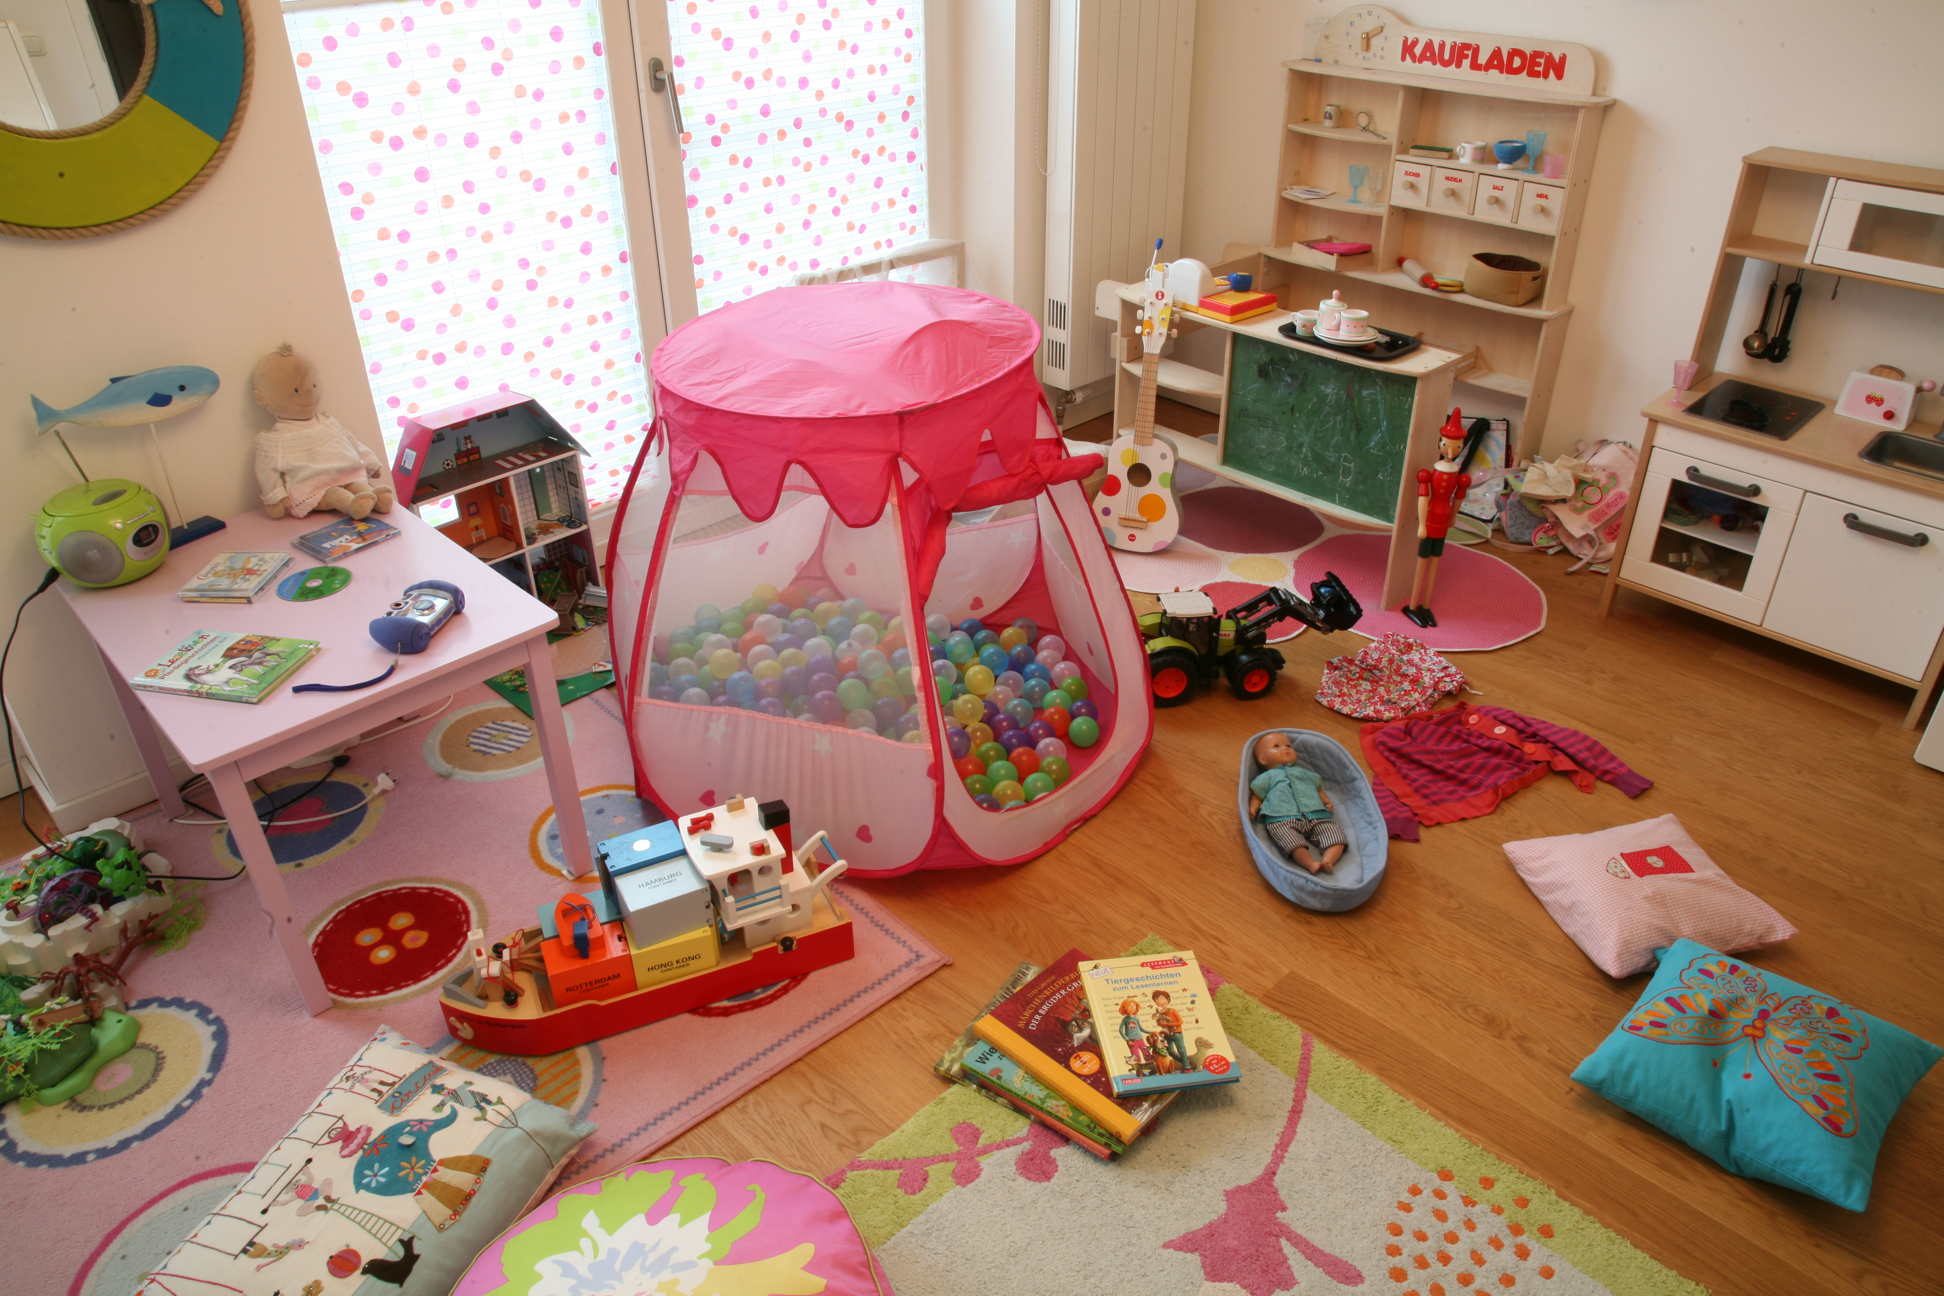
11
(© Heike Platow)
Memory and overconfidence 8.17
Notes:
17

Slide 18
Brainstorming
What do you typically see in a children’s room?
…
…
…
…
Memory and overconfidence 8.18
Notes:
18

Slide 19
Children’s room
What did you see in the picture? How confident are you?
play kitchen
dolls
stuffed animals
kids’ chairs
books
doll house
excavator
Memory and overconfidence 8.19
Notes:
19

Slide 20
Children’s room
play kitchen
dolls
stuffed animals
kids’ chairs
books
doll house
excavator
= not presented
(© Heike Platow)
Memory and overconfidence 8.20
Notes:
20

Slide 21
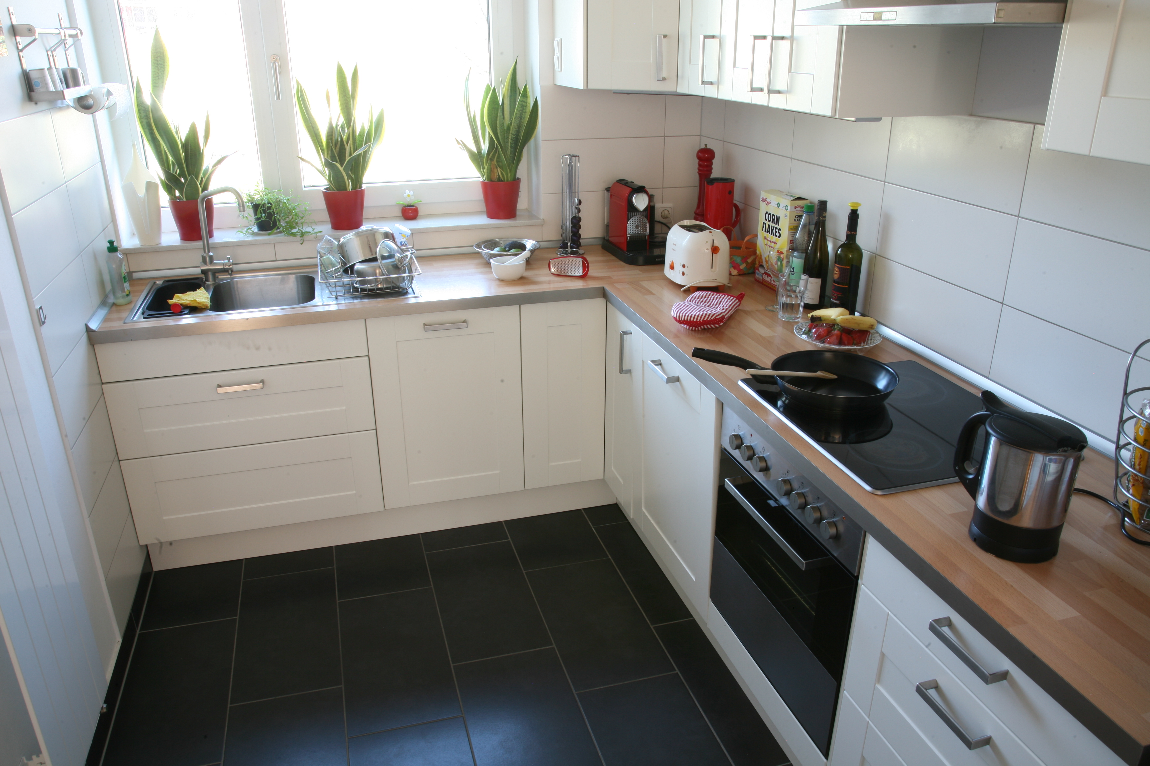
11
(© Heike Platow)
Memory and overconfidence 8.21
Notes:
21

Slide 22
Brainstorming
What do you typically see in a kitchen?
…
…
…
…
Memory and overconfidence 8.22
Notes:
22

Slide 23
Kitchen
What did you see in the picture? How confident are you?
frying pan
toaster
tea towel
kettle
cleaning cloth
bottles
knife block
Memory and overconfidence 8.23
Notes:
23

Slide 24
Kitchen
frying pan
toaster
tea towel
kettle
cleaning cloth
bottles
knife block
= not presented
(© Heike Platow)
Memory and overconfidence 8.24
Notes:
24

Slide 25
Types of memory errors
forgetting
memory biases:
→ negative memories are primarily forgotten (repression)
→ positive memories are primarily forgotten (depressed mood)
illusions/false memories: Certain things are remembered that did not happen this way!
Memory and overconfidence 8.25
Notes:
25

Slide 26
What causes false memories?
Our brain replaces and adds missing information from previous and related events (e.g. visit at the zoo, safari) and a lot is added by “logic” (in the example: rhino, lion) respectively!
Stress increases the proneness to memory errors!
Real memories can often be differentiated from false memories by their “vividness”: false memories are rather “pale” and less detailed.
Memory and overconfidence 8.26
Notes:
26

Slide 27
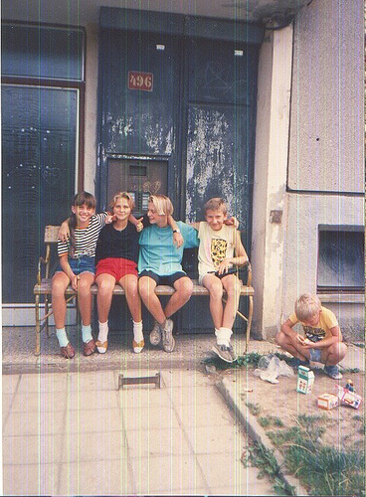
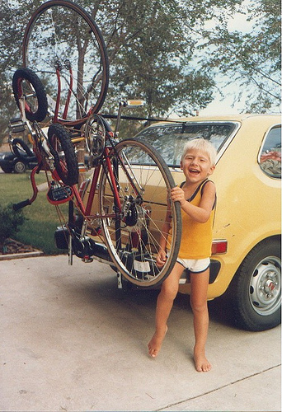
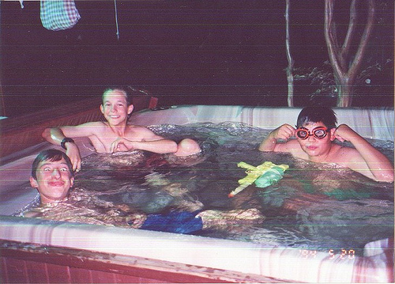
False memories in everyday life
e.g. childhood memories | Siblings’ memories of the same event often differ on many details Sometimes we think that we clearly remember certain events when we actually only know about them from pictures or our parents
e.g. when situations strongly resemble each other | e.g. looking for your car: we are sure to have parked the car at a certain place but this might have been the day before
e.g. to “get hold of the wrong end of the stick” | Our mood often adds to or “flavors” our memories (after an argument, we tend to remember what the opponent said as more hostile than it actually was)
(f.l.t.r.: “childhood untitled57”; “childhood untitled59”; “childhood untitled69” by Phil Schatz)
Memory and overconfidence 8.27
Notes:
27

Slide 28
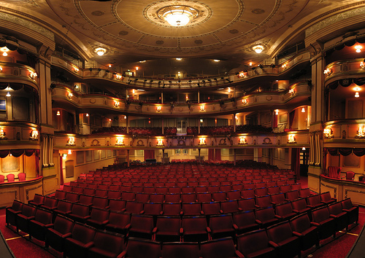
False memories in the general public
Example: causal attribution | In 2006, in a controversial decision, the performance of “Idomeneo” at the Berlin Opera House was cancelled due to the fear of protests by Islamic groups (the play presented some religious leaders, among them Mohammed, in a way that a deeply religious person might find offensive). Looking back today, some people claim to remember that the performance was cancelled following real public protests by Muslim groups, which is not true. Instead, there were also Muslims criticizing the cancellation of the opera back then.
(“Theatre Royal Panorama, Brighton, UK” by Ian Muttoo)
Memory and overconfidence 8.28
Notes:
28

Slide 29
Clinging to false memories
What are the consequences of that?
What are possible consequences of insisting on false memories, i.e. when you are wrongly convinced that they really happened?
???
Memory and overconfidence 8.29
Notes:
29

Slide 30
Clinging to false memories
What are the consequences of that?
What are possible consequences of insisting on false memories, i.e. when you are wrongly convinced that they really happened?
I get into fights with others due to contradicting memories of the same event (e.g. I demand money back that I have been paid back long ago).
In the case of (false) memories of negative events (e.g. supposedly being rejected), I react to my environment in a hostile way and do people wrong.
The line between reality and imagination becomes blurry.
Memory and overconfidence 8.30
Notes:
30

Slide 31
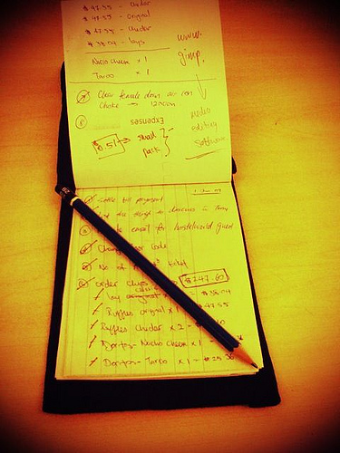
Memory aids in daily life
Do not overstrain your memory. Take notes systematically:
1. Keep an appointment calendar/memo book or use your smartphone (if applicable).
2. No paper chaos: Use one main notebook to write things down or use electronic tools.
3. Pin memos for important plans (e.g. time to take medication) at places you pass several times a day (e.g. pin board, fridge, bathroom mirror).
4. Write down intentions/plans! Whatever is written down gives our memory less to do.
5. Still try to memorize things without aids.
(“To-do list book.” by koalazymonkey)
Memory and overconfidence 8.31
Notes:
31

Slide 32
How can I remember things better?
repeat & revise, COMPREHEND
use mnemonic aids, especially for abstract contexts, e.g.:
  daylight saving:
  In spring you move your garden furniture forward in front of the house.
  In autumn you move them back into the shed.
  screwdrivers: left = loosen
link knew information with prior knowledge
do not study for excessive amounts of time
no alcohol consumption during studying
go to sleep soon after studying
study using as many of your senses as possible (e.g. hearing, seeing…)
Memory and overconfidence 8.32

Slide 33

How can I remember things better?
memory efficiency in %
hearing
The more senses are involved in a learning process, the better you will remember what you learned!
seeing
hearing
seeing
hearing
seeing
discussing
hearing
seeing
discussing
applying
(“Sinne” by Benni-Kristin Fischer)
Memory and overconfidence 8.33

Slide 34
Application to everyday life
Learning objectives:
Our memories can play tricks on us! Especially for important events (quarrel, eyewitness testimony etc.) keep in mind:
If you cannot remember vivid details about an event, think of the possibility that you might be wrong. Seek additional information (e.g. ask a witness).
Use memory aids (calendar, smartphone, notebook to write down appointments and to-do’s).
Memory and overconfidence 8.34
Notes:
34

Slide 35
Application to everyday life
Learning objectives:
False memories are more likely to arise if one is afraid, feels threatened or is under stress.
Before drawing far-reaching conclusions: consider how objective and well-founded your memories and assumptions really are!
Also take into account: false memories are often more pale (i.e. less detailed and vivid) than true memories.
Memory and overconfidence 8.35
Notes:
35

Slide 36
Application to everyday life
During psychosis people are prone to remember things that happened in a different way or not at all.
What aspects of the therapy unit do I find particularly useful or helpful?
When and in what specific situation could I apply what I learned in the near future? What could it help me with (e.g. to feel less tense)?
→ worksheet 8.2
Memory and overconfidence 8.36

Slide 37
What does this have to do with psychosis?
Example: Karen is convinced that someone broke into her flat.
Background: When she comes home from work, the flat door is not locked and the cabinet door in her bedroom stands open. Also, she had a feeling of being watched in the street this morning. Karen is close to calling the police to report the burglary and characterize the assumed persecutor.
But: Karen suddenly remembers that she overslept and hastily left her flat in the morning. That´s why she forgot to close the cabinet door and lock the front door.
Memory and overconfidence 8.37
Notes:
37

