Slide 1
THERAPY UNIT 10:
SELF-ESTEEM
Metacognitive Therapy

Slide 2

Self-esteem: What is it?
based on Potreck-Rose, 2006
???
(“Pile of Euro Notes” from Images Money)
Self-esteem 10.2

Slide 3
Self-esteem: What is it?
based on Potreck-Rose, 2006
The value that a person attaches to him or herself
Subjective appraisal of one’s self
It does not have anything to do with how other people experience you.
(“Pile of Euro Notes” from Images Money)
Self-esteem 10.3

Slide 4
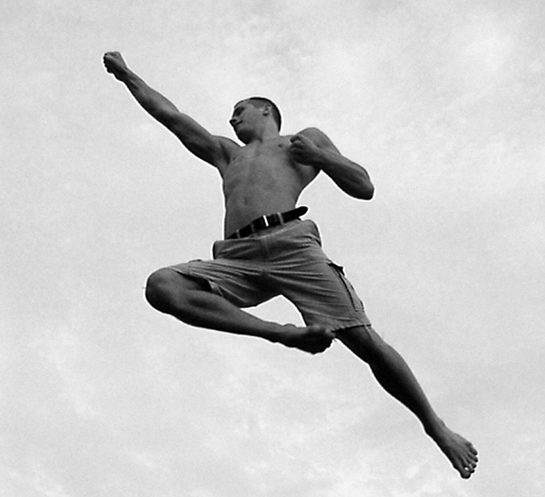
What distinguishes people with a healthy self-esteem?
Voice: ??? klar, deutlich, angemessene Lautstärke
Mimics/gestures: ??? Blickkontakt; festes Auftreten
Posture: ???
(“Superman” by Linus Bohman)
Self-esteem 10.4

Slide 5

Outwardly observable characteristics of a healthy self-esteem
Voice: clear, well-articulated, appropriate volume
Mimics/gestures: eye contact, use gestures to emphasize main points
Posture: straight, upright
…like with everything: don’t overdo it (staring at people, constantly interrupting others, always playing the “alpha dog”!)
(“Goodbye Beach!” from thephotographymuse)
Self-esteem 10.5

Slide 6
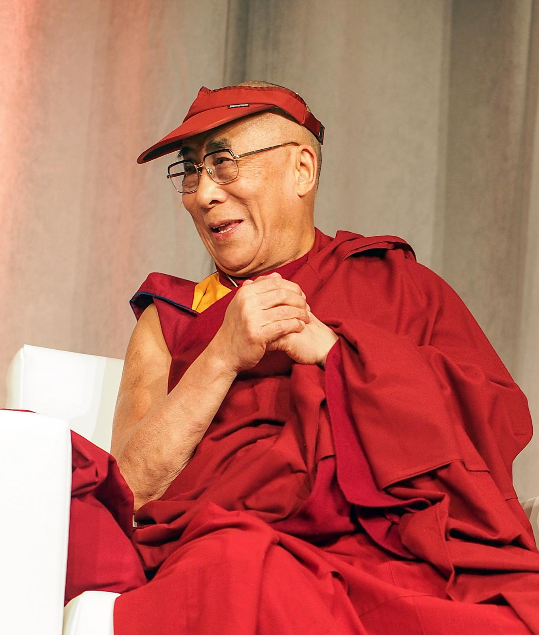
Not directly observable characteristics of a healthy self-esteem
???
(“Tenzin Gyatso - 14th Dalai Lama” by Chistopher Michel)
Self-esteem 10.6

Slide 7
Not directly observable characteristics of a healthy self-esteem
Confidence in one’s own abilities, even when things are not going so well
Accepting of errors or failures (without devaluing oneself)
Introspective; readiness to learn from errors/failures
Positive attitude towards oneself, for example, praising yourself for a success
(“Tenzin Gyatso - 14th Dalai Lama” by Chistopher Michel)
Self-esteem 10.7

Slide 8
Why are we doing this?
Studies show that many (but not all!) people with psychosis have low self-esteem.
This is often hardly taken into consideration during a therapy, due to the fact that generally other afflictions are focussed on first (e.g. hearing voices, experiencing threat).
However, many patients say that they suffer more and longer from self-esteem issues than from other symptoms of the psychosis.
With the help of specific strategies, self-esteem can be actively improved!
Self-esteem 10.8

Slide 9



Psychosis and self-esteem
Psychosis can have different effects on the emotional constitution
Negative effects of psychosis on (mood) self-esteem | Short-term positive effects of psychosis on (mood) self-esteem
→ worksheet 10.1
Self-esteem 10.9

Slide 10
Psychosis and self-esteem
Psychosis can have different effects on the emotional constitution
Negative effects of psychosis on (mood) self-esteem | Short-term positive effects of psychosis on (mood) self-esteem
During psychosis: experiencing threat, fear | During psychosis: rush, excitement, “something is happening at last”
During psychosis: hearing insulting voices. One thus feels worthless and offended. | During psychosis: hearing flattering and affirming voices. One thus feels less lonely sometimes.
After psychosis: feeling ashamed, future may seem shattered (e.g. abandoned by friends and family) | During psychosis: feeling of power, talent, importance (powerful enemies) and destiny
→ worksheet 10.1
Self-esteem 10.10

Slide 11
Psychosis and self-esteem
Psychosis can have different effects on the emotional constitution
The short-term positive effects of psychotic symptoms on self-esteem are generally washed out by the long-term negative consequences.
Abruptly stopping medicine to revisit an exciting world of psychosis is a dangerous game with fire – particularly as fear is often predominant during psychosis!
Self-esteem 10.11

Slide 12

Sources of self-esteem
Self-esteem is not constant, rather it can vary across different activities (symbolised on the right as a book shelf)
The crucial point is whether we pay attention to only our weaknesses (= empty shelves) or also our strengths and abilities (= full shelves)
Hobbies
Relationship
Abilities
Sport
Appearance
Job
Self-esteem 10.12
(“Neues Regal” by Michael Fielitz)

Slide 13
People with low self-esteem…
… tend to pay attention to their own empty shelves and other people’s full shelves
… tend to make negative global appraisals of themselves (“I am worthless”)
… equate behaviour and person (something fails = I am a failure)
Hobbies
Hobbies
Relationship
Beziehung
Sport
Abilities
Sport
Fertigkeiten
Job
Appearance
Beruf
Aussehen
Loser!
Self-esteem 10.13
(“Neues Regal” by Michael Fielitz)

Slide 14
Nothing held back…
I can cook fairly well; I have a good knowledge of world politics; I dance badly but enjoy it nonetheless; I am very interested in cinema…
I am a family person and can make others laugh…
Hobbies
Hobbies
Beziehung
Relationship
Sport
Abilities
Sport
Fertigkeiten
I like my hair, I am happy with my skin but think I am too chubby…
Job
Aussehen
Beruf
Appearance
I feel overstrained in my job; failed an exam; trouble with work colleagues…
What shelf have you not had a look at in a long time? What hidden treasures can you find there?
→ worksheet 10.2
Self-esteem 10.14
(“Neues Regal” by Michael Fielitz)

Slide 15
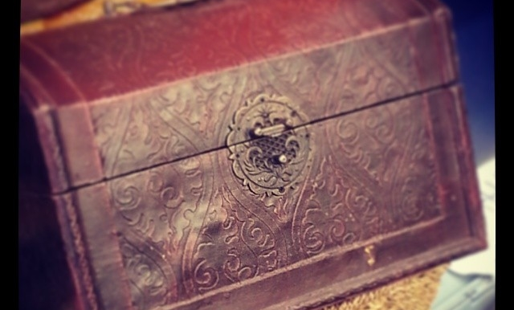
Remembering your strengths
Why is it sometimes difficult to name our own strengths?
  Obstructive assumption: “Don’t toot your own horn.”
  During acute illness there are fewer possibilities to show own strengths and recognize them oneself.
Self-esteem 10.15
(“treasure chest” by burnbless)

Slide 16
Remembering your strengths
Finding “lost treasures”:
  Ask your friends and family what your strengths are and what they value in you.
  Think of concrete situations, in which you achieved something and maybe received compliments for it – they can be small things too.
  …and write down your experiences in a “joy-diary”* so you can fall back on them during bad times.
* In a joy-diary, only the positive events of the day should be noted
→ worksheet 10.3
Self-esteem 10.16
(“treasure chest” by burnbless)
Notes:
Ruth: Verweis auf Arbeitsblatt einbauen

Slide 17
Inner critic
based on Potreck-Rose, 2006
Most people have an inner voice that is called “inner critic”. It often tells us things that we have formerly heard from others (e.g. mean classmates, strict teachers, ambitious parents). The inner critic is not a real person or external enemy, but rather shows just how deeply we have absorbed criticism and exaggerated expectations.
You‘re bad at everything!
You‘re worthless.
Inner critic: know-it-all, nagger, pusher, dogmatist
What is the function of the inner critic?
Self-esteem 10.17

Slide 18
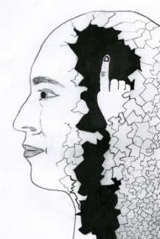
Inner critic
based on Potreck-Rose, 2006
Function of the inner critic:
He spurs us on, helps us to perform better and to face challenges.
Danger:
People with low self-esteem have a very dominant and often too demanding inner critic.
The inner critic should have his place, but not define the entire life.
Self-esteem 10.18
(“Innerer Kritiker” by Lisa Schilling)

Slide 19
Inner critic and kind companion
based on Potreck-Rose, 2006
The opponent of the inner critic is the inner kind companion. Just like the inner critic, this is not a real person, but brings up positive (self-esteem boosting) judgements and memories. People with low self-esteem have a very small and quiet kind companion compared to their big and loud inner critic.
You did well, you can be proud of yourself.
You‘re bad at everything!
You‘re worthless.
Kind companion: appreciates what was done well, caring, judges leniently
Inner critic:
know-it-all, nagger, pusher, dogmatist
Self-esteem 10.19

Slide 20
Strengthen the kind companion
based on Potreck-Rose, 2006
  In order to let the kind companion have more of a say in things, it is helpful to find a figure or a symbol for him which only represents positive things. This could be e.g. a good fairy or a guardian angel or even a cartoon hero or a stuffed animal that symbolises this for you.
You did well, you can be proud of yourself.
  It is best not to choose a real person since we never think only positive things about someone, but negative things too.
What could your kind companion look like?
Close your eyes and imagine what such a kind companion would have to be like for you. Look within yourself and try to find a symbol for that. Take your time. Maybe more than one image come to mind. Is one of them stronger than the others?
Double-check if your kind companion really only radiates kindness, encouragement and support.
Self-esteem 10.20

Slide 21
Strengthen the kind companion
based on Potreck-Rose, 2006
In daily life it is often difficult for people with low self-esteem to let the kind companion have a say. Therefore, it can be helpful to write down one or more of the kind companion’s positive sentences, to have them at hand.
Example: John would like to quit smoking and has already lasted three days. After a fight with his girlfriend he lights up a cigarette.
His inner critic speaks up: “You loser. It was so obvious that you weren’t going to make it. You suck at everything”.
What could the kind companion say?
???
Self-esteem 10.21
(“Innerer Kritiker” by Lisa Schilling)

Slide 22
Strengthen the kind companion
based on Potreck-Rose, 2006
In daily life it is often difficult for people with low self-esteem to let the kind companion have a say. Therefore, it can be helpful to write down one or more of the kind companion’s positive sentences, to have them at hand.
Example: John would like to quit smoking and has already lasted three days. After a fight with his girlfriend he lights up a cigarette.
His inner critic speaks up: “You loser. It was so obvious that you weren’t going to make it. You suck at everything”.
Kind companion: “Don’t be so strict with yourself. It really isn’t easy to quit smoking and even so you lasted three days. In stressful situations it is even more difficult. Just because you smoked a cigarette now does not mean that you will have to keep smoking. Other ex-smokers usually need several attempts too, before they can
be completely smoke-free.”
Self-esteem 10.22
(“Innerer Kritiker” by Lisa Schilling)

Slide 23
Strengthen the kind companion
based on Potreck-Rose, 2006
What are typical situations in which your inner critic is very loud and you devaluate yourself? What could your kind companion say in these situations? Write it down.
Stop short throughout the day and keep asking yourself what your kind companion would say in this situation. Actively look for him, since it feels very unfamiliar at first to pay attention to the positive instead of the negative.
Write down your kind companion’s answers. In times of discouragement, you can read them to help you take courage.
→ worksheet 10.4
Self-esteem 10.23
(“Innerer Kritiker” by Lisa Schilling)

Slide 24
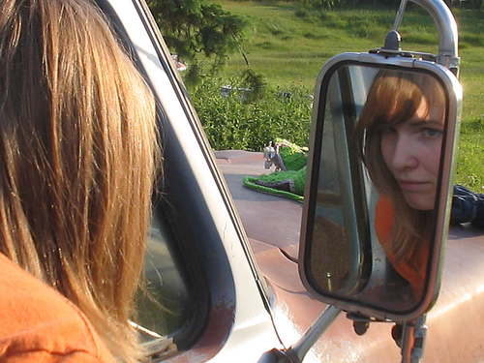
Applying your own standards as the ultimate measurement
There is a difference between how I judge myself and how others judge me!
  If I consider myself ugly, boring etc., others do not necessarily share this view. There are multiple opinions, judgements and preferences!
  Many people are their own worst enemies and are overcritical of themselves! Their inner critic is, as we have just seen, particularly big and loud.
(“Mirror Love” by Katie@!)
Self-esteem 10.24

Slide 25
Comparing with others
  Do you often compare yourself with others?
  If so, with whom?
  How do you fair in these comparisons?
Self-esteem 10.25
Notes:
25

Slide 26
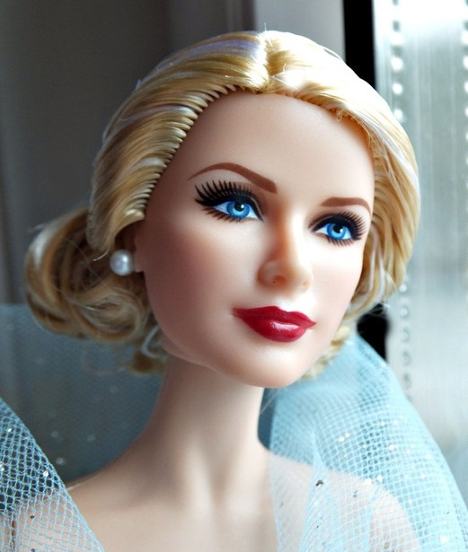
Comparing with others
  Quickly and without noticing it, we compare ourselves with others. This is normal.
  With whom and in what areas we compare ourselves may influence our self-esteem. People with self-esteem issues often choose unfair comparisons (e.g. top manager when it comes to wages)
(“Barbie close-up. Grace” from BarbieFantasies)
Self-esteem 10.26

Slide 27
Comparing with others
Another example for unfair comparisons
  Girl that compares her appearance with pictures of models in glossy magazines (make-up and digital picture editing make the comparison even more unfair)
  Don’t compare yourself too much with other people! There are always people who are better-looking, more successful and more popular.
  Include all areas of life when you are assessing a seemingly “perfect biography”…
Self-esteem 10.27

Slide 28
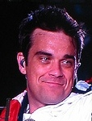

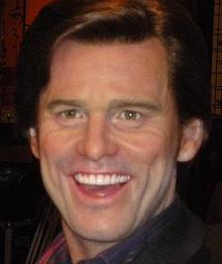

“Perfect Life…?”
Do you know these people?
(f.l.t.r: “Robbie Williams” from gwelt; “Princess Diana in Bristol, UK, 1987” by Floyd Nello; “P1010594” from greginhollywood; “i love NY” by leezie5)
Self-esteem 10.28

Slide 29
“Perfect Life…?”
Do you know these people?
  …famous, rich, good looking, successful???
  BUT: Every one of these famous people has or had psychological problems.
(f.l.t.r: “Robbie Williams” from gwelt; “Princess Diana in Bristol, UK, 1987” by Floyd Nello; “P1010594” from greginhollywood; “i love NY” by leezie5)
Self-esteem 10.29

Slide 30
“Perfect Life…?”
Robbie Williams became famous as a member of the band “Take That”, which he eventually had to leave because of drug use. Later, he began a successful career as a singer. In February 2007, he was admitted to a clinic for addiction to pills and depression.
To the outside world, princess Diana, the first wife of British crown prince Charles, lead a dream life: Money and luxury, admired all over the world for her looks and her charity work. However, she was in fact suffering from bulimia and depression for years. 1997 she was killed in a car accident.
The comedian and actor Jim Carrey suffered from severe depression for a long time. At first, antidepressants helped him to overcome his low periods. He now successfully uses other strategies (e.g. psychotherapy) to treat his depression.
The British soccer star David Beckham suffers from obsessive compulsive disorder. It is very difficult for him when something in his environment is out of order or not symmetrically placed. In an interview, Beckham stated that he suffers from it immensely, as he frequently loses time and experiences interpersonal conflicts as a result.
(f.l.t.r: “Robbie Williams” from gwelt; “Princess Diana in Bristol, UK, 1987” by Floyd Nello; “P1010594” from greginhollywood; “i love NY” by leezie5)
Self-esteem 10.30

Slide 31
Application to everyday life
Learning objectives:
  Self-esteem is the value we place on ourselves. It is never objective.
  Try to take into account and strengthen your self-esteem in different areas of life.
  Search after hidden strengths – e.g. by asking your friends or keeping a “joy diary”.
  Don’t make unfair comparisons.
  Don’t blindly believe what the inner critic is telling you.
  Let the inner kind companion speak to you and look upon you with favour. You could, for example, tell yourself in front of the mirror every day: “I like you, you’re doing great here!” (or also “I like myself!”)
Self-esteem 10.31

Slide 32
Application to everyday life
Tips to appreciate the beautiful things more that one experiences in one day:
  When leaving the house, take a handful of pellets (beans, marbles, etc.) with you in your right-hand pocket.
  Every time you experience something positive (e.g. a smile of a friend, nice conversation, good lunch, etc. ...), move one pellet from the right pocket to the left.
  In the evening, take the pellets out of the left pocket and remind yourself of the beautiful things you experienced that day.
  This way you preserve positive moments and enjoy the present. Unfortunately, we let the good things in life pass by unnoticed way too easily.
  Do you know other methods on how to enjoy and/or remember the good things of the day?
Self-esteem 10.32

Slide 33
What does this have to do with psychosis?
Many (but not all!) people with psychosis have low self-esteem, especially after a psychotic episode (e.g. feeling ashamed; fear of friends turning away).
Many people experience fear but also other emotions during psychosis:
Excitement (“Something is happening at last!”)
Sense of destiny (to fulfil a mission; to be important)
The discussed techniques are meant to help build a healthy and durable self-confidence.
What aspects of the therapy unit do I find particularly useful or helpful?
When and in what concrete situation could I apply what I learned in the near future? How could it be helpful (e.g. to feel less tense)?
→ worksheet 10.5
Self-esteem 10.33

Slide 34
What does this have to do with psychosis?
Example: Max feels more and more sad and thinks he is not good for anything anymore: “I don’t have a job and I am a burden to my family.”
But: Max is currently registered as unemployed, which does not mean that he is incapable. He has got many talents and strengths to help find a work placement (e.g. he has a good technical knowledge and repairs other people’s computers; he is widely read). Besides, he has his family and some good friends who love him.
Self-esteem 10.34

