Slide 1
THERAPY UNIT 11:
LIVING WITH PSYCHOSIS
AND RELAPSE PREVENTION
Metacognitive Therapy

Slide 2
Is it normal to have psychological problems?
How many people are mentally ill?
What do you think?
Living with psychosis and relapse prevention 11.2

Slide 3
Is it normal to have psychological problems?
How many people are mentally ill?
A study from 2014 (Jacobi et al., Nervenarzt 1, 2014) found the following:
When also taking into account people who suffer from single symptoms of mental disorders, these numbers are significantly higher.
Percentage of people that had been mentally ill in the past year | 28%
Depression (most common illness) | 10.6%
Psychosis (includes (among others) schizophrenia and organic psychosis) | 2.6%
Percentage of those who suffered from several mental illnesses at the same time | 50%
Living with psychosis and relapse prevention 11.3

Slide 4

What is stigma and what is self-stigma?
Stigma = literally from Greek: brand, scar or marking
Stigmatization = people/groups are ascribed negative characteristics.
  This happens without any verification or checking the accuracy of such ascriptions.
  Stigmatization leads to a degradation and exclusion of people.
  Stigmatization often occurs in connection with particular illnesses (e.g. HIV), visible disabilities and mental health issues.
  “Self-stigma” means that the affected persons themselves interiorize the experienced stigmatization to the point of feeling inferior.
Living with psychosis and relapse prevention 11.4

Slide 5

Psychosis as a stigma
The term psychosis or schizophrenia arouses wrong impressions in many people. Due to biased depictions in the media, people with psychosis often get labeled as dangerous and unpredictable.
Occasional assumptions about people with psychosis:
They are…
…dangerous and unpredictable
…split personalities (psychosis)
…less intelligent
…incurably ill
Justified? NO!
Living with psychosis and relapse prevention 11.5

Slide 6
Psychosis as a stigma
…dangerous and unpredictable?
People with psychosis are victims rather than perpetrators of violence and abuse.
But: When they are perpetrators...
…newspapers are more likely to report about them, as the type of crime sometimes stands out (e.g. attack on John Lennon by a mentally ill perpetrator).
The strategy of lawyers to justify acts of violence with mental illness (whether true or not) can increase this reputation.
Justified? NO!
Living with psychosis and relapse prevention 11.6

Slide 7
Psychosis as a stigma
…split personalities: In the general public, the word schizophrenic (Greek: split and mind) is often equated with “split personality” and therefore used wrongly. They are not the same illness! Besides, it is disputed if split or multiple personalities exist at all.
…stupid: The development of mental illnesses is in no way related to intelligence. There are people with psychosis that are exceptionally intelligent.
Justified? NO!
The main symptoms of the disorder are:
Hallucinations: e.g. hearing offensive voices
Delusions: e.g. being convinced of persecution by the secret service or to be elected to save the world
Other (unspecific) symptoms: e.g. depression, difficulties with speech and attention
Living with psychosis and relapse prevention 11.7

Slide 8
Stigmatization – What to do?
  Due to a biased presentation in the media, affected people are sometimes labelled as generally dangerous and unpredictable (“seen one, seen them all”).
  Inform yourself on the topic of psychosis. This way you can correct wrong assumptions of other people by using facts.
Living with psychosis and relapse prevention 11.8

Slide 9

(How) do I communicate my disorder?
Schizophrenia is not a notifiable illness. It is your decision whether or not you tell others about your diagnosis. Especially when you don’t know a person very well it is often better to just roughly describe your disorder rather than using the professional term which is often capable of being misunderstood.
Sometimes direct communication makes sense – e.g. when you had an argument with someone during an acute phase of illness and there is need for an explanation of your behavior at the time.
Talking about your disorder with people you trust and are close to can be important for yourself, because…
…it can be a relief.
…others are often better at noticing the early warning signs of a beginning psychotic phase than the concerned people themselves.
→ worksheet 11.1
Living with psychosis and relapse prevention 11.9

Slide 10
(How) do I communicate my disorder?
Suggestion: explaining the symptoms instead of naming the diagnosis
  Especially when you don’t know a person very well it is often better to roughly describe your symptoms rather than using the professional term (schizophrenia, psychosis) which is often capable of being misunderstood.
  In order to be able to explain the disorder to others, it is advisable to become an expert of it yourself.
Living with psychosis and relapse prevention 11.10

Slide 11
(How) do I communicate my disorder?
The main symptoms of psychosis and schizophrenia:
  Hallucinations: Hearing or (more rarely) seeing, feeling or tasting things that are not there (e.g. hearing offensive voices)
Example for communication:
???
Living with psychosis and relapse prevention 11.11

Slide 12
(How) do I communicate my disorder?
The main symptoms of psychosis and schizophrenia:
  Hallucinations: Hearing or (more rarely) seeing, feeling or tasting things that are not there (e.g. hearing offensive voices)
Example for communication:
  “Hallucinations are more common than many people think they are. Around 15% of the population are familiar with hearing voices or other hallucinations. Most of these people don’t have a mental disorder. Hearing voices is a form of “thinking aloud”, similar to having song stuck in your head. It has been reported that some mothers frequently hear their baby cry when in reality it is sleeping peacefully. The classic case is mistakenly hearing your phone ring when you are waiting for a call.”
Living with psychosis and relapse prevention 11.12

Slide 13
(How) do I communicate my disorder?
  Delusions: being convinced by something that is not true (e.g. the conviction of being persecuted by the secret service or being elected to save the world).
Example of communication:
???
Living with psychosis and relapse prevention 11.13

Slide 14
(How) do I communicate my disorder?
  Delusions: being convinced by something that is not true (e.g. the conviction of being persecuted by the secret service or being elected to save the world).
Example of communication:
  “Almost everyone has at some point had the feeling that the whole world was against them or that people in the street were giving them strange looks. In my case these feelings were even stronger. I was entirely convinced that particular people were after me and trying to harm me. I now know that that this wasn’t true.”
  “There are some days when you feel ready to take on the whole world. You think that you could do anything and that no one was better than you. In my case this state lasted longer than normal and unfortunately I overestimated and overstrained myself.”
Living with psychosis and relapse prevention 11.14

Slide 15
(How) do I communicate my disorder?
Other (unspecific) symptoms: e.g. depression, sleep disturbances and difficulties with attention
Example for communication:
???
Living with psychosis and relapse prevention 11.15

Slide 16
(How) do I communicate my disorder?
Other (unspecific) symptoms: e.g. depression, sleep disturbances and difficulties with attention
Example for communication:
  “Everyone gets sad sometimes. Unfortunately, my sadness lasted a really long time. I felt very down and hopeless and thought it would never stop. Nothing cheered me up, I was hardly able to get anything done and just hid away at home. My self esteem was really low during that time. Luckily it did get better after a while!”
Living with psychosis and relapse prevention 11.16

Slide 17
Results of a survey in the general public*
Certain psychotic-like experiences are quite common in the general population. Contrary to people with psychosis these experiences do not lead to impairment in every day life and are rarely judged to be 100 % true.
Statements that are supported by people without a psychotic disorder | yes-answers
Did you ever think that people can communicate telepathically? | ???
Do you believe in the power of witchcraft, voodoo or the occult? | ???
Have you ever felt as if other people can read your mind? | ???
Did you ever think that everyone was gossiping about you? | ???
Have you ever had experiences with the supernatural? | ???
Do things around you ever feel unreal, as though it was all part of an experiment? | ???
Have you ever felt as if you were being persecuted in some way? | ???
Have you ever felt as if things in magazines or on TV were written especially for you? | ???
Do you occasionally hear voices although no one is there? | ???
* Sources: Emmanuelle R. Peters (Instrument: PDI), Steffen Moritz (Instrument: KSF)
Living with psychosis and relapse prevention 11.17

Slide 18
Results of a survey in the general public*
Certain psychotic-like experiences are quite common in the general population. Contrary to people with psychosis these experiences do not lead to impairment in every day life and are rarely judged to be 100 % true.
Statements that are supported by people without a psychotic disorder | yes-answers
Did you ever think that people can communicate telepathically? | 61%
Do you believe in the power of witchcraft, voodoo or the occult? | 44%
Have you ever felt as if other people can read your mind? | 33%
Did you ever think that everyone was gossiping about you? | 32%
Have you ever had experiences with the supernatural? | 26%
Do things around you ever feel unreal, as though it was all part of an experiment? | 26%
Have you ever felt as if you were being persecuted in some way? | 19%
Have you ever felt as if things in magazines or on TV were written especially for you? | 16%
Do you occasionally hear voices although no one is there? | 15%
* Sources: Emmanuelle R. Peters (Instrument: PDI), Steffen Moritz (Instrument: KSF)
Living with psychosis and relapse prevention 11.18

Slide 19


Relapse prevention
single episode
Mental disorders (e.g. psychosis) may or may not reoccur. The individual courses are very variable:
several episodes
several episodes with some symptoms in-between
several episodes with increasing symptoms in-between
(“Verlauf Symptomatik” by Ruth Klinge)
Living with psychosis and relapse prevention 11.19

Slide 20
Stress scales
In order to be well, stress and relaxation should be kept in balance. If strain prevails the scales become unbalanced. This raises the risk of relapse.
Stress
Relaxation
→ worksheet 11.2
(adapted from Behrendt, 2001)
Living with psychosis and relapse prevention 11.20

Slide 21

Stress reduction
Allow yourself timeouts and breaks
Do things you enjoy
Learn relaxation techniques
Allow friends to help you
Make plans carefully, think intentions through from A to Z
(“A Spot to Relax” by xtacocorex)
Living with psychosis and relapse prevention 11.21

Slide 22
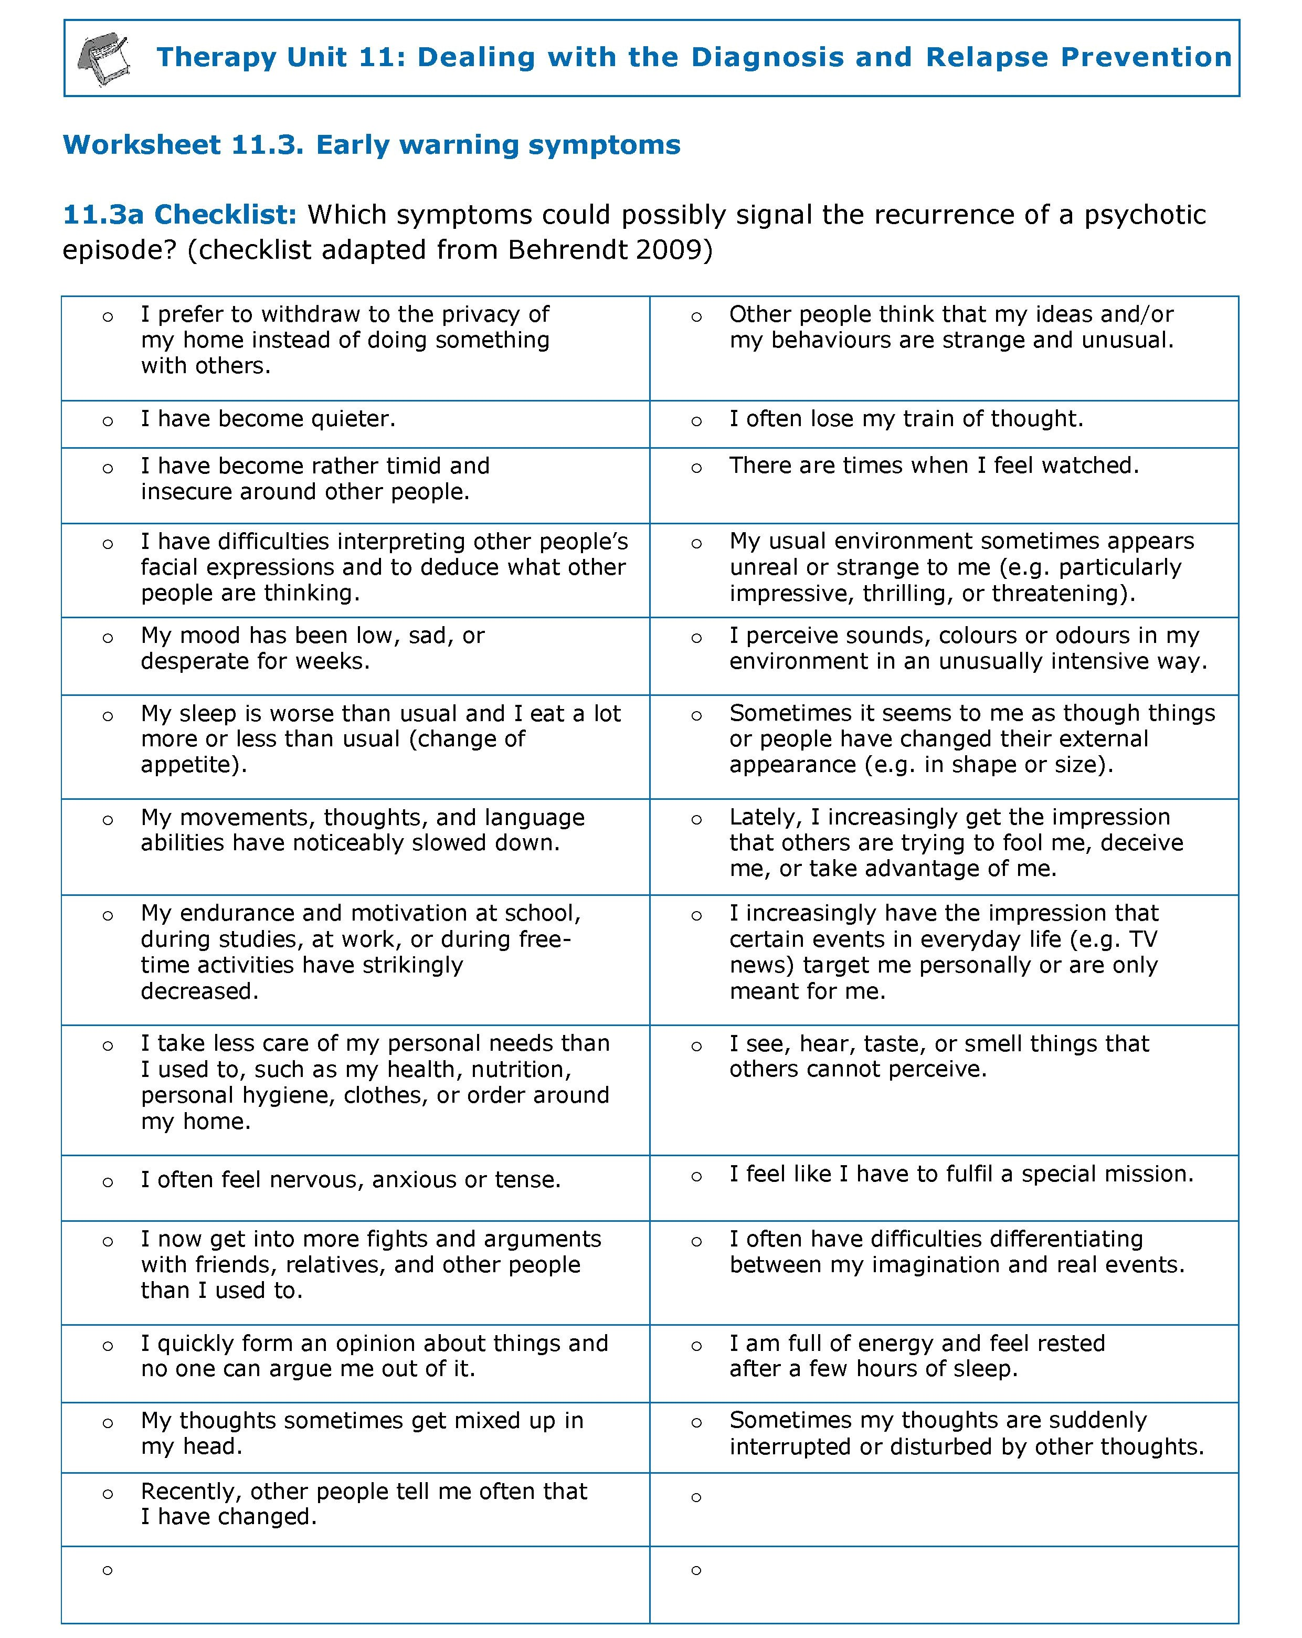
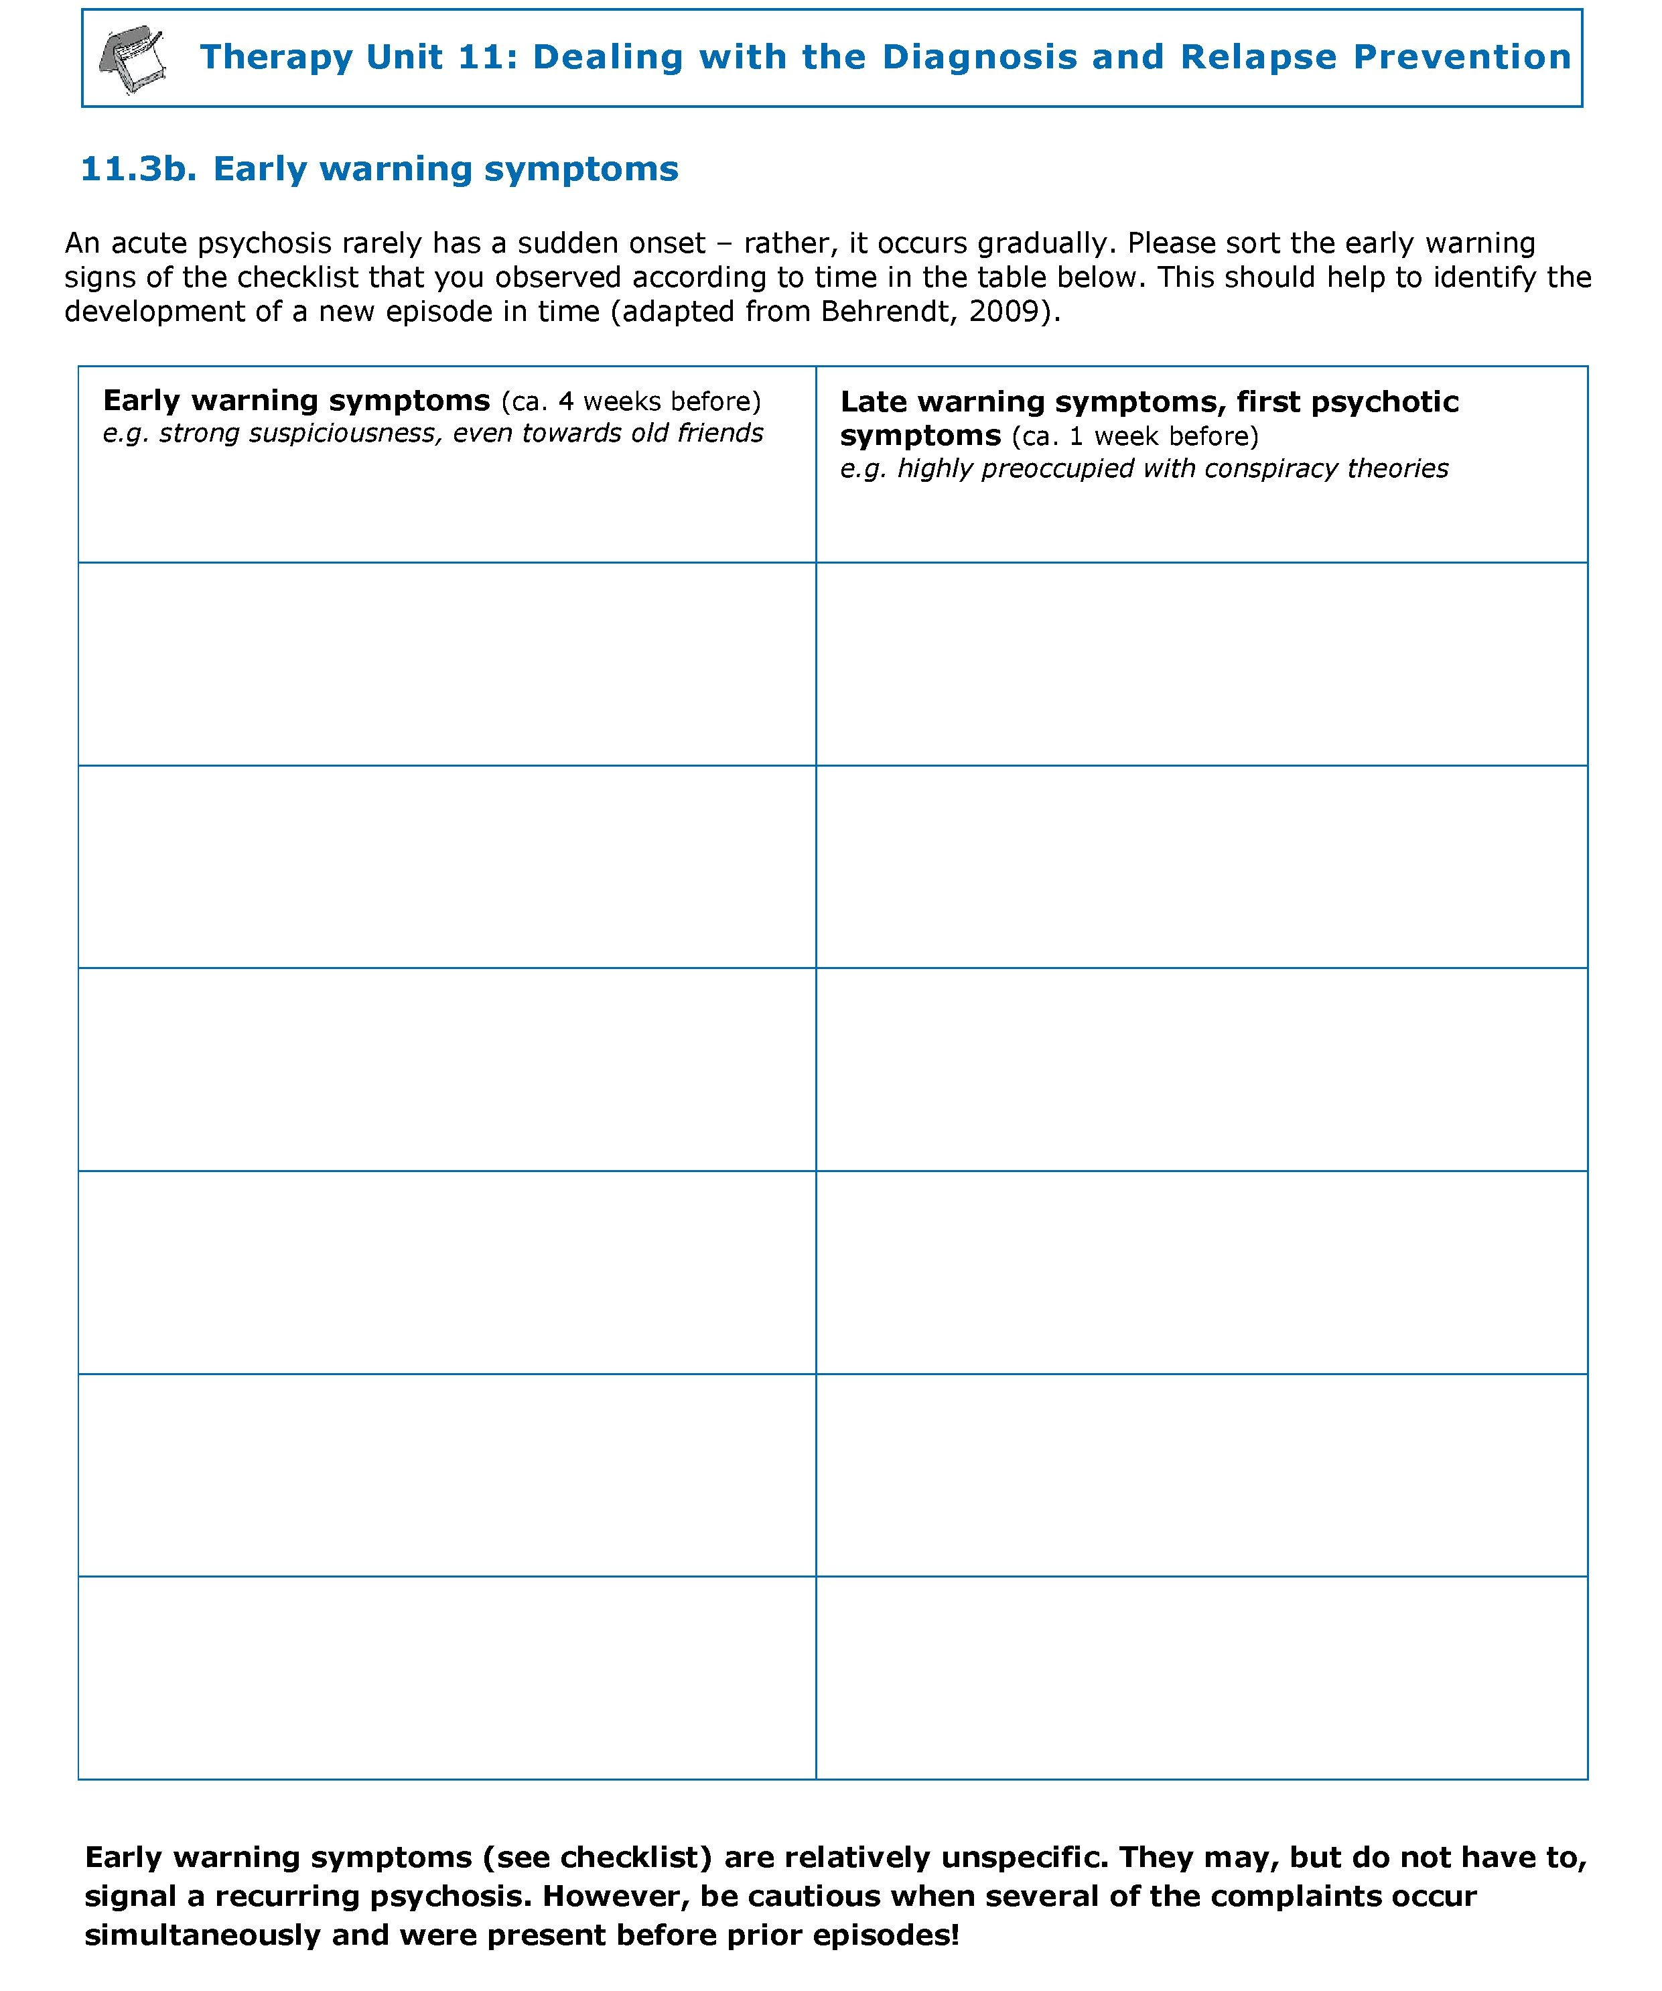
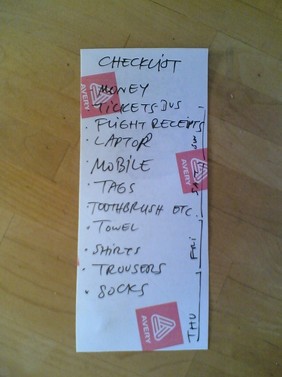
Early warning symptoms: excerpt from checklist
Worksheet
Worksheet
→ worksheet
11.3 a, b
(Checklist in dependence on Dr. med. T. Wobrock, “Checklist” by akaalias)
Living with psychosis and relapse prevention 11.22

Slide 23
Emergency plan
What do I do when I notice warning signs of psychosis?
Symptoms | What I do:
Early warning symptoms: e.g. nervousness, not being able to bring oneself to go to work, getting into fights with others more often | e.g.: I look after myself better, try to reduce stress and practice relaxation techniques. I ask people I trust if they are noticing any change.
Late warning symptoms: e.g. sleep disturbances, the feeling that others are laughing or talking about one | e.g.: I reread the Metacognitive Therapy material (e.g. the yellow card) and think of possible alternative explanations for my assumptions.
First psychotic symptoms: e.g. hearing insulting voices | e.g.: I call my therapist and ask for an appointment.
Serious psychotic symptoms: e.g. conviction of being observed by cameras at home | e.g.: I turn to a person who I trust and who is informed about my condition and makes sure that I am admitted to a hospital. A treatment with (or increase in dosage of) neuroleptics might be indicated.
→ worksheet 11.4
Living with psychosis and relapse prevention 11.23

Slide 24
Application to everyday life – dealing with stereotypes
Learning objectives:
  Psychosis/schizophrenia is not a notifiable illness. It is your decision whom and how much you tell others about your disorder. But be absolutely honest with professionals to ensure that you get the best possible help and support.
  Mental disorders occur more often than people expect, nonetheless there are prejudices about them and about the affected persons.
  Correct stereotypes or false information about the disorder as long as you want to and feel that it is helpful.
Living with psychosis and relapse prevention 11.24

Slide 25
Application to everyday life – relapse prevention
Learning objectives:
  Look out for symptoms of stress which can contribute to the development of a mental disorder in an extreme case.
  Allow yourself enough breaks and think of strategies helping you to reduce stress.
  A relapse of psychosis does not come suddenly but is preceded by different (early) warning signs (e.g. sleep disturbances, irritability). Look out for these warning signs and use your individual emergency plan in case you notice them.
Living with psychosis and relapse prevention 11.25

Slide 26
What does this have to do with psychosis?
Terms like schizophrenia and psychosis arouse false impressions in many people. Become an expert of your own disorder.
This can be helpful for dealing with prejudices and stigmatization, as well as for the prevention of possible relapses.
What aspects of the therapy unit Living with psychosis and relapse prevention do I find particularly useful or helpful?
When and in what specific situation could I apply what I learned in the near future? What could it help me with (e.g. to feel less tense)?
→ worksheet 11.5
Living with psychosis and relapse prevention 11.26

